Slide 1
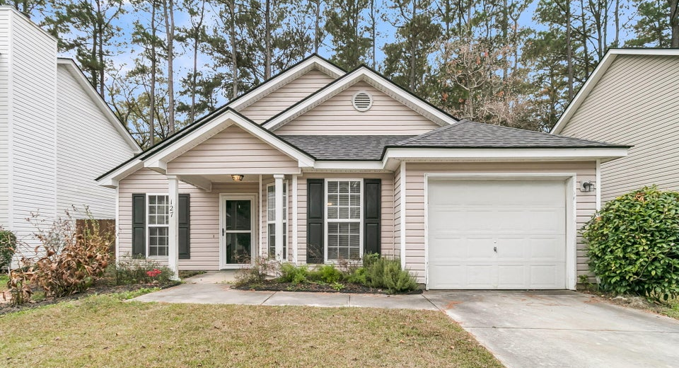
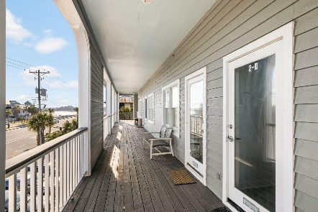
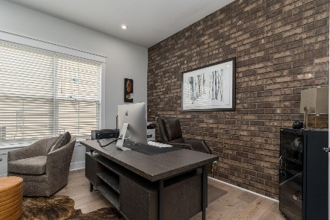
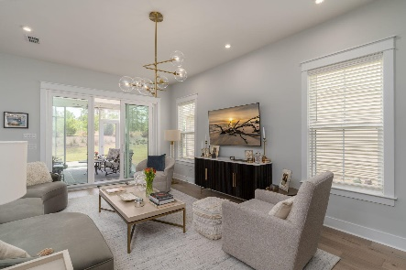

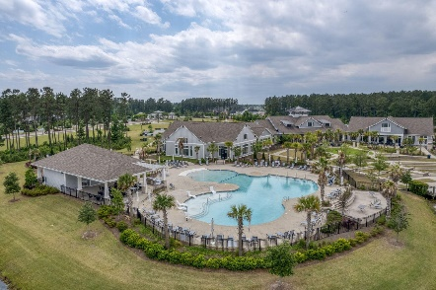
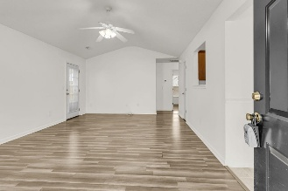
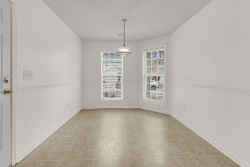
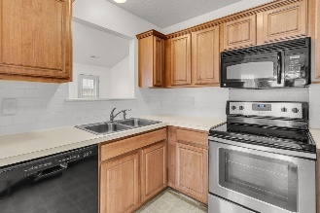
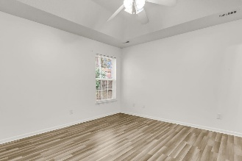
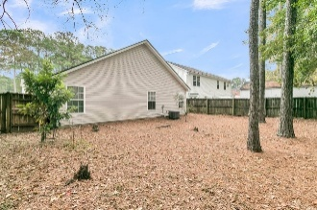
127 Trickle Drive Bradford Chase | Summerville, SC 29483 | MLS# 25031950 | $289,000
Darrell Creek Elevated Home With Elevator & Salt Pool
Cute Cottage Home
Co-sponsored by
Come see this charming 3 bedroom, 2 bath home in Bradford Chase perfect for a first time home buyer or looking to downsize.
One story living, with a spacious great room and eat in kitchen. The Primary bedroom has a tray ceiling and ceiling fan, garden tub/shower combo in the primary bath.
Enjoy the fully fenced in back yard with trees and a perfect spot for an outdoor patio set. Situated not too far from Summerville's growing downtown.
Offering $3000
Lender Credit
Rochelle Rennert
843-847-9694 | rochellesellscharleston@gmail.com | www.theunlockingdreamsteam.com
AgentOwned Premiere Group, Inc. | 219 N Highway 52 Ste A | Moncks Corner, SC 29461-3926

