Slide 1
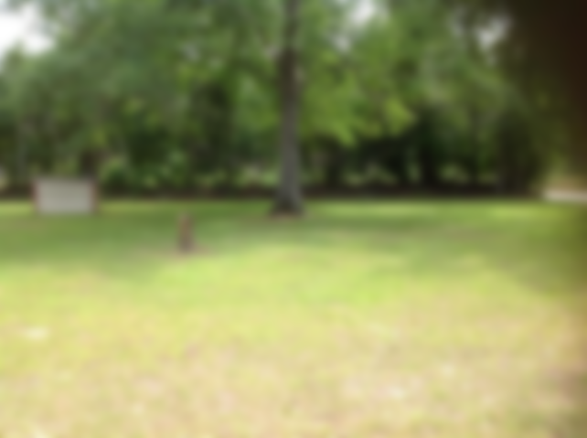
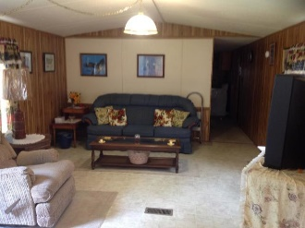
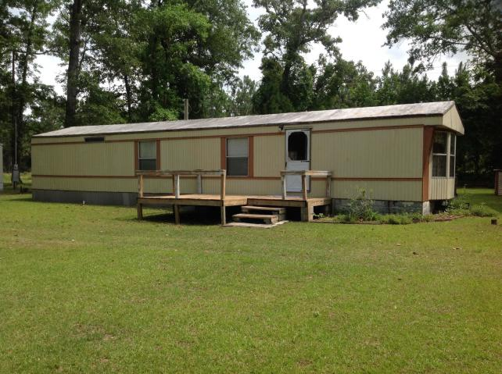
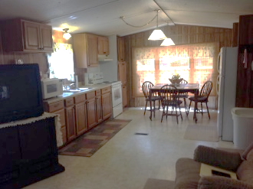
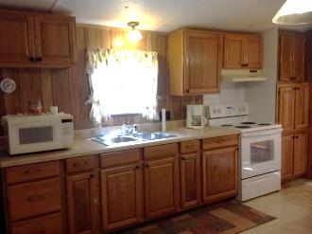
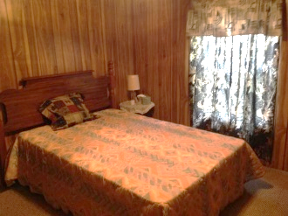
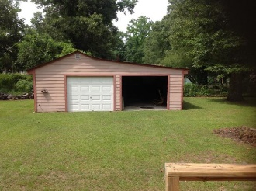
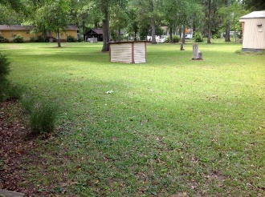
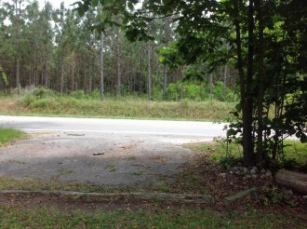

Make you appointment today and you can spend your summers at the lake.
12807 Old Number Six Highway
Eutawville, SC 29048 | MLS# 20014170 | $67,900
2 Beds | 1 Bath | 660 Square Feet
This property has 2 bedrooms and 1 bath with large corner lot (2 lots). This property is close to several public lake access spots. The property is well maintained. Also workshop/storage/garage space. There is also a separate electrical panel for a camper or RV for your friends and family. Also set up for sewer hook up for camper/RV as well. Please note that the siding is metal and the skirting is vinyl and metal. Buyer and Buyers agent please verify all information of importance.
Carla C Davis
Mobile - (843) 437-4873
gaweber@tds.net
AgentOwned Premiere Group
141 A N. Main Street
Summerville, SC 29483

