Slide 1
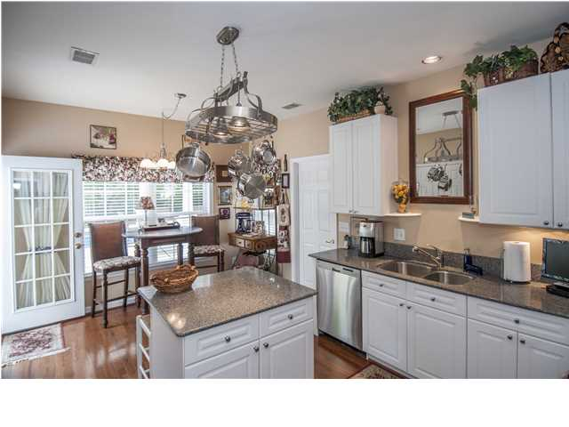
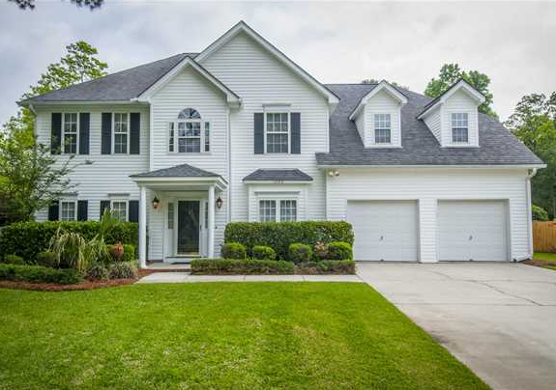
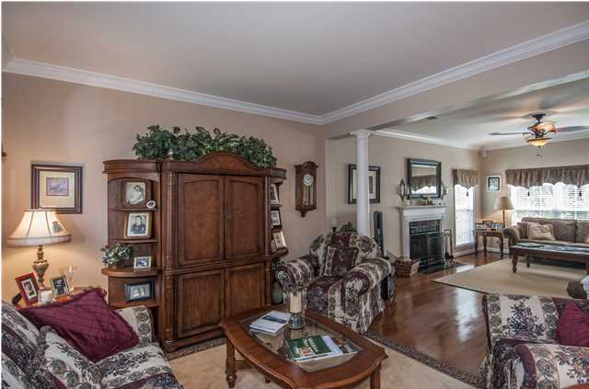
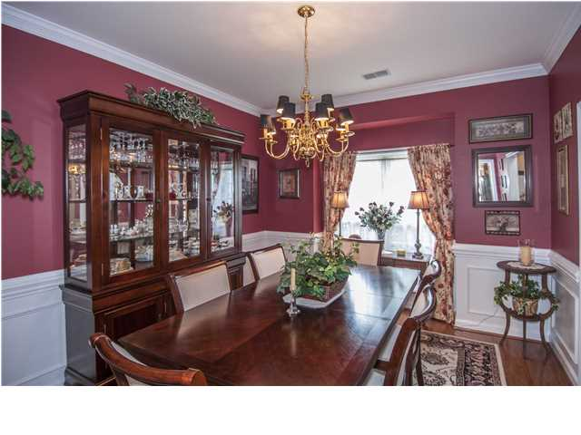
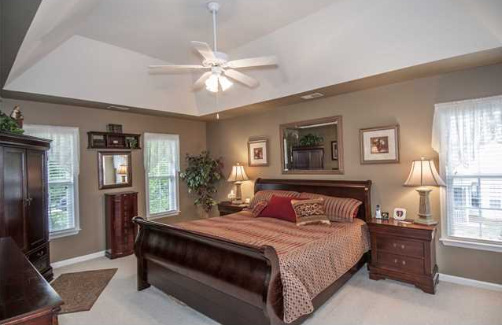
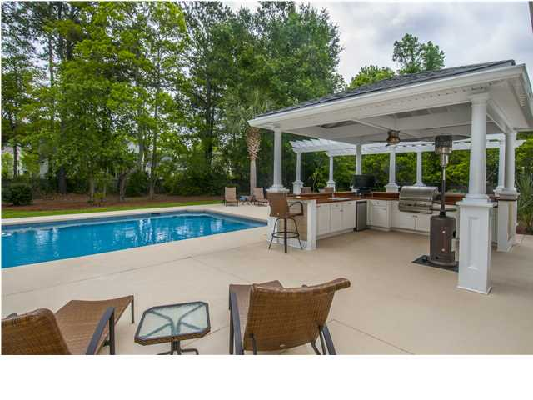
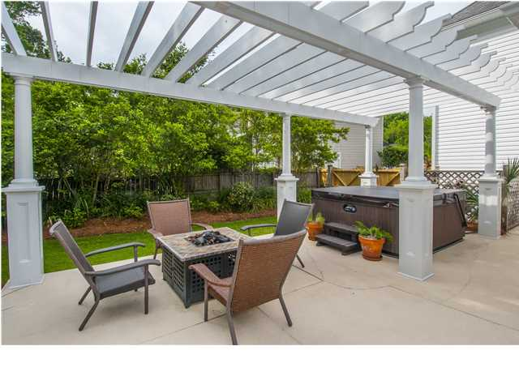

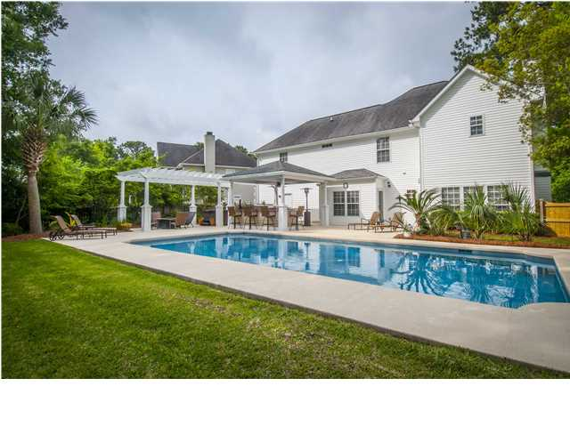

1280 Marsh Rabbit Ct Dunes West ~ Mt Pleasant MLS# 1411605 ~ $535,000
Back on the Market
This home is a private paradise!! Gorgeous backyard with a saltwater pool, huge outdoor kitchen, fire pit and hot tub!! At night the palm trees are beautifully lit and is such a great setup for entertaining or just taking some time to relax! The outdoor kitchen includes a built-in fridge, grill, cabinets, cable TV & a marine grade wood countertop, all nestled under a new portico. This home sits back on a cul-de-sac lot. As you enter you are welcomed by hardwood floors throughout the main, with the dining room to the right and the living room/family room to the left. A BEAUTIFULLY updated kitchen with brand new stainless steal appliances, white cabinets & silestone countertops all open to the backyard retreat. Upstairs is a wonderful layout. Master bedroom to your left and 4 additional rooms to the right. You can use the space as 5 bedrooms or 4 bedrooms with a bonus/playroom. Dunes West is a private gated community with swim/tennis, golf, boat storage, crabbing dock and a boat launch! This home is a must see!
Catherine Parker
Realtor
843-814-0551 M
843-202-3678 F
cparker@carolinaone.com
catherineparkersellscharleston.com

