Slide 1

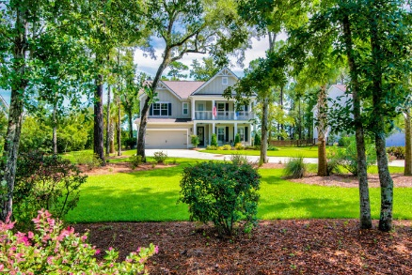
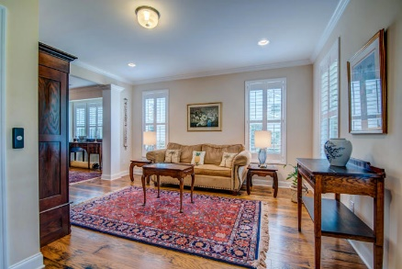
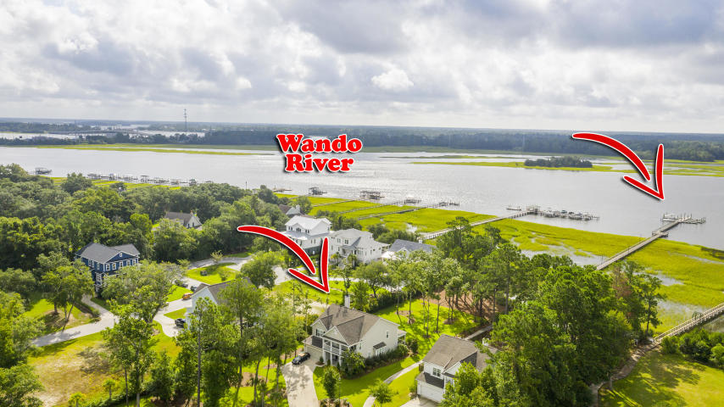
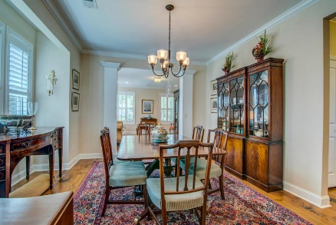
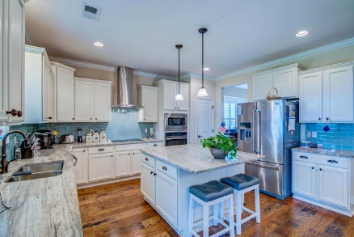
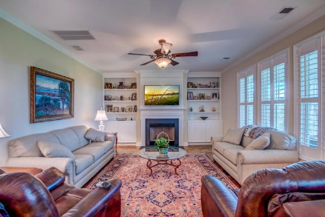
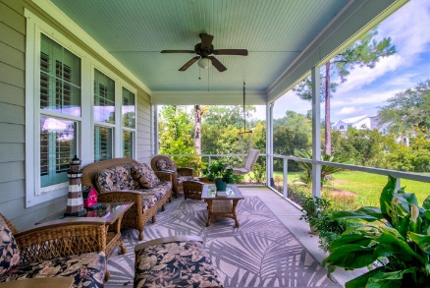
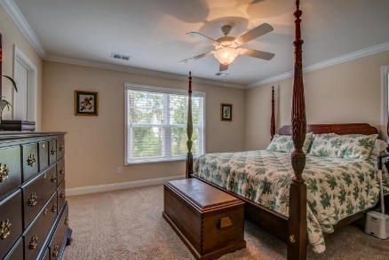
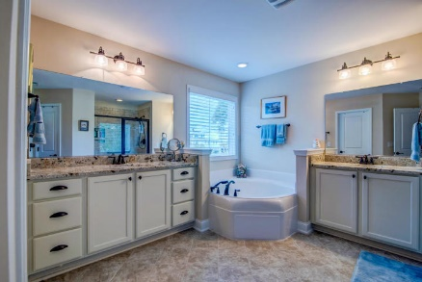
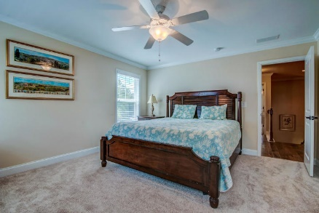
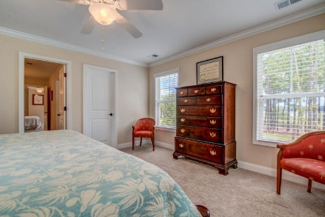
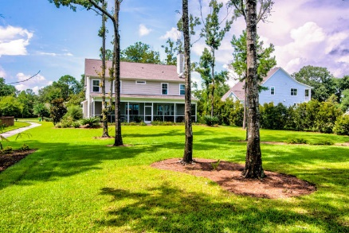
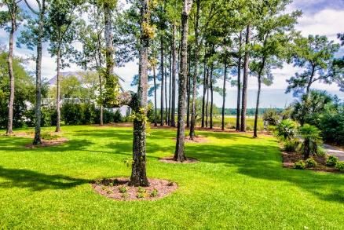


1280 River Walk Court
River Club Estates
Charleston, SC 29492
MLS# 20024960 | $965,000
Wando River
Best Value
Motivated Seller
Nestled into a lush landscape of native foliage and tall pines, this coastal inspired home is perched on the banks of the Wando River providing serene water views and just steps to its own deeded deep water boat slip. Double stacked piazzas welcome you and hint at the southern charm you'll find inside. Entering the home, you're greeted by rustic yet refined hardwoods that span the entire first floor, high ceilings, beautiful millwork, and plantation shutters.
Boating and fishing enthusiasts will enjoy the ease of having their boat just steps from their door and being able to cruise the waterways of Charleston and surrounding area, or the open Atlantic within minutes of leaving your neighborhood! River Club Estates is a nine home enclave developed with a dedication to the boating and coastal life complete with private community dock and deeded boat slip for each home. Oversized lots combine with established wooded buffers to lend an air of privacy and serenity while still being conveniently located to necessities. Feel a million miles away from it all while being just minutes to the new Point Hope Commons shopping center anchored by Publix, I-526, the beaches, and the world-class shopping and dining of historic downtown Charleston.
Don Dawson
843-514-0452
ddawson@carolinaone.com
Carolina One Real Estate • 2713 Highway 17 North • Mount Pleasant, SC 29466
www.TeamDawsonSC.com

