Slide 1
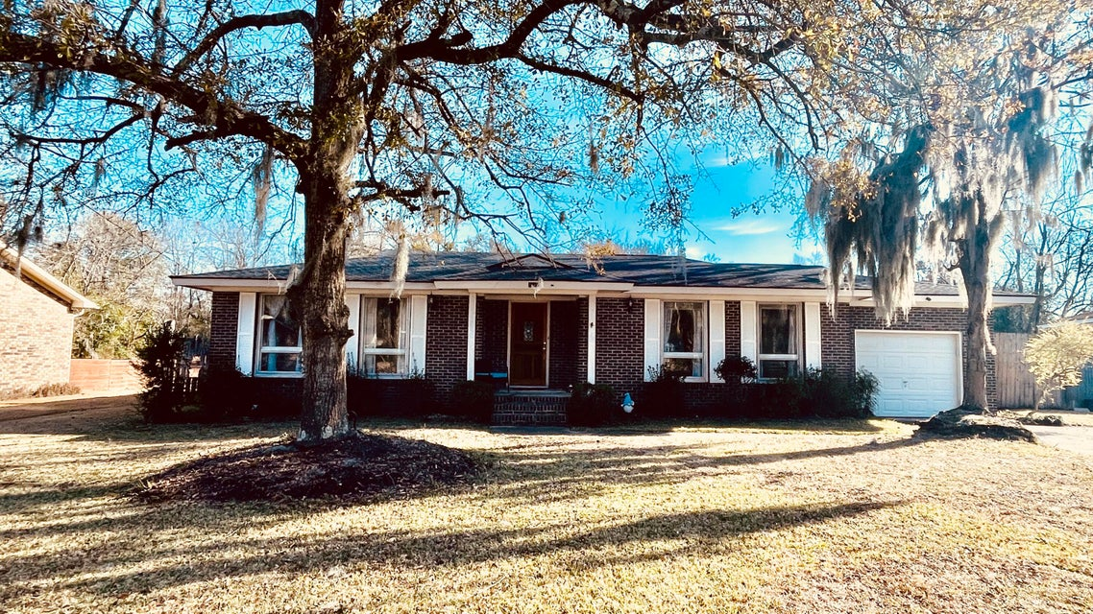
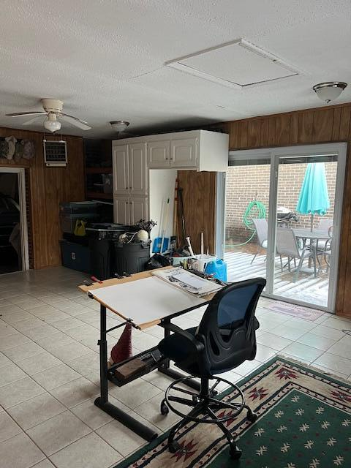
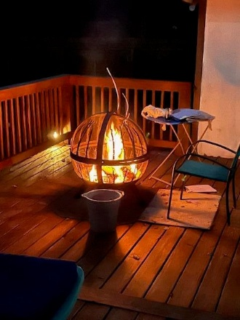
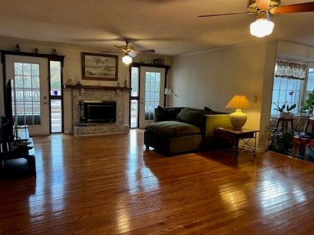
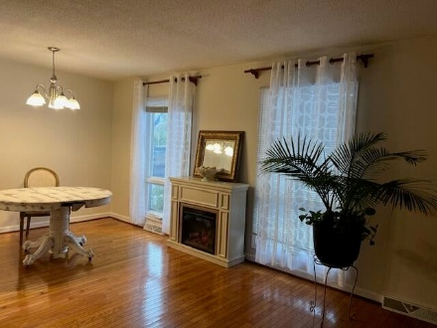
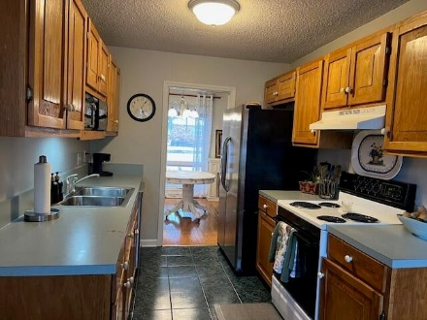
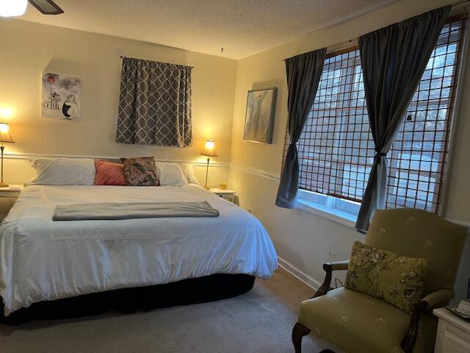


3% BAC! 3 Bed/2 Bath
1281 Redeemer Drive
Berkeley Hills · Hanahan, SC 29410 · MLS# 25000986 · $360,000
Nestled under the oaks! One level living in authentic brick ranch style home with two living spaces, one in front of home and one is a large family room with wood burning fireplace! Roof replaced 2019, HVAC 2014. Huge primary bedroom and detached room as another bedroom or office area. Cosmetic updates reqjuired to make it your own! Desireable area within close proximity to schools, Park Circle, and easy access to hwy 526. There is also a ''work room'' that could be playroom, craft room, or extra living space that is heated/cooled! Fabulous large outdoor deck and back yard for year round enjoyment. One car garage and fenced in yard complete the home. Close proximity to all restaurants and action in Park Circle and only 15 min to airport.
Therese Jenkins
843-568-9748
therese@beautifulhomesllc.com
Beautiful Homes Realty
130 River Landing Dr #7322
Daniel Island, SC 29492
www.theresejenkins.com

