Slide 1
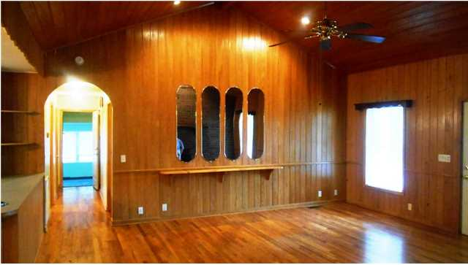
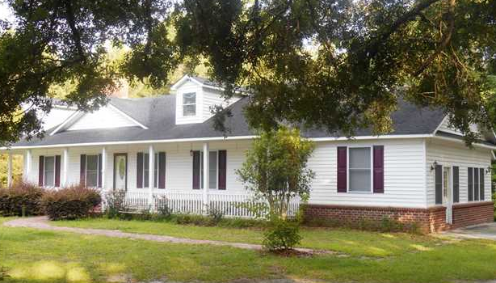
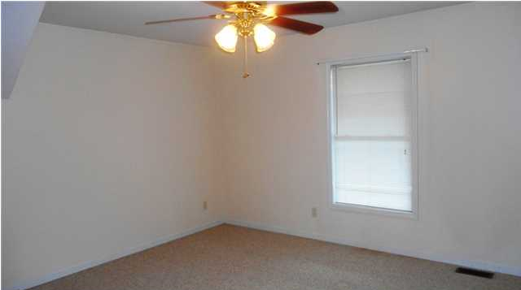
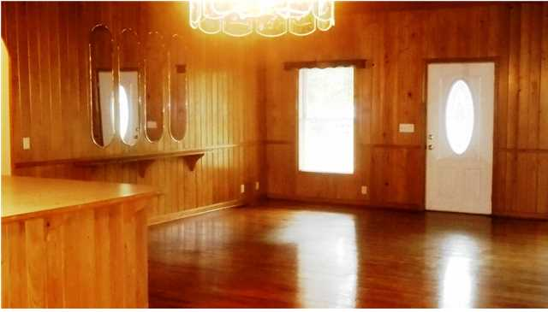
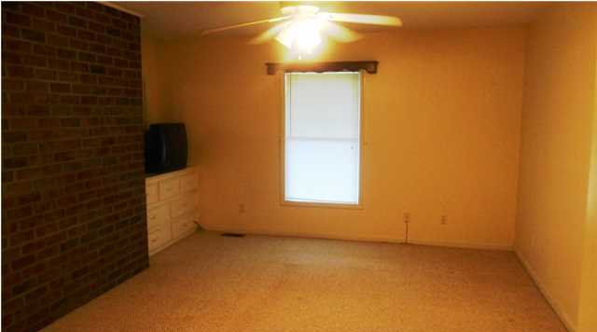
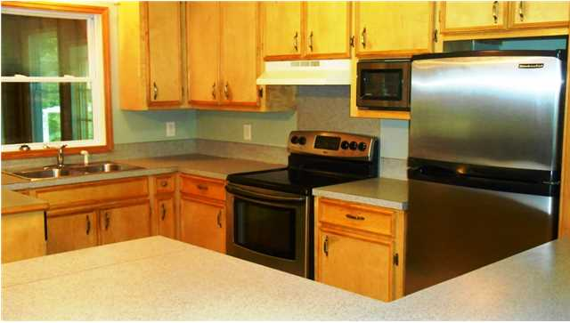
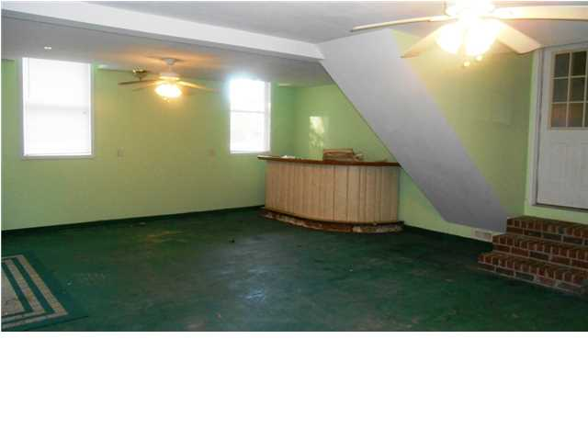
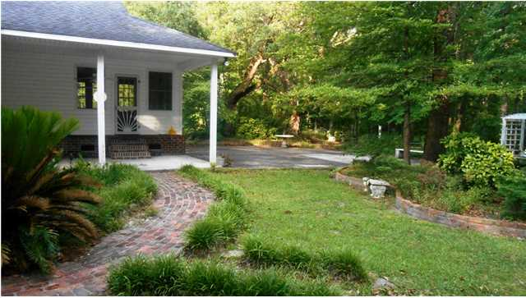
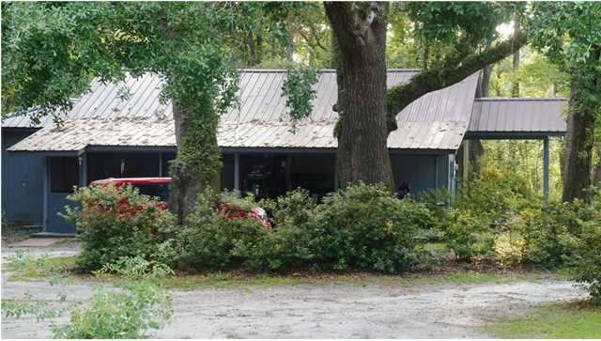
AMAZING COUNTRY LIVING OPPORTUNITY
PRICE REDUCED
210 Barberry St
White Gables
Summerville
MLS# 1417492
$209,900
COUNTRY LIVING AT ITS FINEST!! This 3 bedroom, 2 bath home is situated on six acres of land graced by majestic oak trees. The cottage covered with a tin roof could be anything you desire.....Mother-in-law cottage, perfect for an office, business, art or craft studio. Also on the property is a cook house complete with a small kitchen and a wood shop for those interested in wood working. The family room has a full brick fireplace and hearth surrounded by hardwood paneling on the walls and vaulted ceiling. Hardwood flooring throughout except for bathrooms and bedrooms. Third bedroom is located upstairs. There is a large recreation/game/laundry room which leads out to the patio behind the house. The large tiled sunroom is perfect for gatherings and leads out to a covered patio behind the house.
Diane Watkins, ABR
Cell: 843-813-0276
Office: 843-821-1111
diane@milerproperties.com
www.milerproperties.com
Miler Properties | 625 Old Trolley Rd | Summerville, SC 29485

