Slide 1
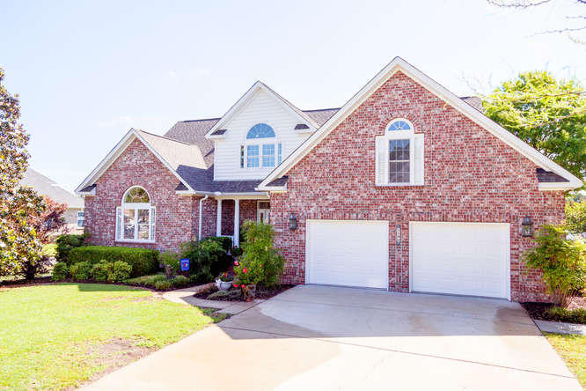
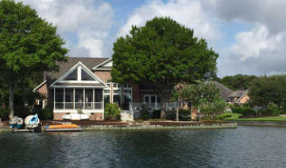
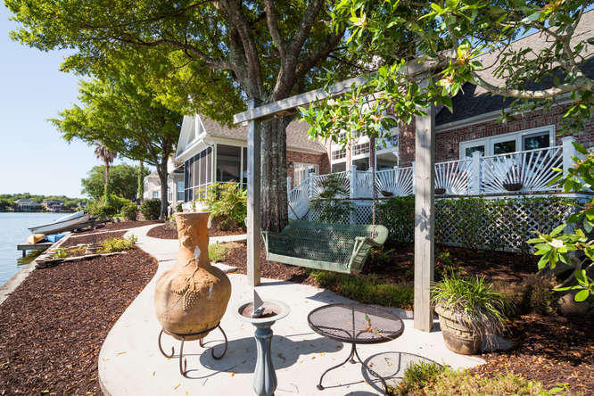
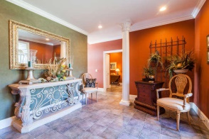
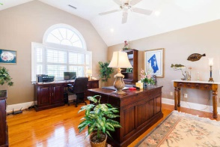
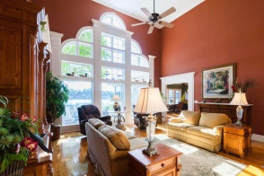
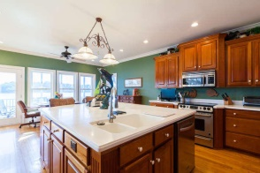
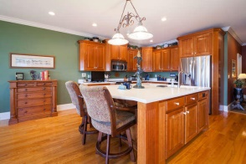


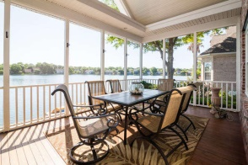
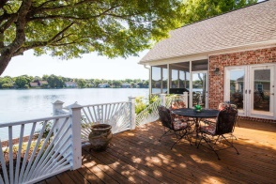
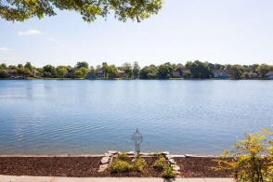


4% Agent Co-broke Through 6/19/15!
1186 Waterfront Dr - Mt Pleasant - MLS# 15013340 - $997,500
If you've been waiting patiently for a WATERFRONT HOME ON THE BIG LAKE to come available in Hidden Lakes, here's your opportunity! Homes like this don't come on the market very often. This gorgeous, custom, brick home with Master Bedroom downstairs sits on a premium lake AND canal-front lot. Understated elegance can be found throughout in features such as the massive two-story windows in the living room, the coffered ceilings in the Master bedroom, the large island in the kitchen, and the spacious screened-porch and deck on the back overlooking the lake. This owner has meticulously taken care of this home since they built it in 1999 and it can be seen throughout. Check out the features list in the documents section for more info and come see this home today before it's too late!
The Boulevard Company, LLC
Mark Macpherson
mark@beachbreak-properties.com
843.367.5640 Mobile

