Slide 1
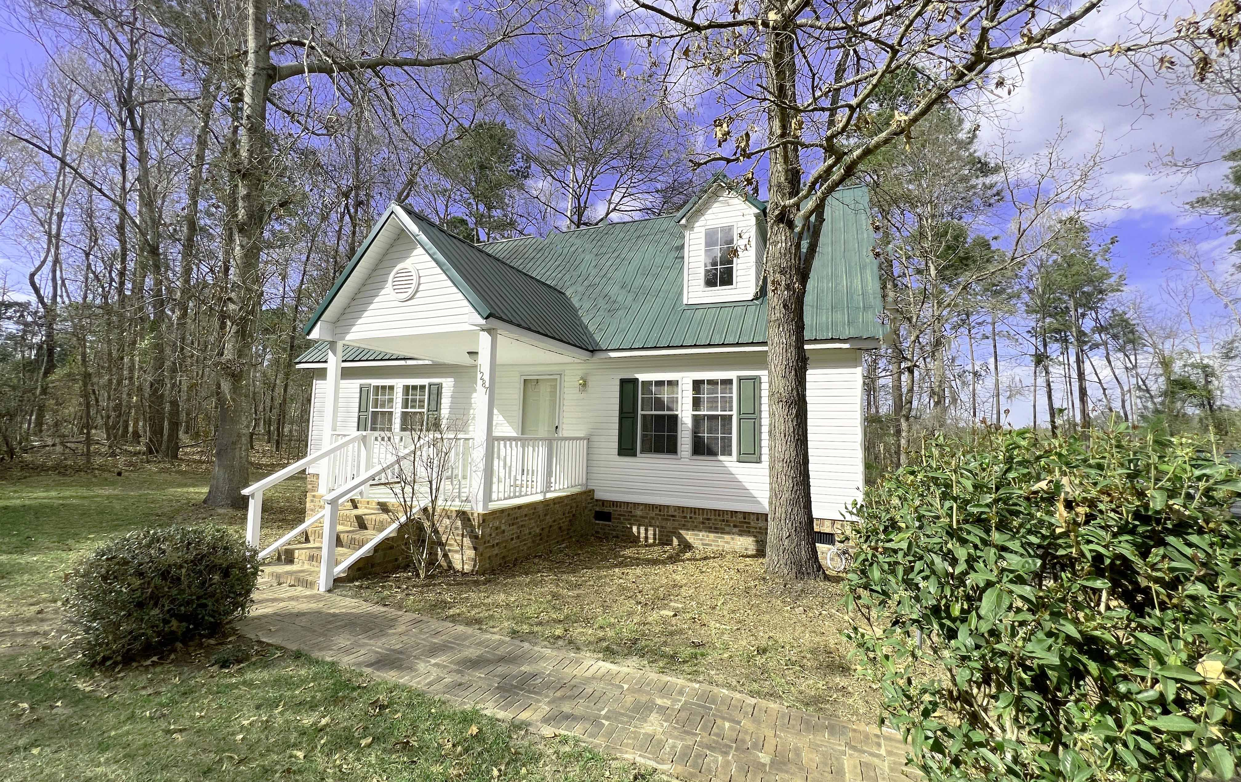
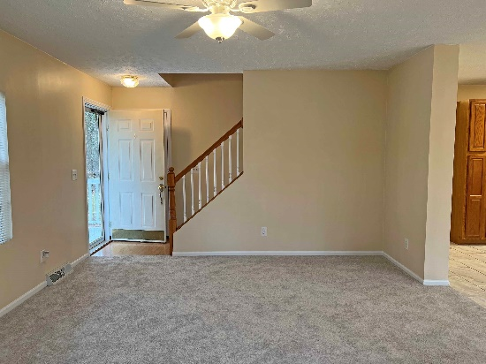
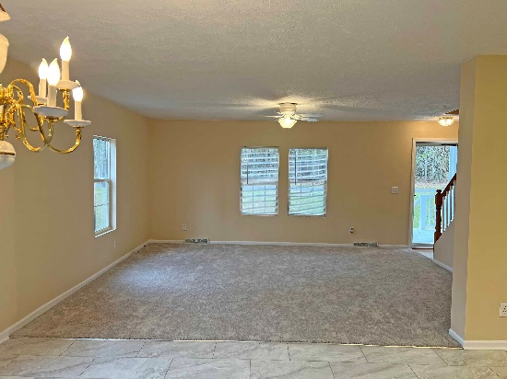
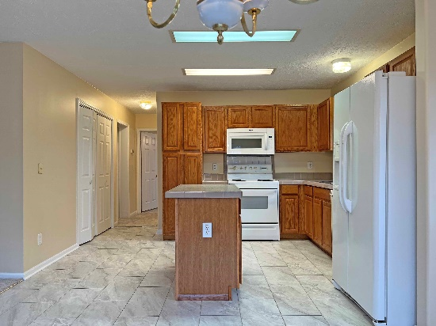

Near Lake Marion
1287 Wonders Way
Manning, SC 29102 ~ MLS# 150607 ~ $250,000
3 bedroom / 3 bath - 2 story house in Frierson subdivision near Lake Marion. Down the road from the boat church just in time for the spring / summer season. Enjoy the lake all year around. Tons of fishing and boating to do here. Newly painted, new carpet and and flooring on 1st floor. The home sits on .78 ac with a fenced in back yard. This home is ready for you to move in. Only 10 mins to Manning for shopping and food.
Lake Homes Realty, LLC
Elloree, SC 29047
www.SCLakeLife.com
Kristie Anderson
(803) 387-9459
kristie@sclakelife.com

