Slide 1
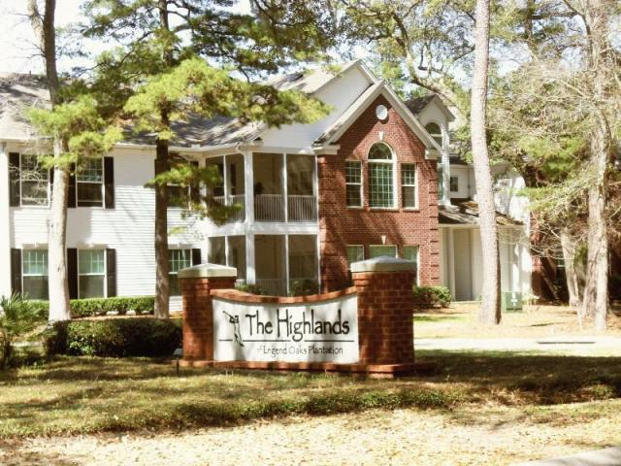
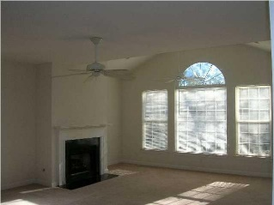
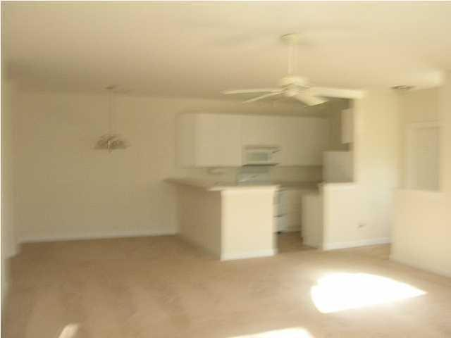
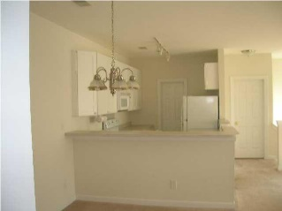

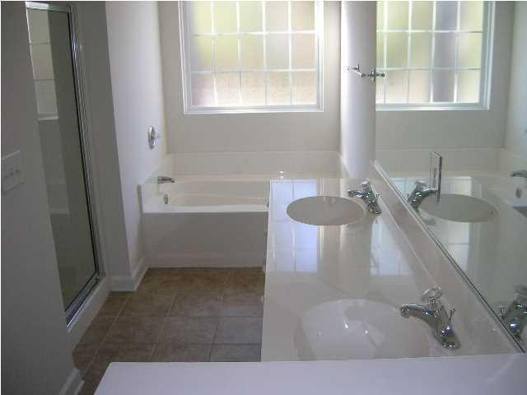
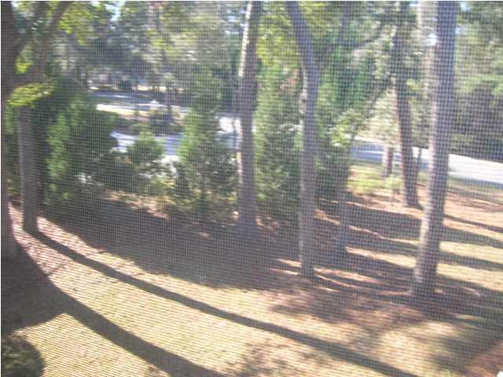
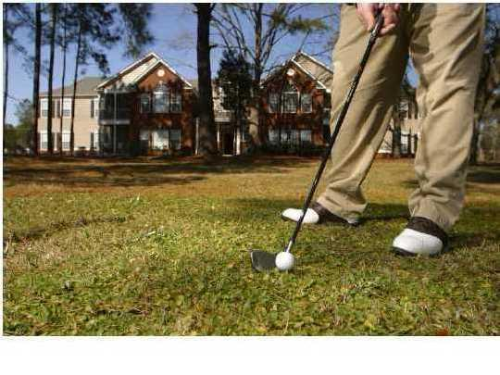

128 Golfview
Legend Oaks Plantation
Summerville, SC 29485
MLS# 16021773 $142,900
2 Bedrooms | 2 Baths
Golf Course Condo
This light and bright condo is located in the golf course community of Legend Oaks Plantation and is surrounded by beautiful great oaks. Approximately 1625 square foot second floor unit with private screened porch. Features include a master suite with sitting room and two walk in closets. Master bath with tile floor has stand up shower and separate soak tub and double bowl vanity. Large great room, vaulted ceiling, gas fireplace, two ceiling fans, and dinning area. Gourmet kitchen has white cabinets, fridge, microwave, dishwasher, titled floor and oversize walk in pantry. There is also a separate laundry room. There are ceiling fans in all bedrooms, 2 in great room and master bedroom sitting room. This property adjoins the Legend Oaks Golf Course and is surrounded by grand oaks. A block away from the clubhouse, swimming pool and tennis courts. The Highlands is in the award winning Dorchester 2 school district with Beech Hill Elementary just across the road and Ashley Ridge High School a few miles away. Freshly painted and brand new carpeting just installed, ready for a quick close.
Bill Milo
843-412-0052
bill@weichertrealtorspc.com
www.charlestonareahomesforsale.net
Weichert Palmetto Coast
1035 Johnnie Dodds, Ste B2
Mt. Pleasant, SC 29464

