Slide 1
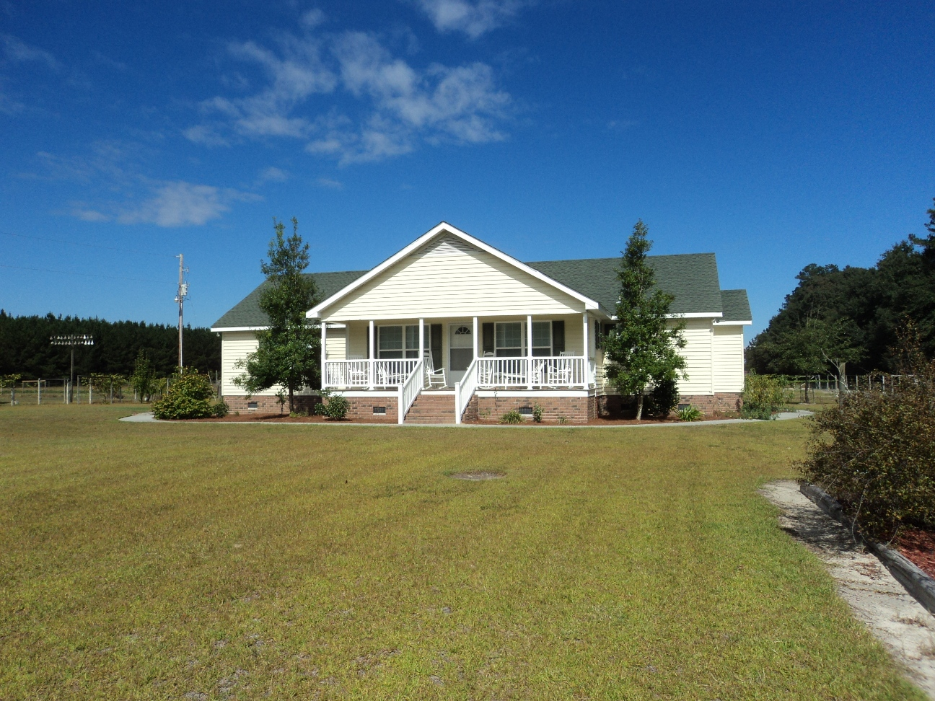
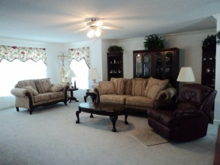
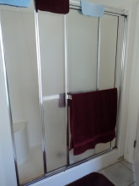
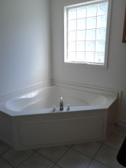
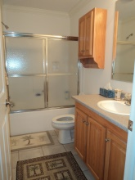
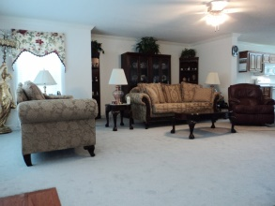
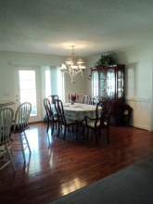
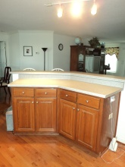
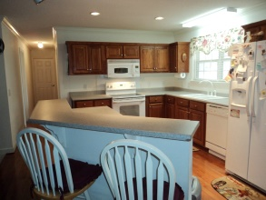
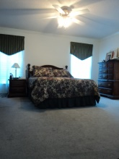
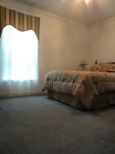
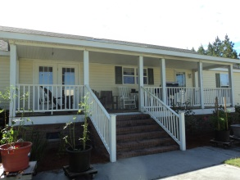
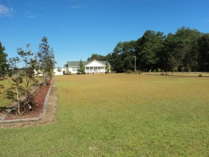
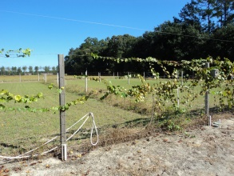
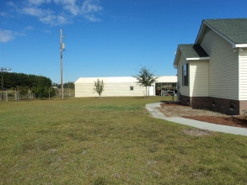
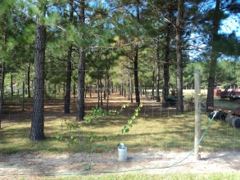
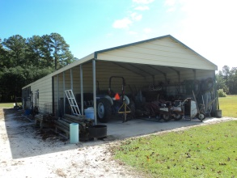
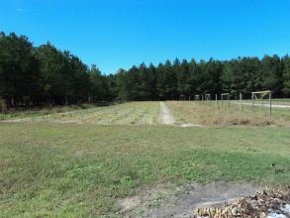


11.4 Acres - Perfect for horses!
128 Shiloh Loop | Ruffin, SC 29475 | MLS# 1326372
Offered at $199,900
11.4 Acres ~ Perfect for horses!
This is a great 1 story home with an open floor plan. The kitchen is open to the living room and has plenty of bar seating for entertaining guests. The bedrooms are large and all have walk in closets. The 11.4 acres of land is partially fenced in. There is an electric fence around the garden area and there is irrigation installed throughout the garden with hose bibs in multiple spots as well. There are 3 large plant beds in the front yard with irrigation. The 2 car garage is very large and it has a large carport on the front and a smaller partially closed in carport on the back with plenty of room for storing tractors, etc.
Shawn Bergen
(843) 364-0136 M
(843) 972-2400 O
shawn@thebergenteam.com
www.thebergenteam.com
RE/MAX Advanced Realty
311 Johnnie Dodds Blvd
Mt Pleasant, SC 29464

