Slide 1
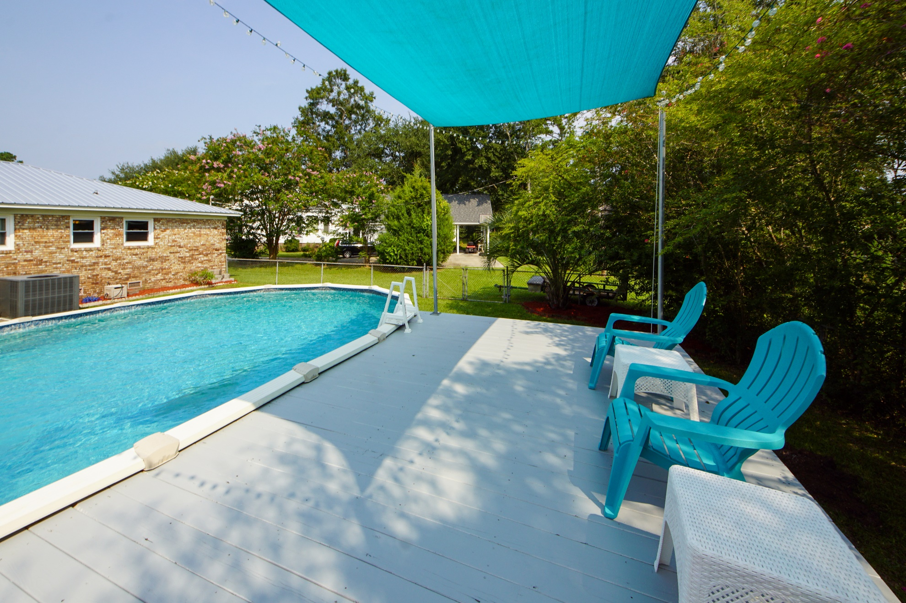
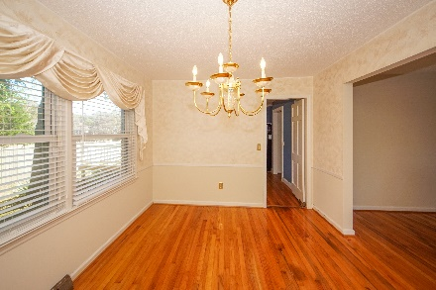
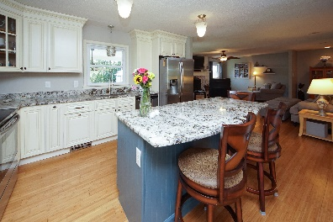
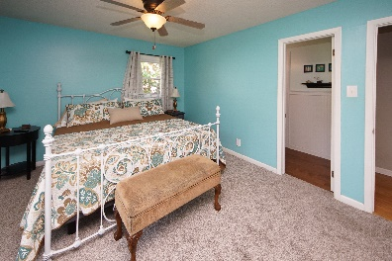
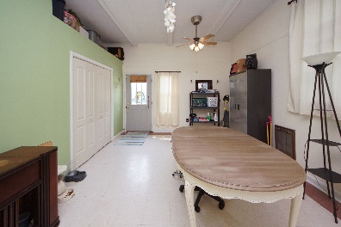
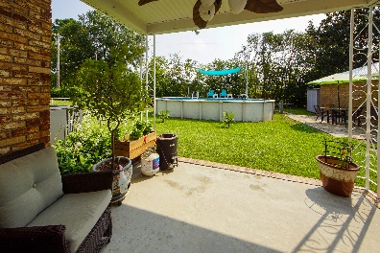
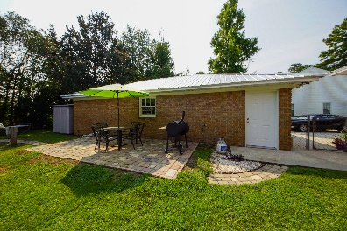


128 Land O Pines Circle
Land O Pines :: Moncks Corner
MLS# 21020242
Otranto Beauty
$318,000
Live by the Lake for
$399,999
Don’t Miss It!
Own a piece of lake life with a remodeled brick home in Pinopolis!
This stunning home is upgraded and flows with an open concept, spacious kitchen with island, new kitchen cabinets, granite counter tops and windows letting in the bright sunny, lake lifestyle. Attached garage is now a living space with full bathroom perfect for additional family room, man cave or home office. Own a home with the option of putting your boat in the lake or walking in the back yard to your 16x28 above ground swimming with deck and lighting. Perfect spot for entertaining. Detached (25x36) 2 car garage has a work shop, lighting, and AC with separate detached storage building. New metal roof, new AC installed 2019 make this home a must see and must own near the lake!
Come take a virtual tour: https://charlestonvirtualhomes.com/2210289
Connie White, Broker
843-532-3356
connie@chrepros.com · conniewhiterealestate.com
Charleston Homes · 597 Old Mt. Holly Road · Suite 301 · Goose Creek, SC 29445

