Slide 1
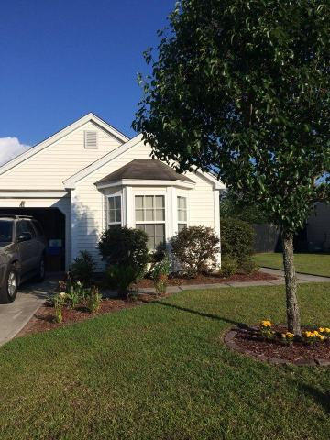
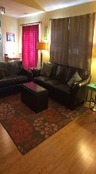
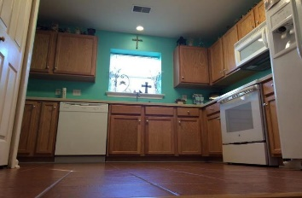
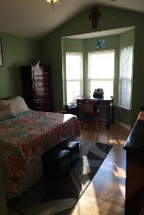
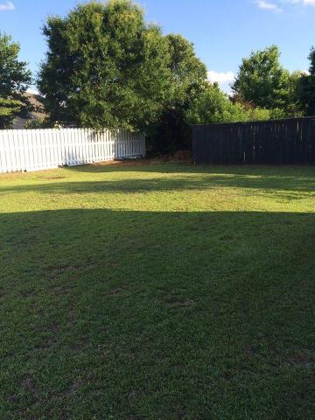
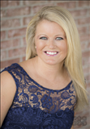

Great home in The Peninsula! 1291 Palm Cove Drive | Charleston, SC 29492 | MLS# 15017934 | $197,500
137 Beaufain Street
MLS# 15000837 - $1,150,000
Beautiful home in desirable neighborhood of The Peninsula within minutes to Mount Pleasant! Large living space with bamboo flooring that opens to the kitchen. Kitchen boasts tile floors and lots of counter space with like-new appliances! Large master bedroom has vaulted ceilings with walk-in closet! Complete with a 1-car garage and spacious yard! HVAC system is less than 2 years old. A must see!
Check out the virtual tour for more pix!
Melissa Britt Thierfelder, MRP melissabritt@remax.net
Office: 843-442-8787 | Cell: 843.725.8016
www.melissabritt.remax-carolina.com
RE/MAX Elite | 91 Broad St | Charleston, SC 29401

