Slide 1
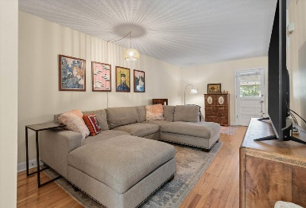
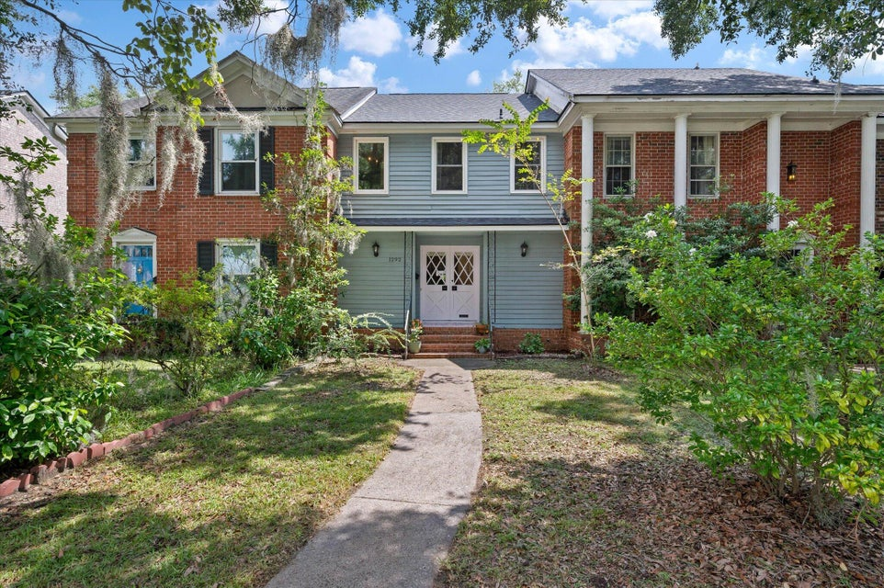
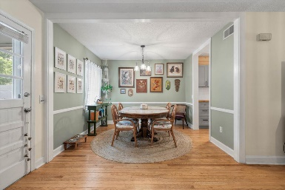
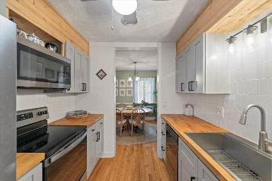
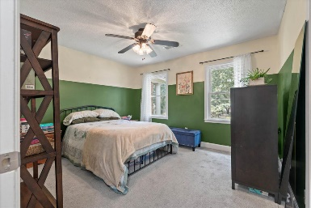
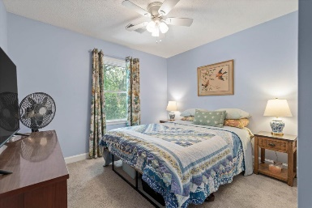
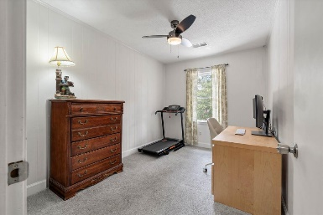
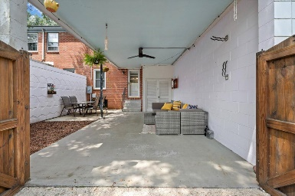


1292 Ashley Hall Road
Heathwood Villas · Charleston, SC 29407 · MLS# 24020660 · $389,900
West Ashley Townhome with no HOA!
This quaint townhome is located in the heart of West Ashley. Its a rare to find a townhome with no HOA and this is it! This property is very convenient to Downtown Charleston and all of the wonderful amenities West Ashley has to offer including shopping and top notch restaurants. This house has 3 bedrooms, 1 full bath and a half bath located on the first floor for guests. The kitchen is updated with a stainless steel farmhouse sink, a tile backsplash, updated cabinetry, stainless steel appliances and butcher block countertops. The cute outdoor blue paint adds to the charm of this town home with glass and wood double front doors that open into the family room. Just off of the kitchen is a breakfast area and a reading nook and beyond that is the back door that leads out to a covered patio area which is perfect for entertaining. Beyond the patio/garden area is a beautiful wood gate that leads out to the alleyway and just beyond the alley is two designated parking spaces and room for gardening. This home is just a short five minute walk to Lenevar Park, providing easy access to green space, playgrounds, tennis courts, and a fitness trail. Perfect for dog walking, exercise, sports...etc"
Carey Nikonchuk
843-276-1701
cnikonchuk@gmail.com
www.brennamangroup.com

