Slide 1
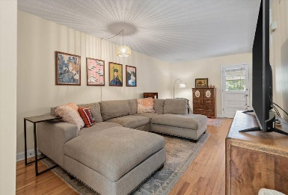
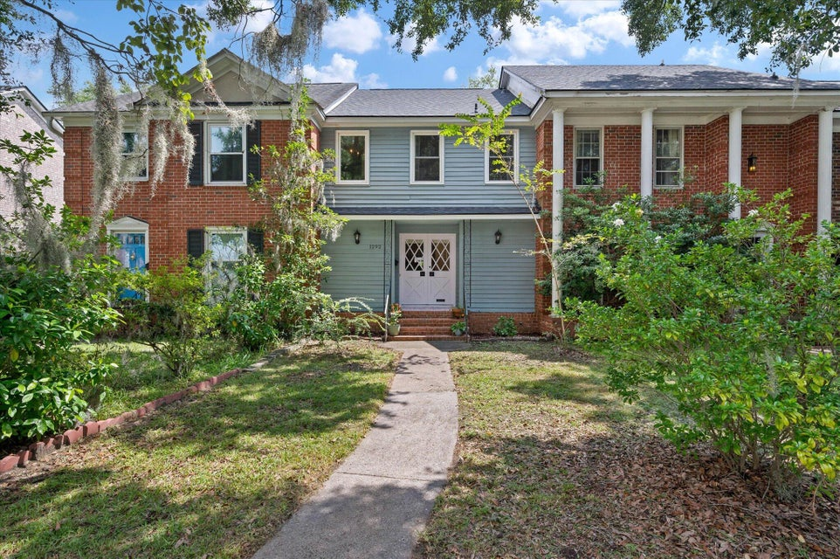
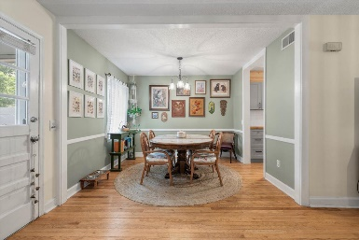
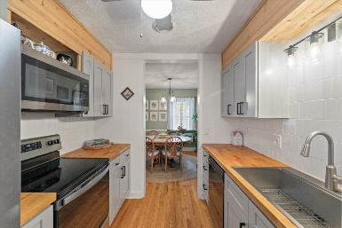
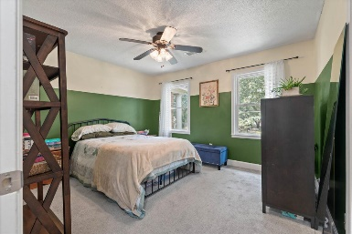
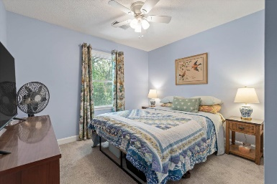
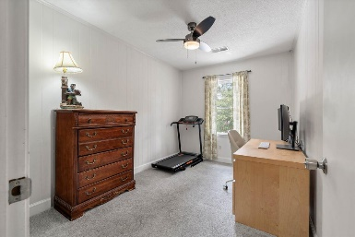
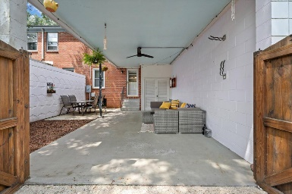


1292 Ashley Hall Road
Heathwood Villas · Charleston, SC 29407 · MLS# 24020660 · $389,900
Top Notch West Ashley Townhome
Charming Townhome in the Heart of West Ashley Discover this rare gem—a quaint townhome with no HOA—nestled in the heart of West Ashley. This property offers exceptional convenience, just minutes from Downtown Charleston and all the fantastic amenities West Ashley has to offer, including premier shopping and top-notch restaurants. This inviting home features 3 bedrooms, 1 full bath, and a half bath conveniently located on the first floor for guests. The kitchen is a highlight, boasting modern updates such as a stainless steel farmhouse sink, a stylish tile backsplash, updated cabinetry, stainless steel appliances, and butcher block countertops. The charming glass and wood double front doors open into a cozy family room. Adjacent to the kitchen, you'll find a breakfast area and a reading nook. Beyond that, the back door leads out to a covered patio area, ideal for entertaining. The patio/garden area is enclosed by a beautiful wood gate that opens to an alleyway, where you'll find two designated parking spaces and additional room for gardening. This home is just a short five-minute walk to Lenevar Park, providing easy access to green space, playgrounds, tennis courts, and a fitness trail, perfect for dog walking, exercise, sports, and more.
Carey Nikonchuk
843-276-1701
cnikonchuk@gmail.com
www.brennamangroup.com

