Slide 1
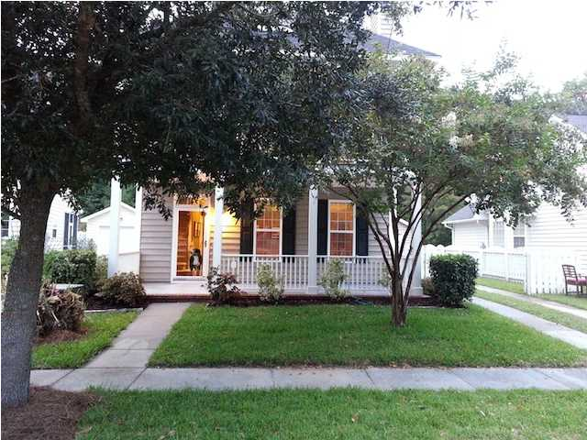
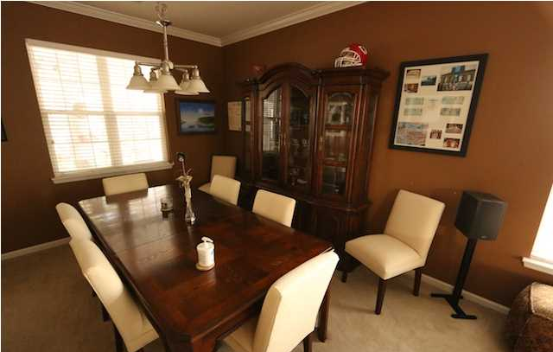
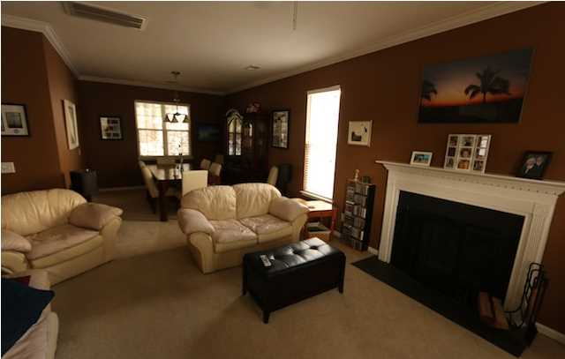
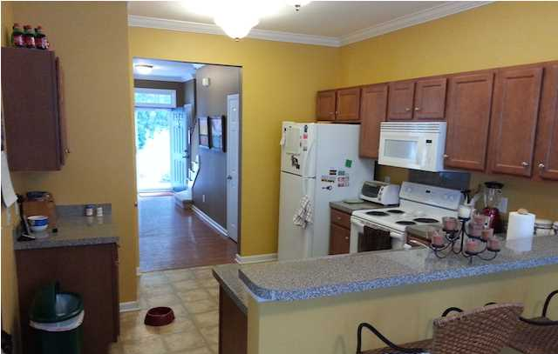
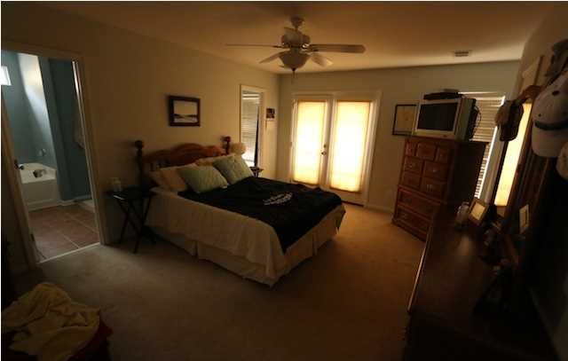
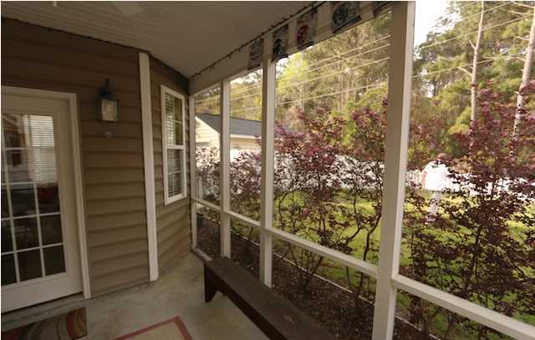

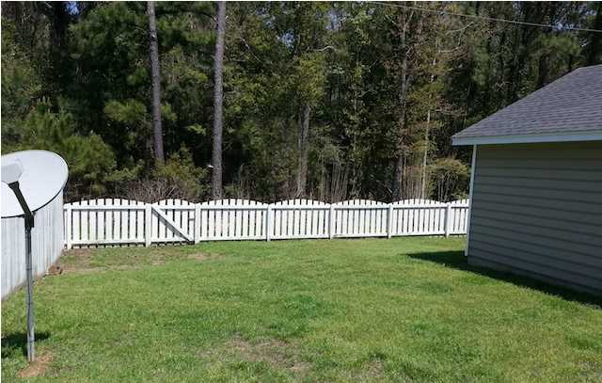

1297 Laurel Park Trail
Laurel Grove ~ Mt Pleasant
MLS# 1424234 ~ $315,000
Motivated Seller!
You found it! This home is situated one of the best kept secrets in Mount Pleasant, beautiful Laurel Grove. With gorgeous tree lined streets and a very quaint appeal, this neighborhood is a gem! The home is located on the quiet end of the neighborhood and backs up to a wooded buffer. It is one of the few homes in the neighborhood that has a two car garage AND a screened-in porch. Not to mention that is also boasts double porches on the front of the home that gives it that extra low country look for a nice southern flair. And to top it off the nice sized back yard is fully fenced in! Inside you will find a very clean and well laid out floor plan. There is a formal dining room, a really nicely sized great room with a fireplace and also a lovely eat-in kitchen with a bar top counter and a breakfast nook which flows right onto the screened in porch. Upstairs are three large bedrooms and the master has a nice walk in closet, a roomy master bath with double sinks and access to the second floor piazza! So look no further! This home is priced to sell and you will be hard pressed to find a home in this price range with so many features in Mount Pleasant.
Carey Nikonchuk
(843) 276-1701 M
cnikonchuk@gmail.com
www.palmettoproperty.net

