Slide 1
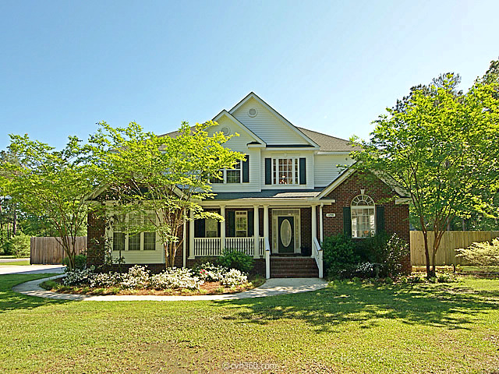
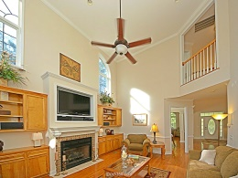
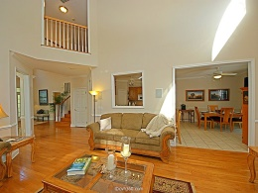
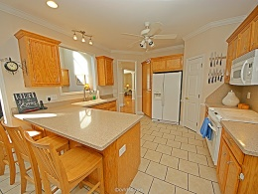
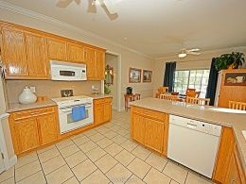
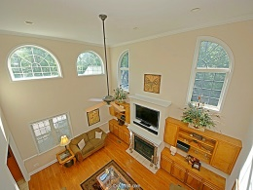
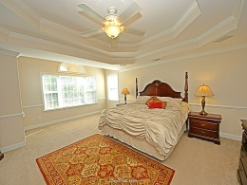
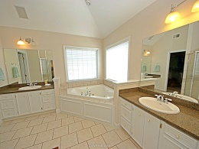
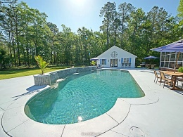
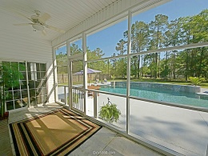
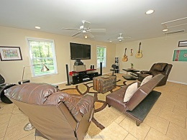
Open House
Saturday 1-4
1298 Pinopolis Road
Moncks Corner
MLS# 15010250
$535,000
This Beautiful 5 bedroom 4 bath home won't last long! Ideal for a large family, it welcomes you with a two story entry, formal living room, dining room and hardwood floors throughout the first floor. The great room includes a fireplace, custom built-ins, and a peek a boo to the upstairs hall. There is an in law suite downstairs with its own entrance, presently part of witch is used as a home gym. Upstairs the master is huge, boasting a beautiful tray ceiling sitting area , a master bath with walk in closets. An in ground pool with three waterfalls, large pool deck and pool house are the highlight of the back yard. The pool house could be a rental unit, a man cave or teen hangout. The hot tub on the screened porch is great for relaxing. Blocks away from Berkeley HS . Just a short walk to the lake. Don't hesitate , this is the home you have always wanted!!
David Carroll
843-564-3308 | tristr33@aol.com
Brand Name Real Estate | 207 East Bay Street Ste 311 | Charleston, SC 29401

