Slide 1
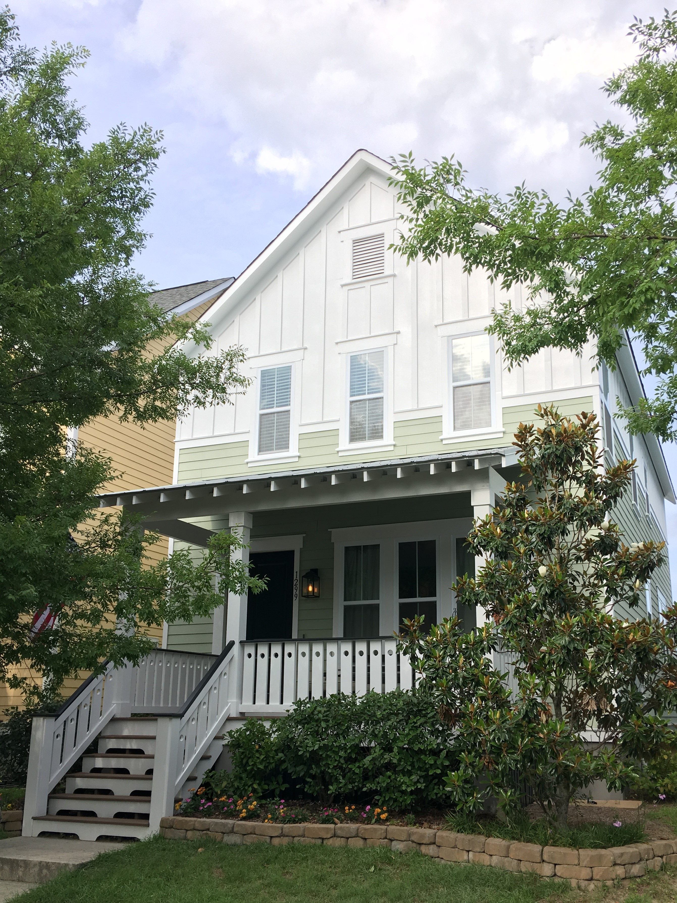
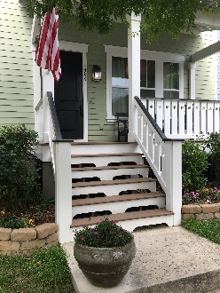
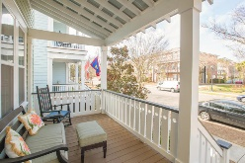
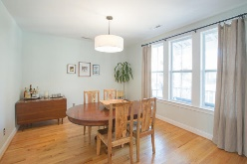
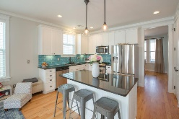
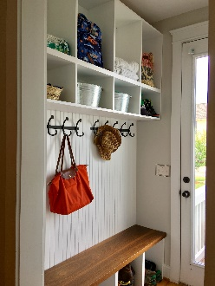
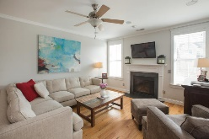
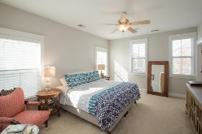
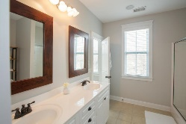
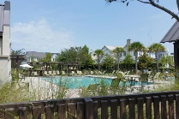
1299 Appling Drive MLS# 18003982 · $465,000
Darrell Creek Elevated Home With Elevator & Salt Pool
Not To Be Missed In The Heart Of Mount Pleasant!
Perfect combination of LOCATION and AFFORDABILITY! Welcome home to 1299 Appling Drive! Just minutes to the beach or downtown Charleston, this adorable 3 bedroom, 2.5 bath coastal cottage checks all the boxes. Greeted by the large front porch, features include an open floorplan with dining room just off the foyer opening to the spacious family room with gas fireplace, breakfast area and bright kitchen with stainless steel appliances and glass tile backsplash. A mudroom/drop-zone with plenty of storage is just off the kitchen. The second floor features a large master suite with huge private bath and walk-in closet, plus two additional bedrooms and a full bath. Enjoy the community pool, playground and lakefront walking trails for Watermark residents. This home and neighborhood offers wonderful amenities and lowcountry lifestyle!
Kimberly Jackson
(843) 276-9771 | kimberly.jackson@agentownedrealty.com
AgentOwned Preferred Group | 824 Johnnie Dodds Blvd | Mt Pleasant, SC 29464

