Slide 1
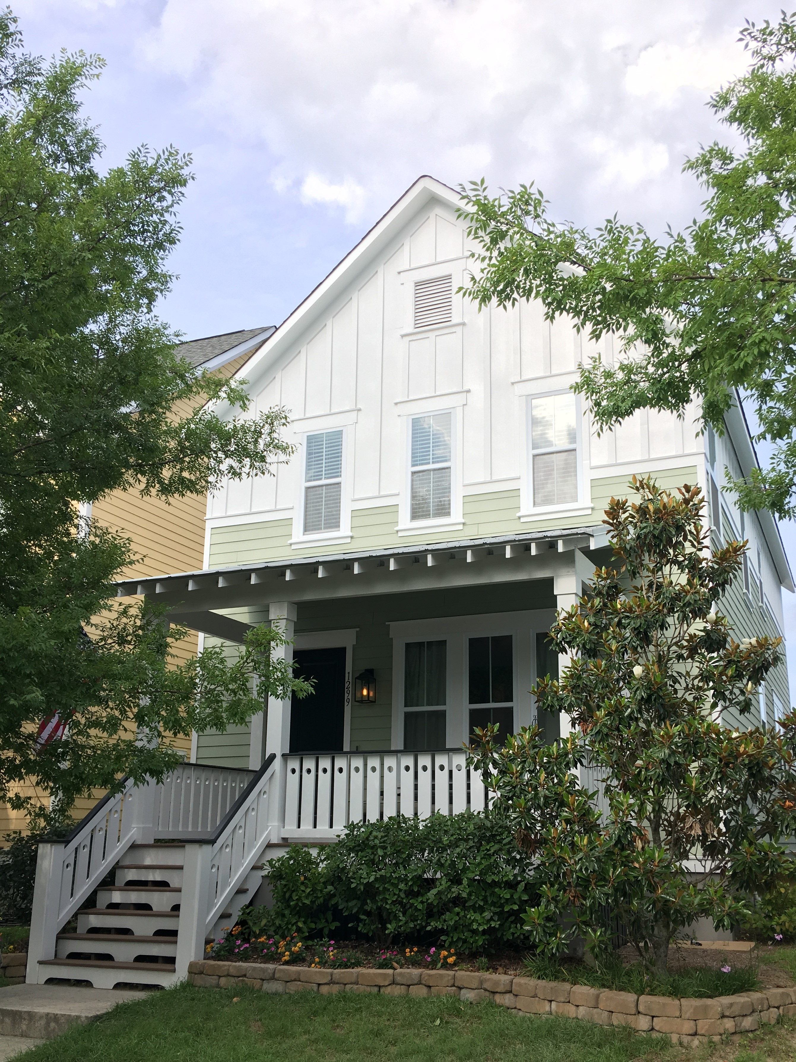
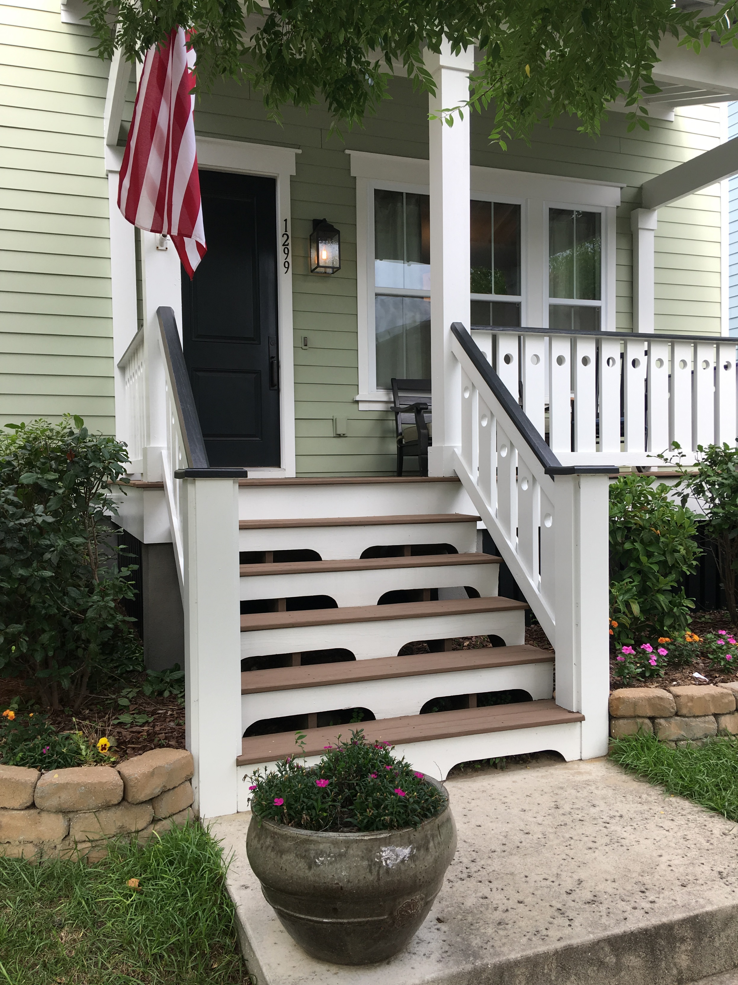
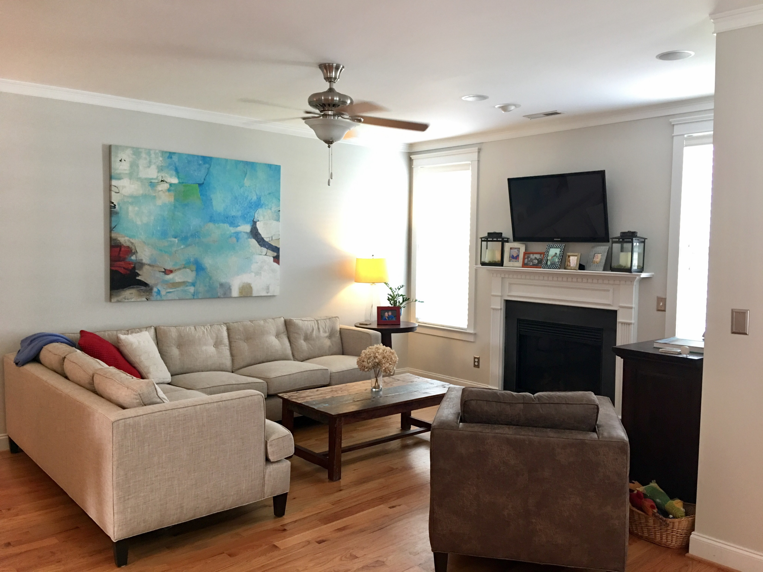
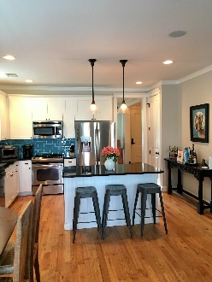
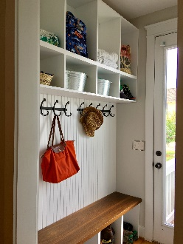
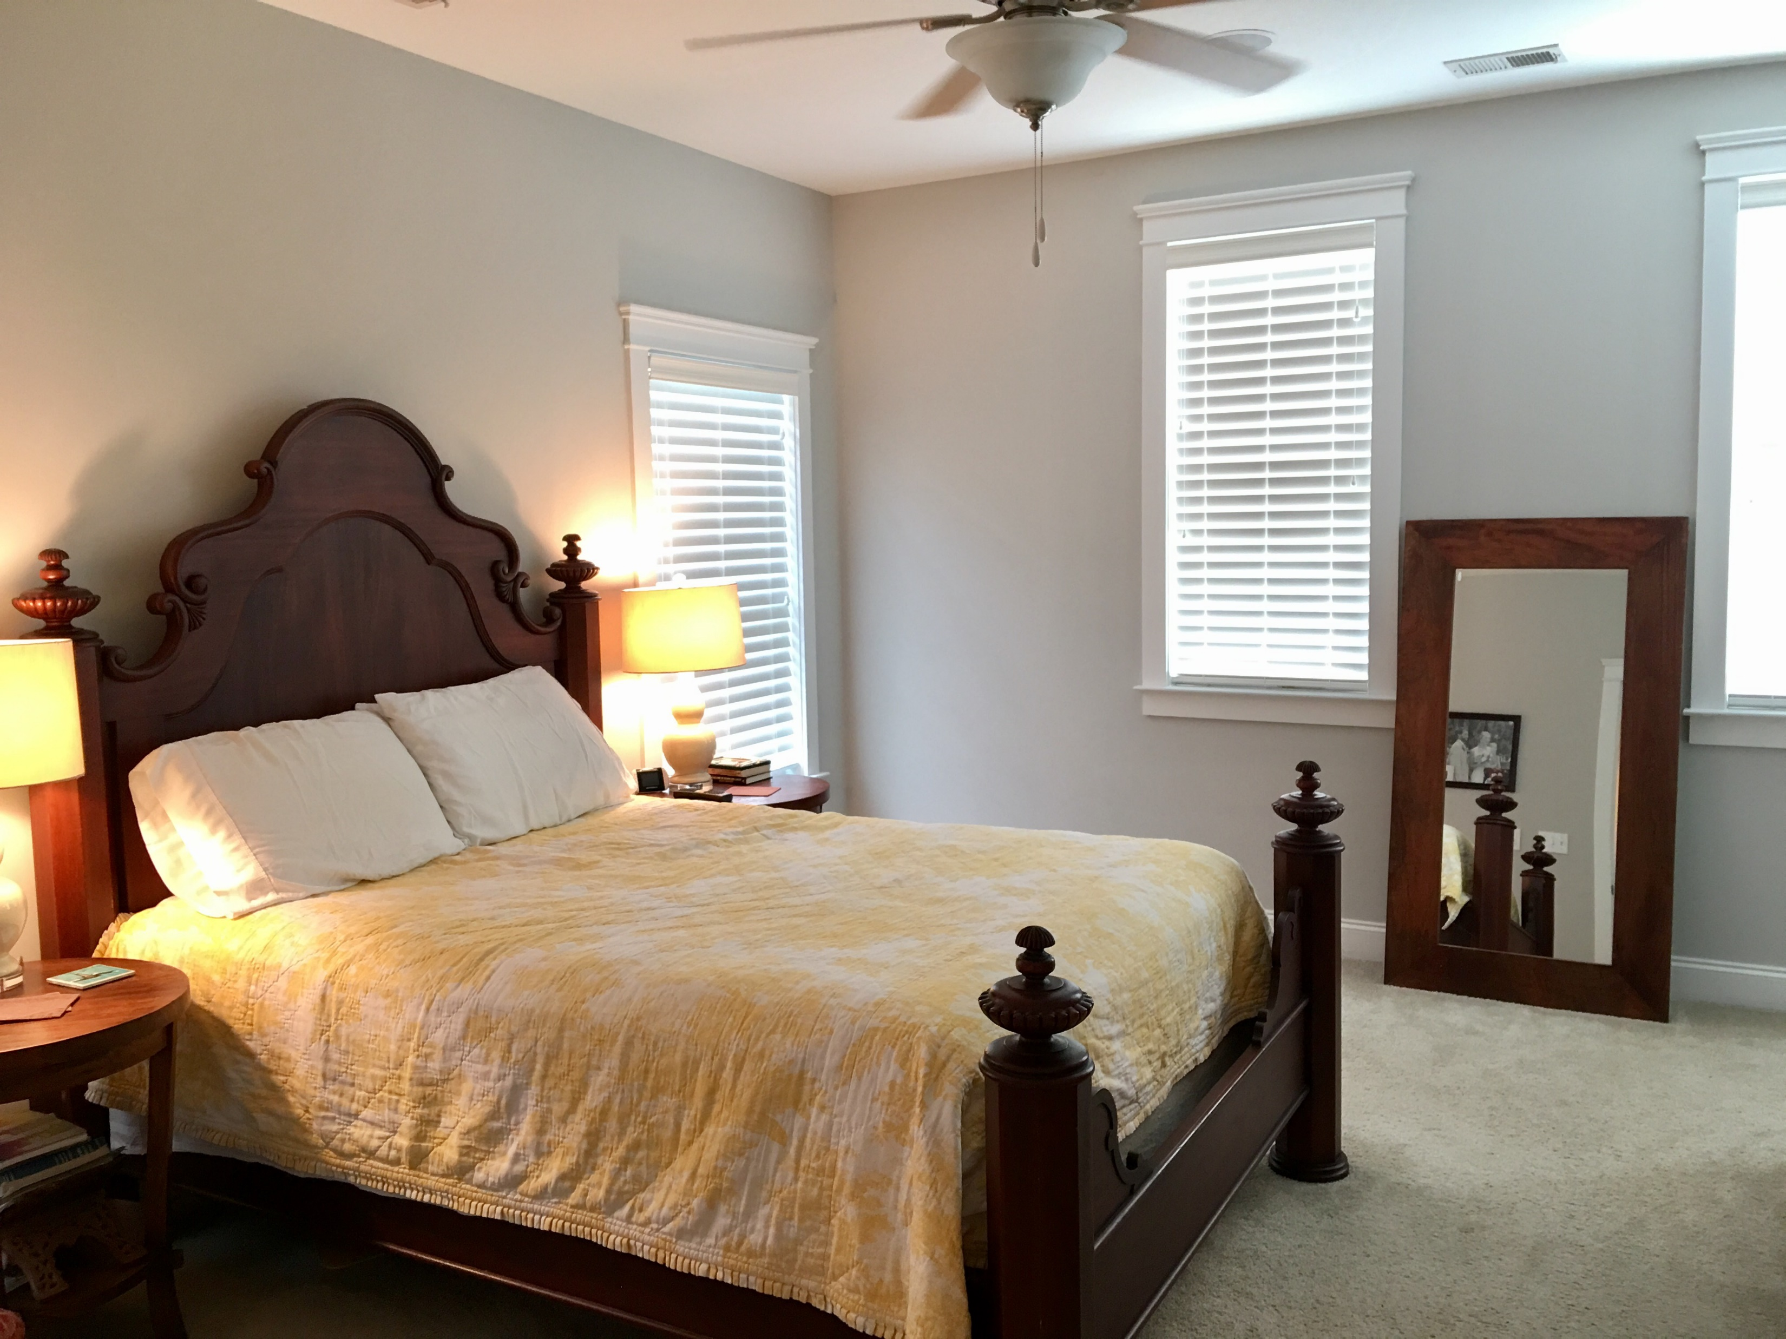
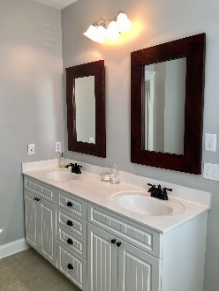
1299 Appling Drive MLS# 17015351 · $479,500
Darrell Creek Elevated Home With Elevator & Salt Pool
Just Reduced In Watermark!
Adorable Cottage In The Heart Of Mount Pleasant!
The perfect combination of LOCATION and AFFORDABILITY! Welcome home to 1299 Appling Drive! Just minutes to the beach or downtown Charleston, this adorable 3 bedroom, 2.5 bath coastal cottage checks all the boxes. Greeted by the large front porch, features include an open floorplan with dining room/office just off the foyer opening to the spacious family room with gas fireplace, breakfast area and bright kitchen with stainless steel appliances and glass tile backsplash. A mudroom/drop-zone with plenty of storage has been added just off the kitchen. The second floor features a large master suite with huge private bath and upgraded shower, two additional bedrooms and a full bath. This home and neighborhood offers wonderful amenities and lifestyle all in the heart of Mount Pleasant!
Kimberly Jackson
(843) 276-9771 | kimberly.jackson@agentownedrealty.com
AgentOwned Preferred Group | 824 Johnnie Dodds Blvd | Mt Pleasant, SC 29464

