Slide 1
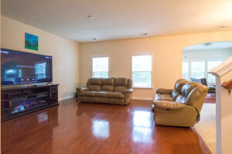
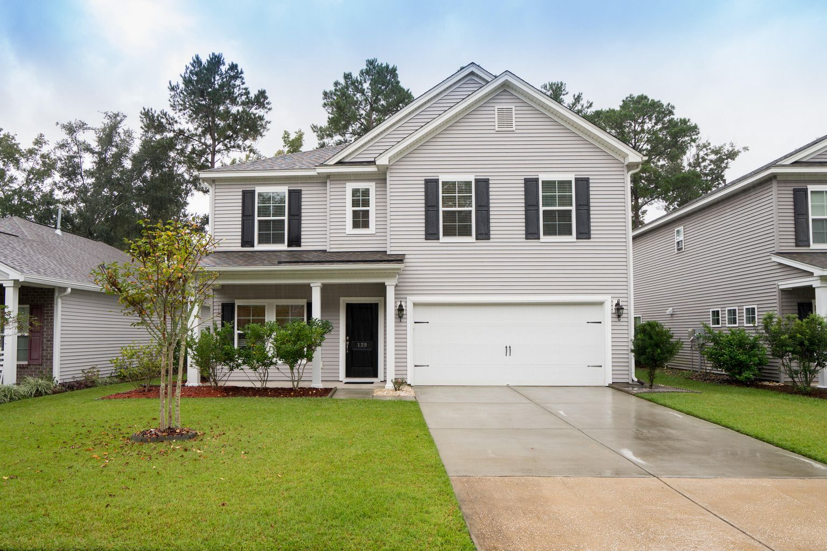
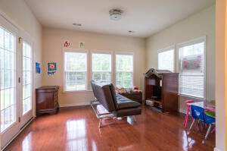
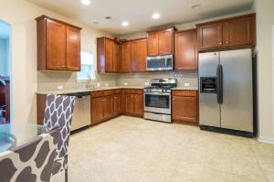
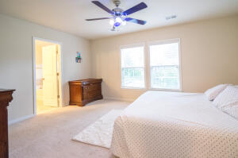
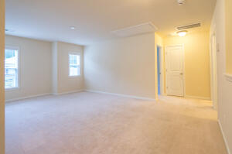
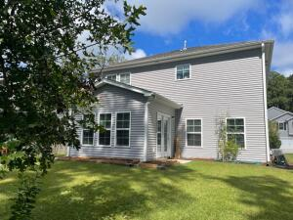
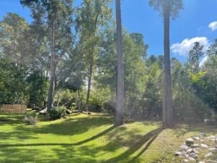


129 Gazania Way
Grand Bees · Charleston, SC 29414
MLS# 21027147 · $429,000
Turn Key In West Ashley
Immaculately kept home in West Ashley!
Close to schools, hospital and shopping. This home boasts an open floor plan with 3 bedrooms, a formal dining room or office, a sunroom and a huge loft area. When you enter the home the dining room or office area is to the left and straight back there is a large family room with a gas fireplace that opens up to the breakfast area and spacious kitchen. The kitchen has granite countertops, a pantry, a gas range and the entrance to the garage is just off of the kitchen. Past the breakfast area is a large sunroom for that extra living space that opens out into the lovely backyard. Upstairs you will find a massive master bedroom with an ensuite bathroom with a separate tub and shower and a huge walk-in closet.
The master bathroom has a gorgeous tile floor and the stand alone shower is fully tiled as well. Also upstairs you will find two more generously sized secondary bedrooms and a huge loft area that has multiple possibilities! One feature that adds to the flow of this floorpan is that the laundry room is upstairs for ease of use.
This home also boasts a two car garage. And it backs up to a wooded buffer so you do not have to worry about your neighbors peaking into your windows. The homeowners have kept this home in immaculate condition. Grand Bees is a master planned community with beautiful landscaping, a neighborhood pool and tons of walking trails! The location cannot be beat. Close to everything! Walmart and Harris Teeter are just around the corner! The beach is just minutes away and downtown Charleston is only a few miles away.
Take a video tour: https://youtu.be/lWPQZ8OLJQM
Carey Nikonchuk
(843) 276-1701 M
cnikonchuk@gmail.com
www.palmettoproperty.net

