Slide 1
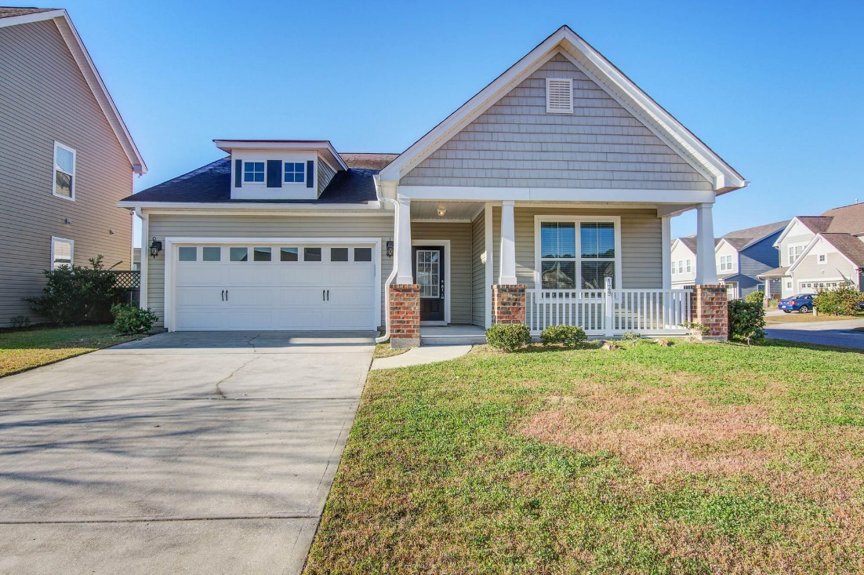
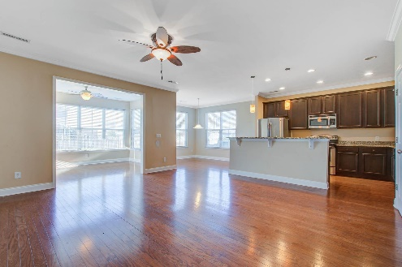
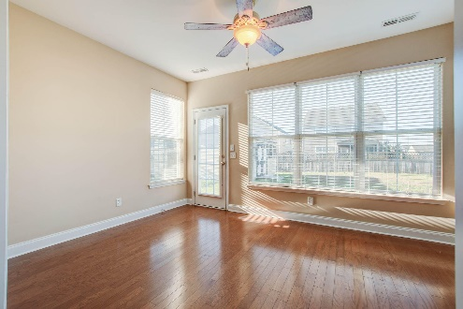
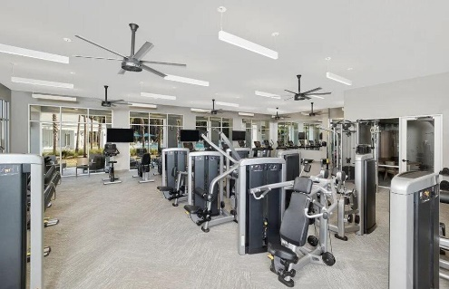
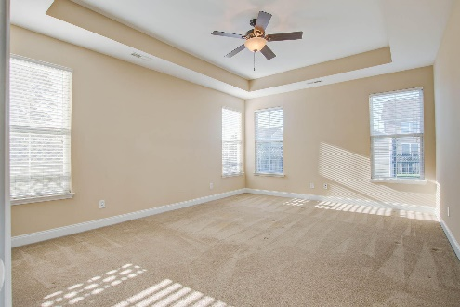
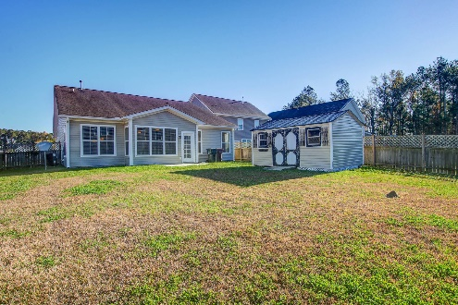
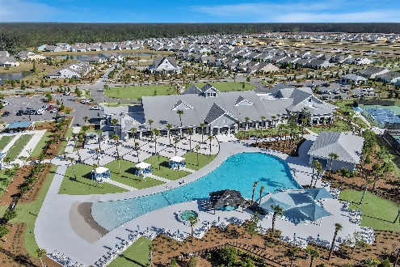
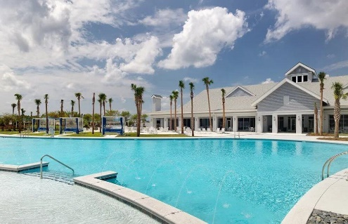
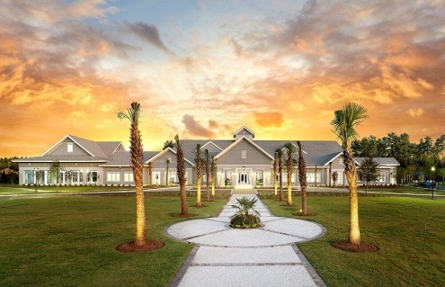


Just Listed in Foxbank Plantation
REDUCED
129 Woodbrook Way
Moncks Corner, SC 29461
MLS# 23027842 · $365,000
Michael Dew
O 843-769-5100
M 843-870-7000
michaeledew@gmail.com
www.michaeldewrealestate.com
Lovely 3 bedroom 2 bath property in desirable Foxbank Plantation on corner lot. 2 car attached garage. Wood floors through out main living areas. Open concept floor plan. Eat in kitchen with an island, stainless steel appliances, granite counter tops and plenty of cabinets. Master bedroom has tray ceilings, walk in closet and master bath with walk in tiled shower and dual sinks. Patio overlooking private fenced in back yard with shed. Must see!
AgentOwned Charleston Group
902 Savannah Hwy
Charleston, SC 29407
Real Estate ● Mortgage
Insurance ● Business Brokerage

