Slide 1
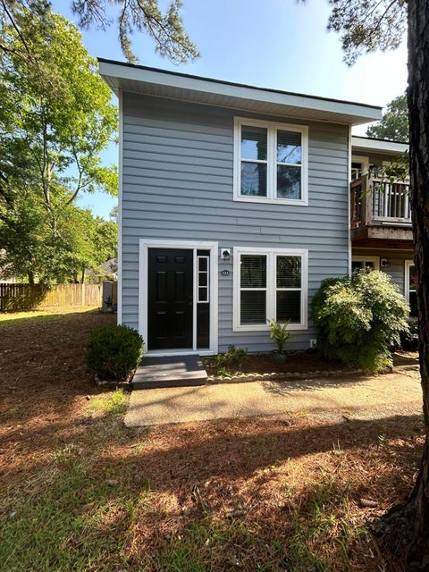
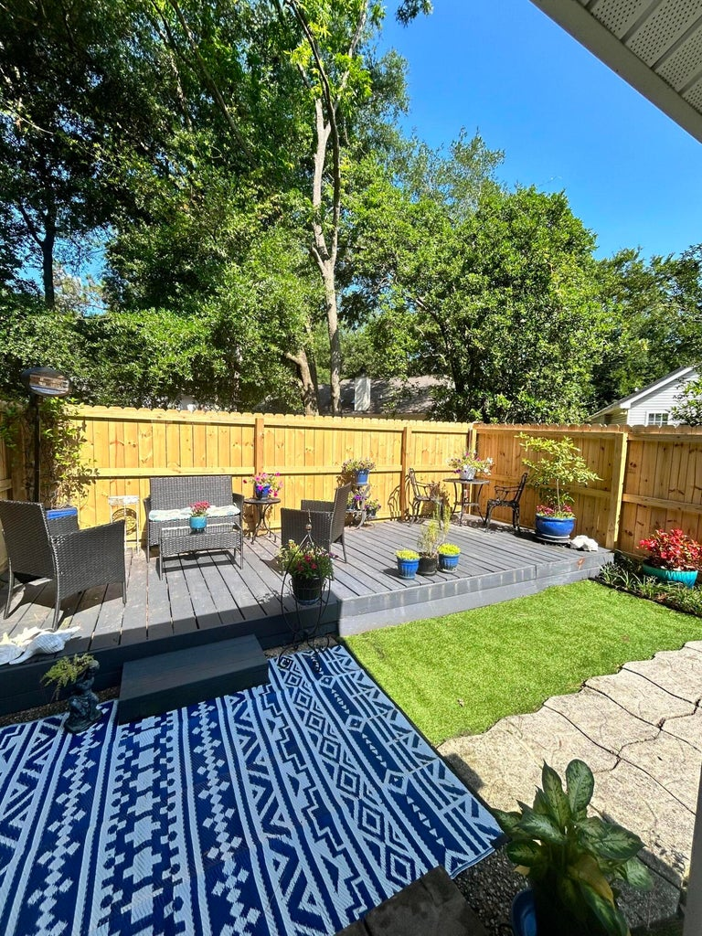
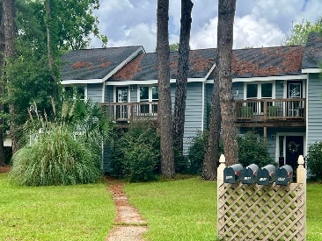
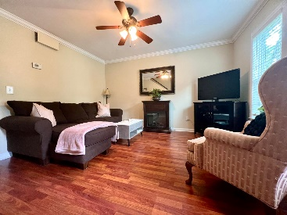
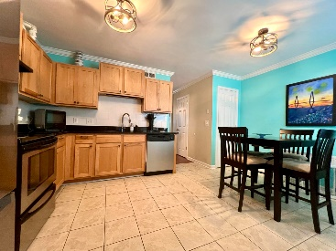
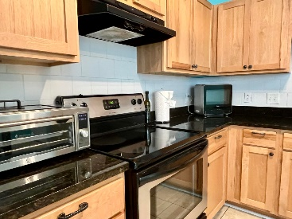
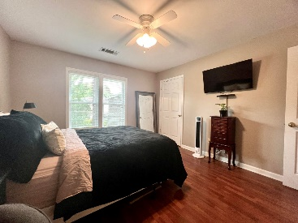
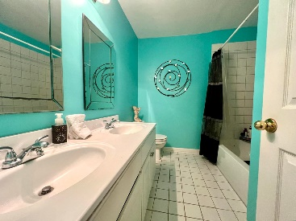
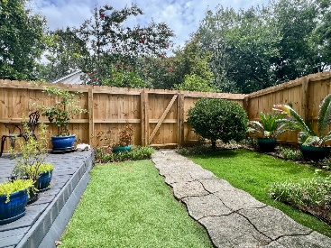


12 Commercial Row A Rivers Point | Charleston, SC 29412 | MLS# 24019089 | $360,000
Great Primary or Investment Property
Welcome Home to this adorable condo with a town house appeal. Well maintained and move in ready! This home features two well-sized bed rooms with wood flooring upstairs with a full bath. Lots of closet space! Downstairs you will find the eat-in kitchen with tile flooring, nice wooden cabinets, granite countertops, under mount sink and is equipped with a stainless steel stove and dishwasher. Off of the kitchen is the laundry area. There is also a powder room between the kitchen and living room. The living room has wood floors throughout and is a nice area to gather with company. Stepping outside, the back yard is a welcoming space designed for entertaining. It includes a deck space and patio area, providing a suitable area for outdoor gatherings, as well as a wood fence that ensures privacy. James Island is known for its vibrant community vibe, with lots of dining choices. The proximity to Downtown Charleston and Folly Beach makes life easy!
VIDEO TOUR
Kelly Rozier
(843) 209-3129
kellywrozier@gmail.com
Brand Name Real Estate
4 Carriage Lane Suite 106
Charleston, SC 29407

