Slide 1
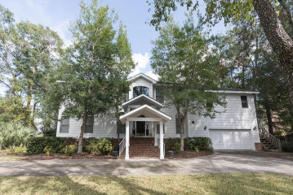
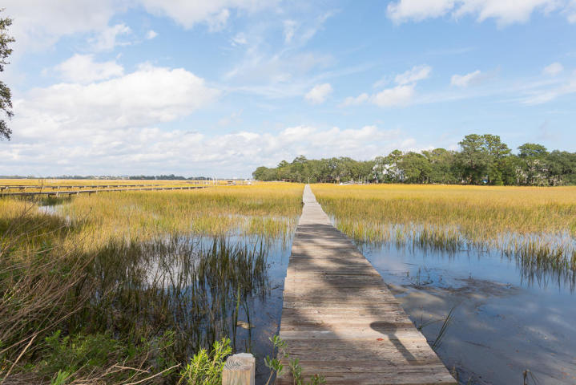
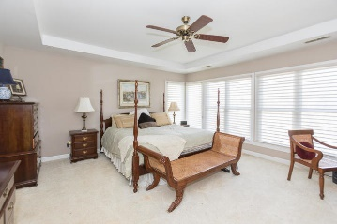
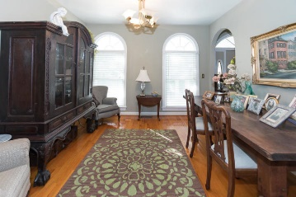
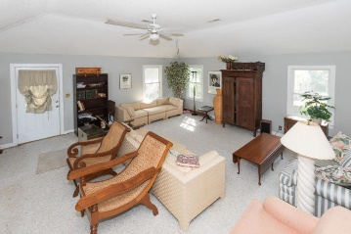
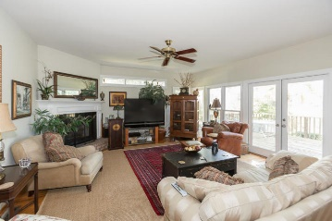
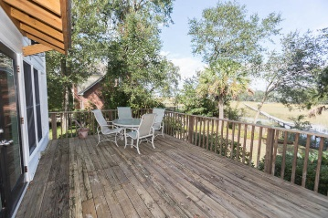
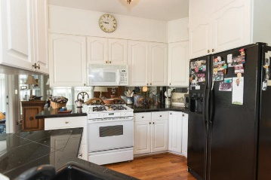
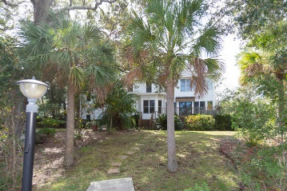


James Island Waterfront
12 Held Circle
Creek Point · Charleston, SC 29412
MLS# 19030166 · $795,000
4 bedroom 3 bath home on deep water. Hardwood floors through out main living areas. Living/dining combo. Eat in kitchen with island opens to family room with fireplace. Lovely tiled sun room with views of water. Bedroom downstairs with full bath. Upstairs is master en suite with water views. 2 additional spacious bedrooms and laundry room. Huge room above garage with outside access. Great deck, perfect for entertaining. 2 car garage. New roof. Great location. Close to Folly Beach and down town.
Michael Dew
O 843-769-5100
M 843-870-7000
michaeledew@gmail.com
www.michaeldewrealestate.com
AgentOwned Charleston Group
902 Savannah Hwy
Charleston, SC 29407
Real Estate ● Mortgage Insurance ● Business Brokerage

