Slide 1
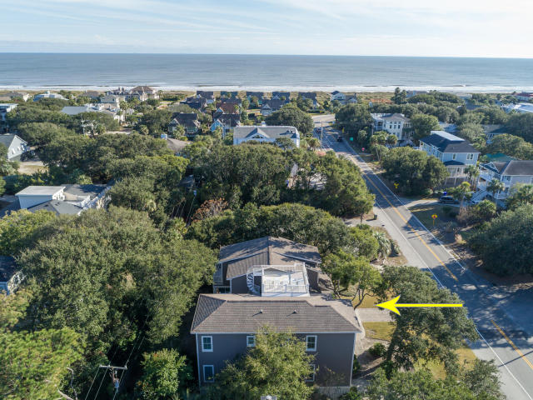
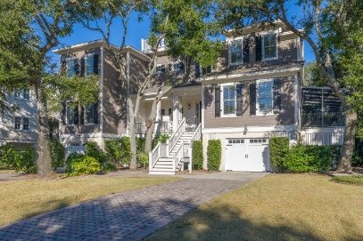
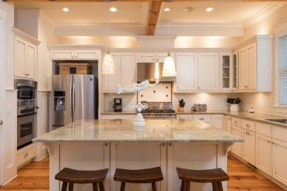
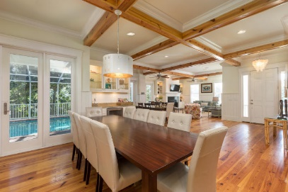
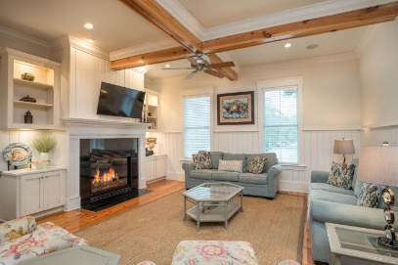
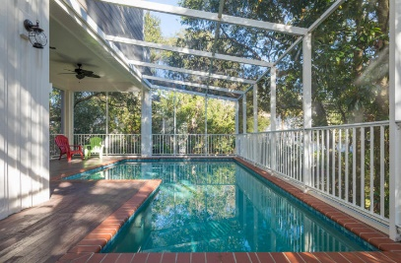
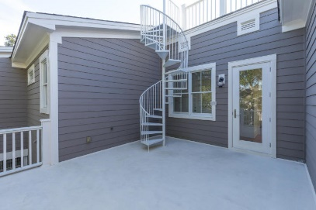
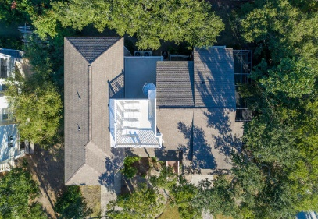
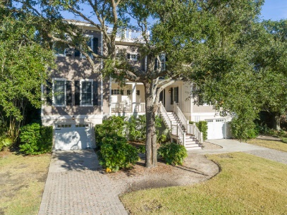



12 41st Avenue
Isle of Palms, SC 29451
MLS# 17031544 ~ $1,599,000
Just Reduced
$785,000!
IOP Stunner Steps to Beach ~ Sleeps 18 + Pool
Just steps away from public beach access, this enormous home that currently sleeps 18 is the best deal on IOP!
No detail was spared in this custom elevated home built only 9 years ago.
You'll love the knotty pine flooring throughout (less baths and laundry), 10' coffered ceilings, 8' doors, gas fireplace, built-in bookshelves, wet bar with wine cooler, gourmet kitchen, heated enclosed pool, screen porch, two rooftop decks, elevator, private bathrooms for each bedroom and more.
The location is amazing as it's also just down from every amenity you could dream of: restaurants, marina, golf, tennis, private club and more! This home is on the weekly rental market and that information is available upon request. Buyer to verify all pertinent information.
Beth Moore
M (843) 532-4892
bmoore@carolinaone.com
Meg Kandik
M (843) 814-5137 | O (843) 603-4659
Meg@HolyCityRE.com | www.holycityre.com
Bennett Construction & Realty | 804 Tennent Dr | Charleston, SC 29412

