Slide 1
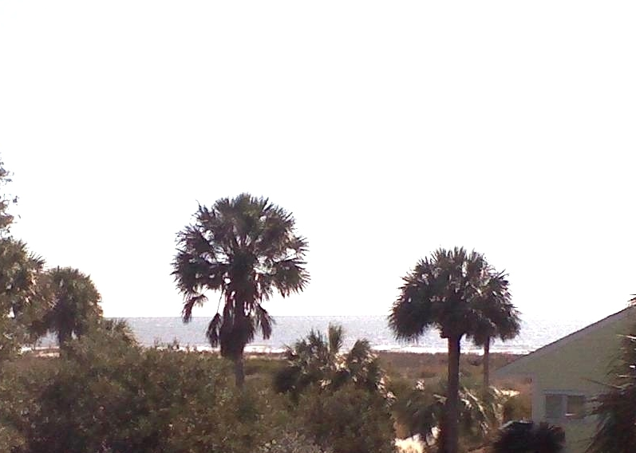
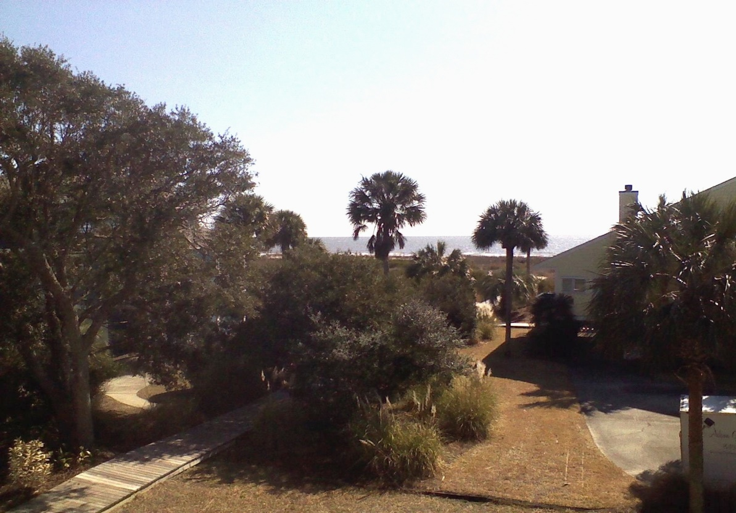


The Admiral had this house built to last for his big family. It did just that and had only minor damage from Hurricane Hugo. This large home has great bones and with the right buyer could be a showcase. The views of the ocean are beautiful and can be seen from most of the rooms. The home has approximately 3585 square feet of enclosed area which includes a heated pool with tile deck. The pool has been closed. There is an indoor shower near the pool and a cedar sauna. There are approximately 630 sq. feet of decking. The house is handicap accessible with a porch lift. The architect was Gertraude Dilling and she designed the home to withstand potential storms. The central air conditioning and heating is a "Green" friendly geothermal system. Being on the second row from the beach allows for wonderful breezes year round. This home was never rented and is the home of the original family. The owners do not belong to Wild Dunes, but buyers can join if they decide. The square footage was taken from the owners--the buyers should measure to verify. The house is being sold "AS IS" no warranties--no repairs-buyers may have home inspection for information only. The downstairs is 18' above mean high tide. This is the perfect spot for a beautiful beach residence. The home is also being listed as land if buyers want to remove this house and build a new residence. This is one of the most desirable lots on the Isle of Palms. Just step out of the front door for a stroll on this beautiful beach area.
Build your dream home with views of ocean
12 54th Ave
Isle of Palms, SC
MLS# 2822763
$999,000
Peggy Reese
E-PRO, GRI
phreese@bellsouth.net Mobile (843) 693-2050
AgentOwned Realty Co
Real Estate ● Mortgage ● Insurance ● Business Brokerage

