Slide 1
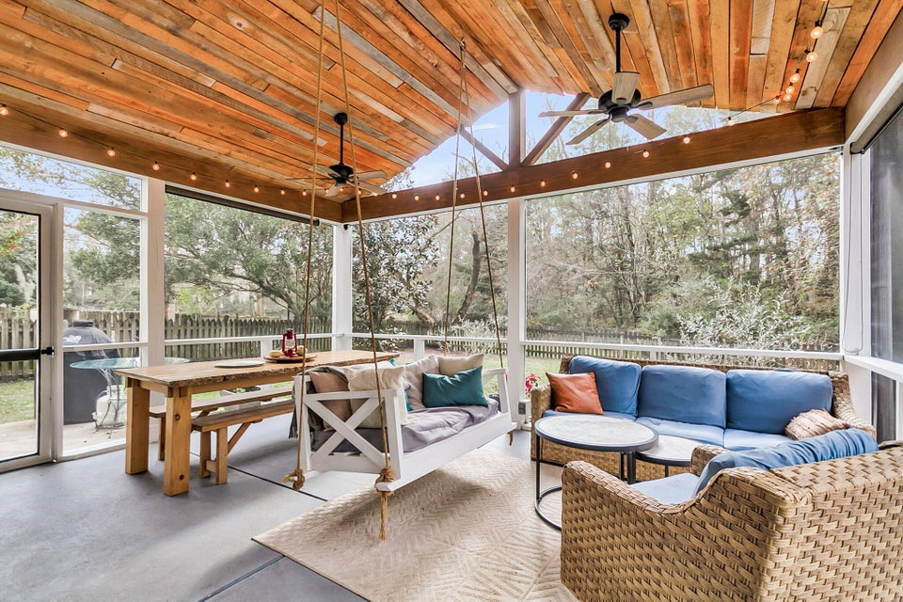
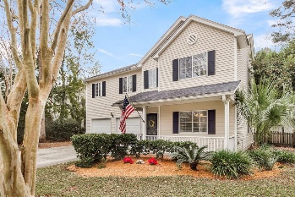
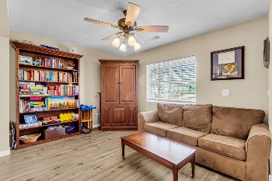
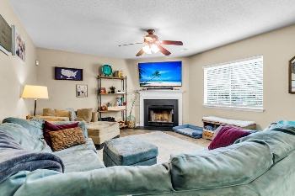
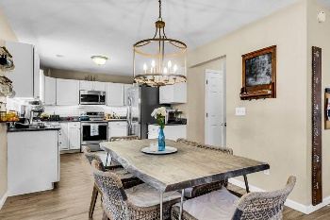
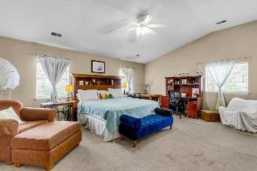

12 Creek Bend Drive
Bridges of Summerville | Summerville, SC 29485 | MLS# 25031767 | $419,000
Amazing Outdoor Living Space! Bridges of Summerville
Beautiful 4-bedroom, 2.5-bath home on a stunning wooded lot with a fenced backyard and serene pond views! This home offers exceptional outdoor living with a recently added oversized screened-in porch featuring soaring ceilings, plentiful seating for watching the big game, and a spacious dining area perfect for holiday meals or game nights. Step outside to enjoy the firepit area, grilling patio, and large lawn—an outdoor oasis that is truly a must-see! Charming curb appeal welcomes you with a full front porch. Inside, an open floor plan, gorgeous laminate wood floors, and abundant natural light create a warm and inviting atmosphere. To the right, the living/flex room flows seamlessly into the dining room, offering plenty of space for entertaining family and friends. Continue into the updated gourmet kitchen, complete with granite countertops, subway tile backsplash, stainless steel appliances, white cabinetry, an eat-in area, custom light fixture, and a convenient butler's pantry with shelving and a washer and dryer. The kitchen overlooks the inviting family room, which features a wall of windows and a cozy wood-burning fireplace. Upstairs, the spacious primary suite boasts 10-foot ceilings, an ensuite bath with a relaxing soaking tub, separate shower, and a vanity. The massive walk-in closet includes split sections - ideal for two owners. Three additional generously sized bedrooms with large closets share a full bathroom on the second floor.
Recent upgrades include:
New main HVAC air handler in attic (2025) | New main outside HVAC unit (2019) | New roof (2019)
Two new double-capacity water heaters (2024)
Located just one block from the community pool and park, this home is perfectly situated in The Bridges of Summerville - close to restaurants, shops, medical offices, the hospital, and just a short drive to the airport, downtown, and local beaches. Don't miss this exceptional home. Schedule your showing today!
Stan Huff
843-670-2835
stan.huff@agentowned.com
Jill Marcacci
843-297-5590
jill@agentowned.com
www.agentownedrealty.com
AgentOwned Realty Co. Preferred Group, Inc. | 824 Johnnie Dodds Blvd | Mt Pleasant, SC 29464

