Slide 1
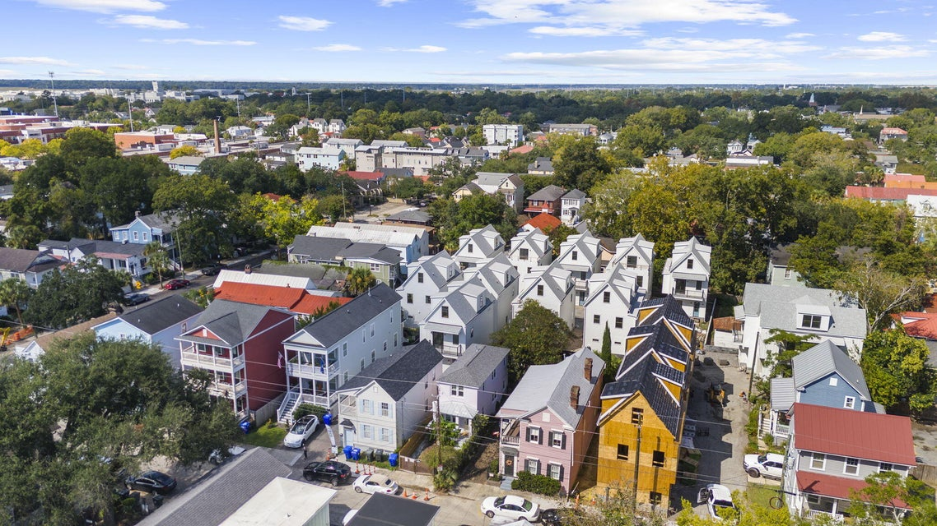
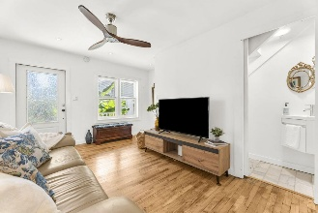
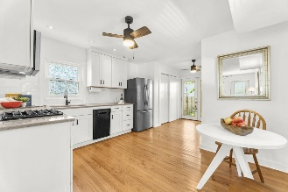
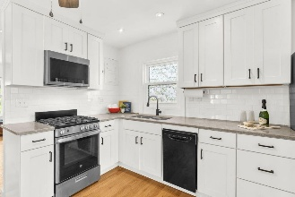
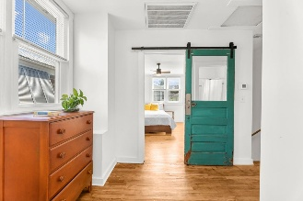
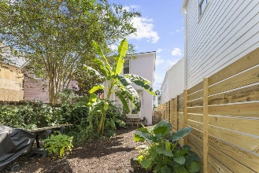

AMAZING OPPORTUNITY CLOSE TO MUSC AND THE CITADEL
CHARMING COTTAGE IN CHARLESTON'S WESTSIDE!
12 Nunan Street
Westside | Charleston, SC 29403 | MLS# 25028050 | $615,000
Welcome to this beautifully maintained home in the highly sought-after Westside neighborhood of downtown Charleston. Enjoy the best of city living with close proximity to local restaurants, shops, parks, MUSC, The Citadel, and the College of Charleston. Gated off street parking, a fully fenced lush backyard and covered front porch offer the best of low-country living. Inside, you'll find a large living space with a new half bathroom. An updated eat-in kitchen with a built-in microwave, dishwasher, gas range and refrigerator. Along with a small office space and storage closet holding a stack-able washer and dryer. Upstairs, there are two large bedrooms with a full bathroom and a nice nook in between perfect for a futon or small sofa.
Other recent upgrades include a roof, new HVAC system, tankless water heater and all new windows throughout providing peace of mind for years to come.
VIRTUAL TOUR
Carolina One Real Estate
195 W Coleman Blvd
Mt Pleasant, SC 29464-3495
Kathy Ware 843-830-3804
Kathy.ware@carolinaone.com
www.katherineware.com

