Slide 1
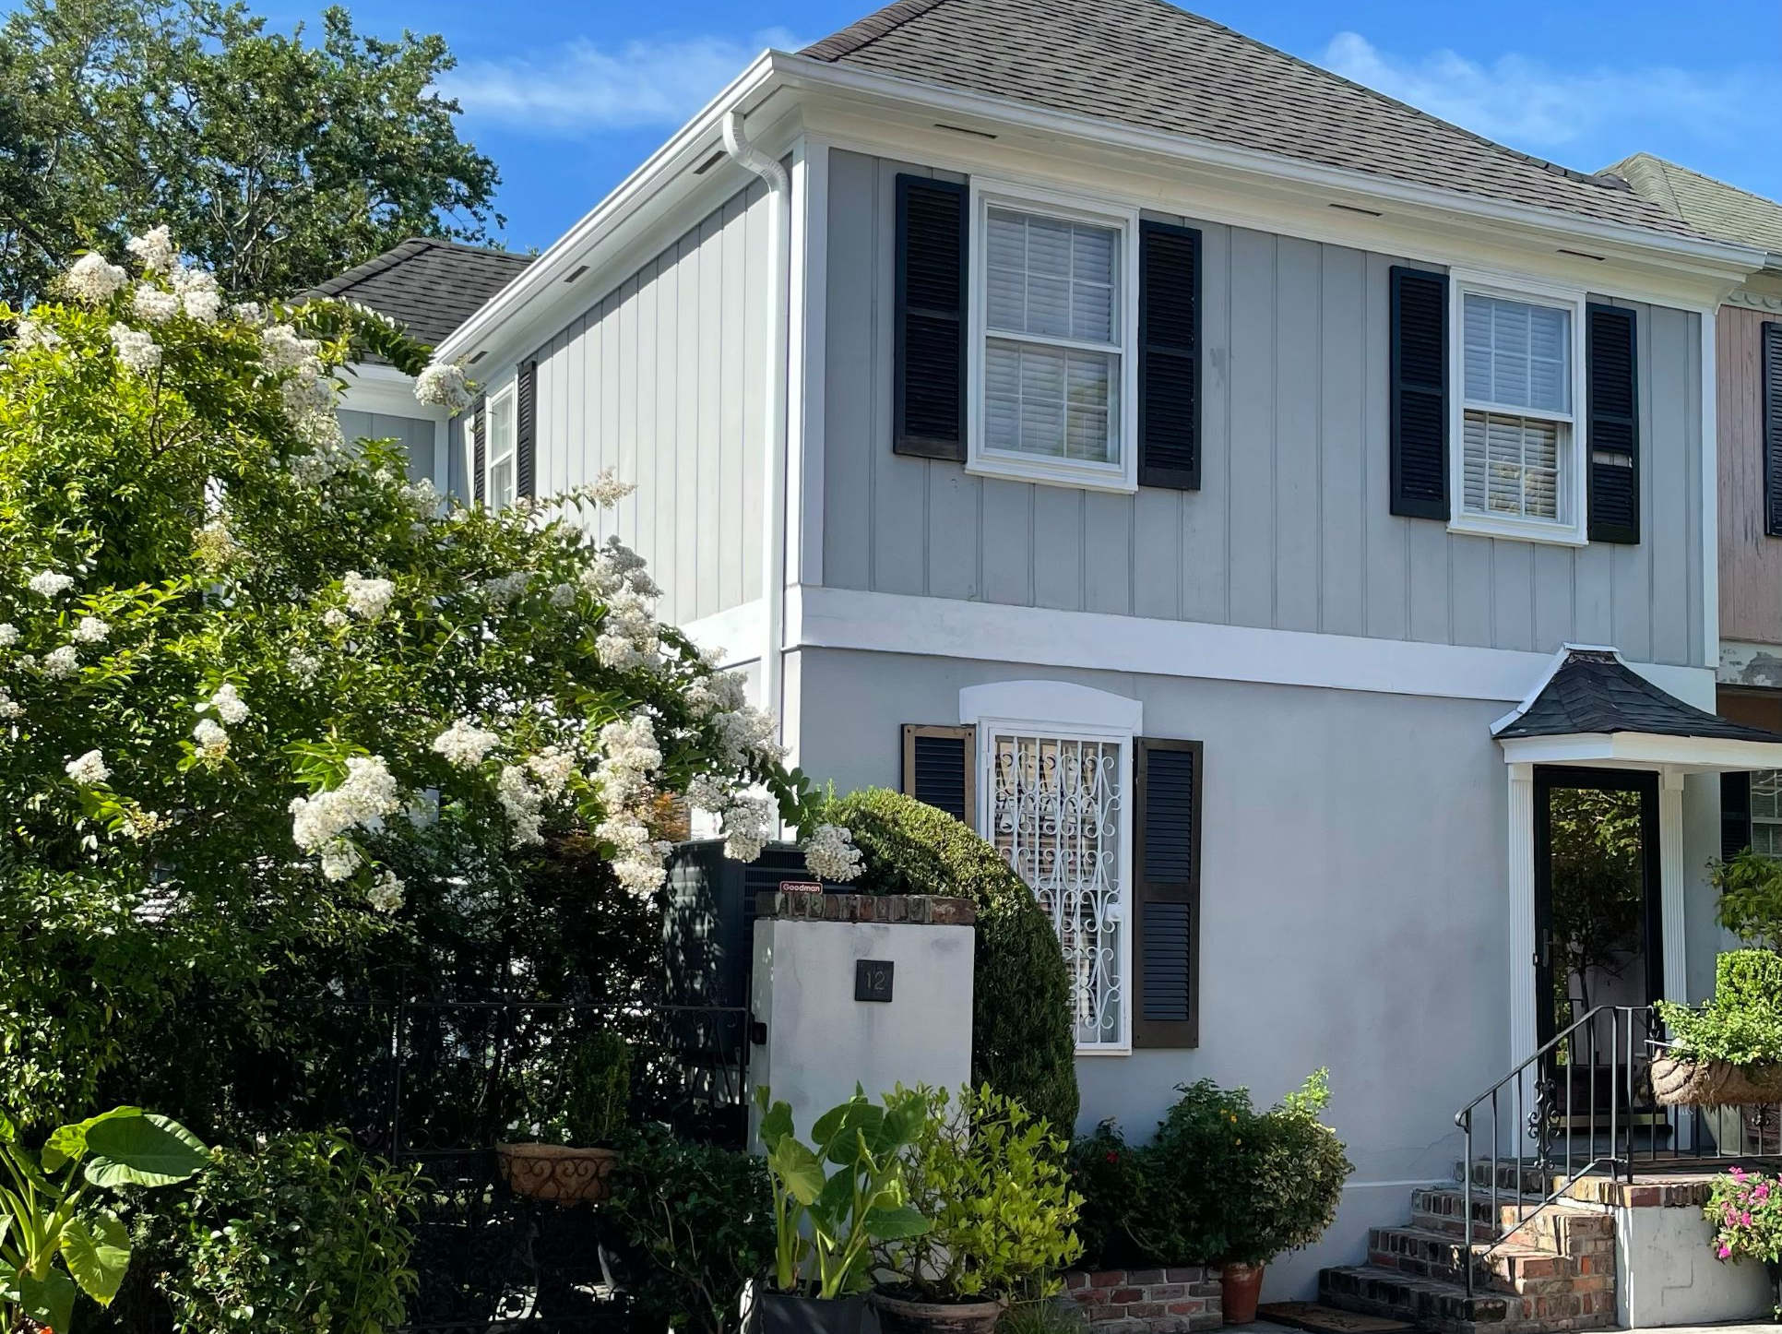
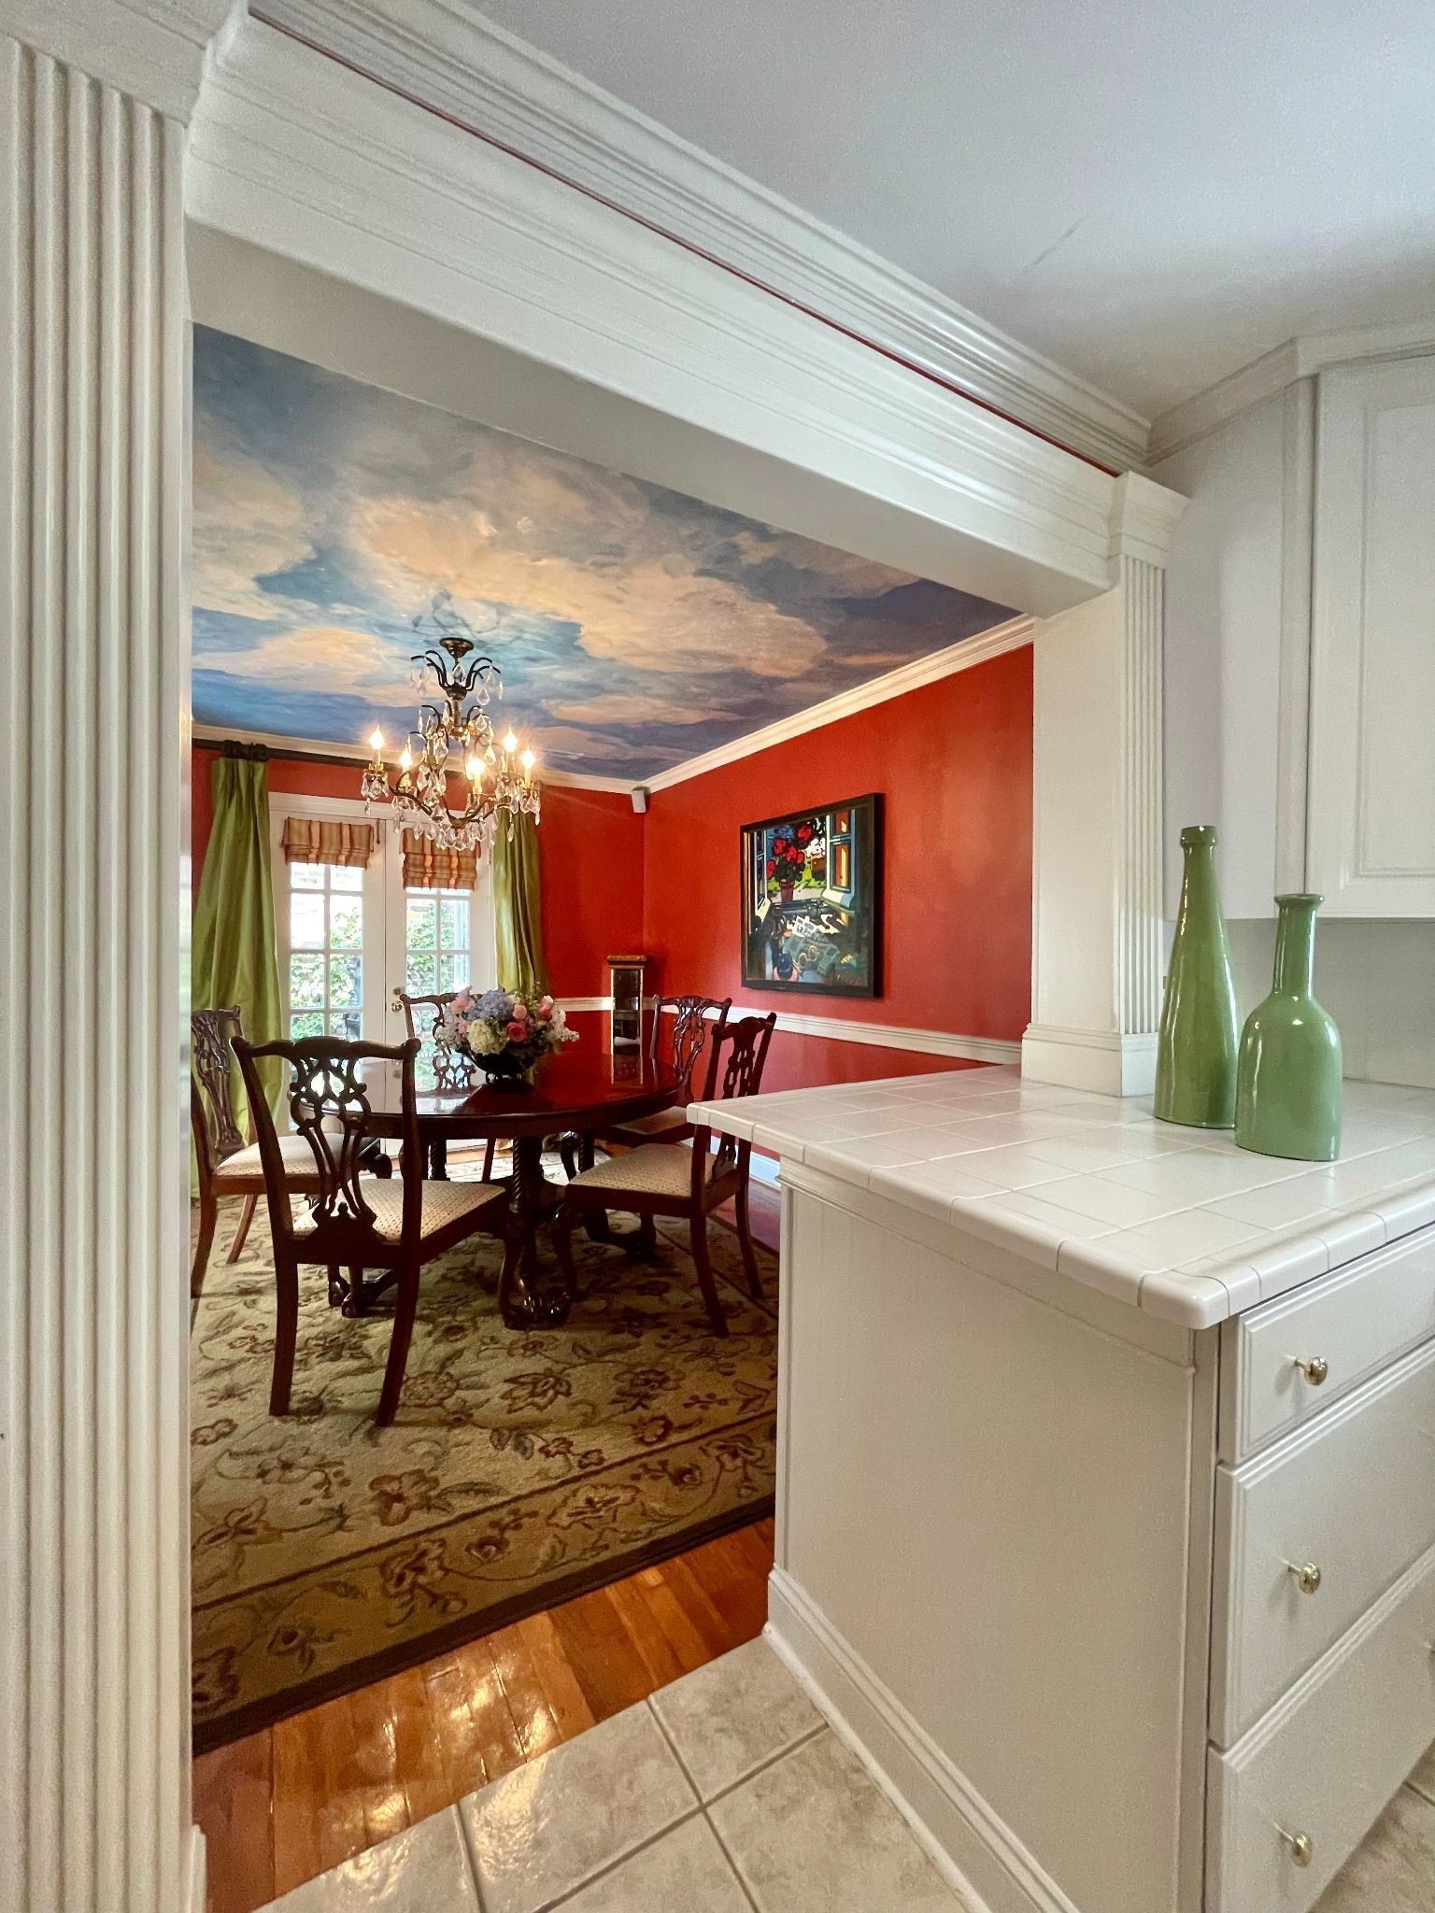
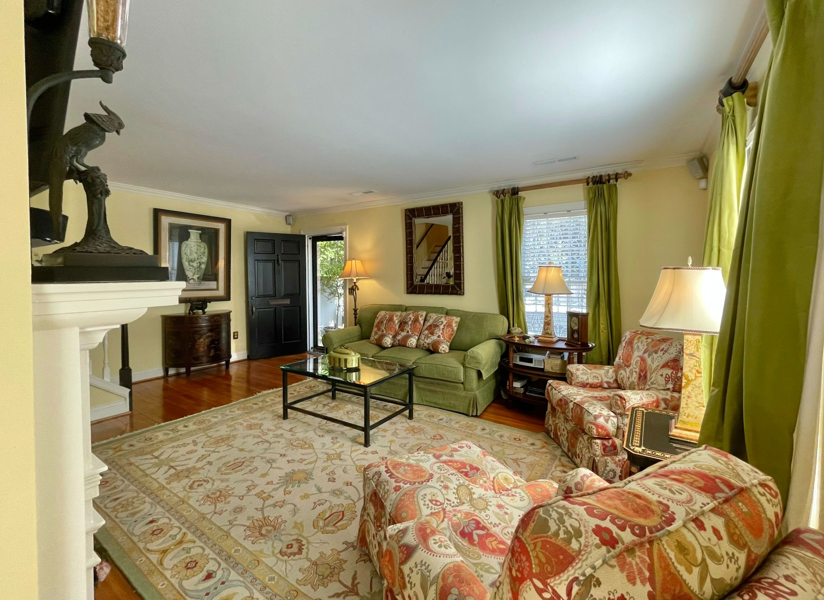

OPEN HOUSE 12 POULNOT LANE
THURSDAY 11:30 TO 1
Harleston Village in Downtown Charleston Historic District
$725,000
3 Beds, 2.5 baths
Townhouse, no HOA
1,370 SF
Secret garden
Enjoy the Lifestyle of an urban setting in the heart of the Historic District with its many opportunities to walk to the nearby Colonial Lake, restaurants, bars, shopping, entertainment, the Dock Street Theatre, Chas. Library Society, The Gibbes and more.
Kay E. Kennerty MBA
REALTORⓇ
843-345-5011
Kay@AgentOwned.com
AgentOwned.com
Notes:
DO NOT ALTER LAYOUT. YOUR FILE WILL BE RETURNED OR EDITED IF IT IS RECEIVED ALTERED.

