Slide 1
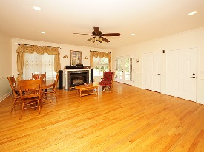
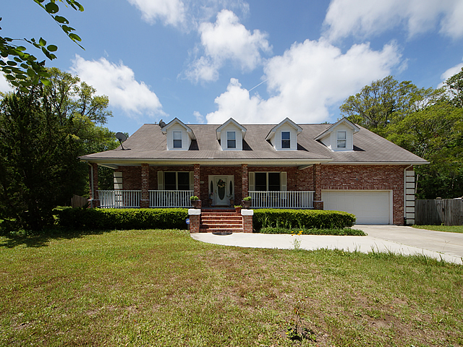
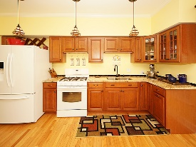
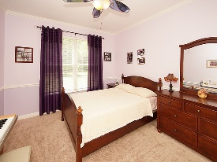
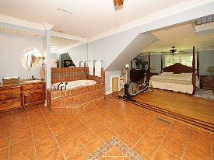
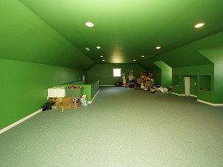
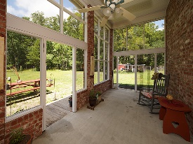
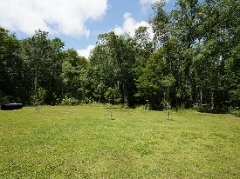


Johns Island Dream
1300 Dogpatch Lane
Hickory Hill
Johns Island, SC 29455
Open House Canceled!
Under Contract In 3 Days!
MLS# 17012704 | $480,000
4 Bed / 3 Bath
Spectacular brick home on 4.69 acres! Unique in design, the master bedroom has a gorgeous staircase leading to a second floor sitting area with a balcony overlooking the property. Master bath is equally as large as the bedroom with an elevated soaking tub and separate tiled shower. Hardwood flooring, new kitchen cabinets, new granite countertops, island, gas fire place, screen porch are down stairs. Second story has a large living room, 2 bedrooms, office and full bath. Chicken coop will convey with the sale and has electricity in the coop. Pictures are worth a thousand words!
Connie White, Broker
C: 843-532-3356
conniesyouragent@gmail.com
Charleston Homes
597 Old Mt. Holly Road
Suite 301
Goose Creek, SC 29445

