Slide 1
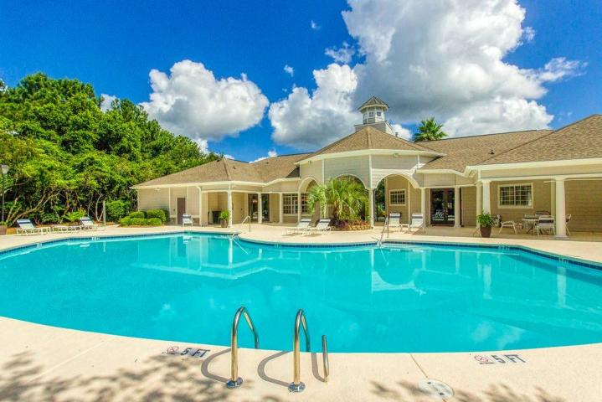
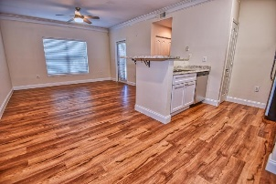
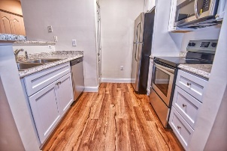
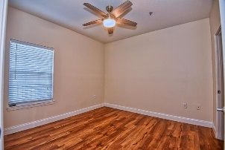
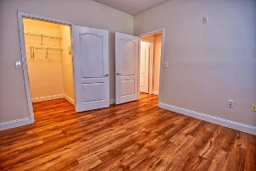
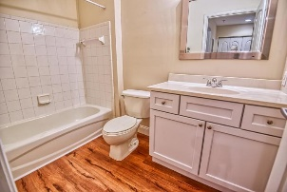
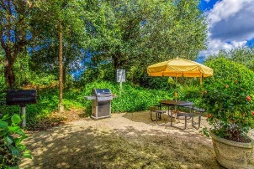
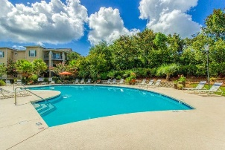
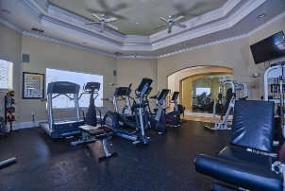
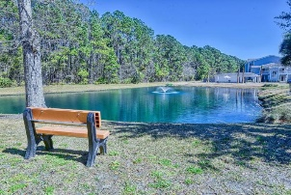


1300 Park West Boulevard 1013
Park West ~ Mount Pleasant
MLS# 20005943 ~ $164,500
Open House Lunch ~ Friday, Oct 3 from 11 - 1
Handyman Special… Bring your hard hats!
The Best Bargain in Mt. Pleasant
$5000 Price Reduction
NEW! NEW! NEW! This beautiful, renovated, first floor condo is pretty much all new. The exterior of the building and the hurricane rated windows, ALL NEW. The kitchen appliances, cabinets and counters, ALL NEW. The flooring, paint, and ceiling fans throughout, ALL NEW. The bathroom vanity and fixtures, ALL NEW. Madison at Park West is the last bargain remaining in Mount Pleasant. With great amenities like the pool, clubhouse and tennis courts and an on-site property manager, homes in Madison are in demand. Then consider the location, convenient to schools, shopping and restaurants. Don't wait, home prices in Madison have been rising, this home won't last long, come see it today!
Steven Ginsberg, ABR, EPRO
(843) 860-7782
sginsberg1@gmail.com | www.steveginsberg.com
Realty ONE Group Coastal | 654 Coleman Bvld Suite 100 | Mt. Pleasant, SC 29464

