Slide 1
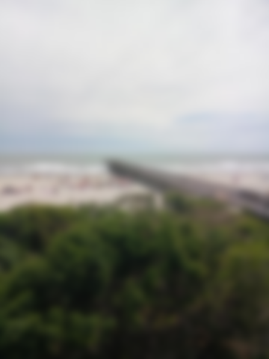
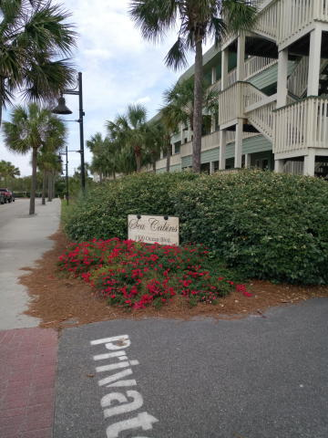
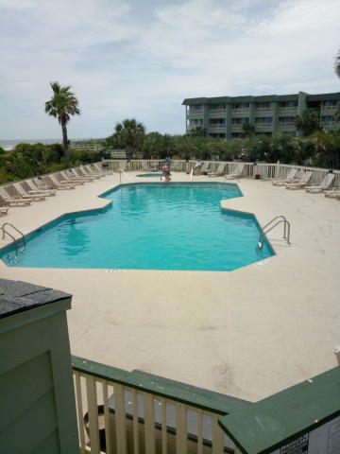

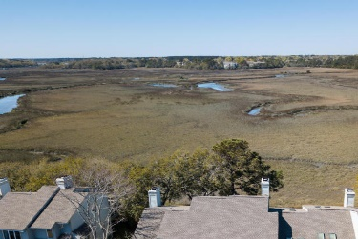

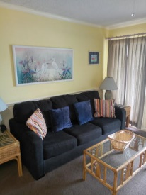
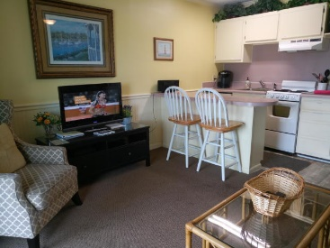
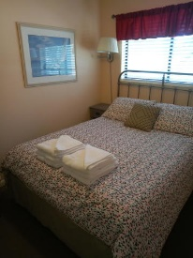
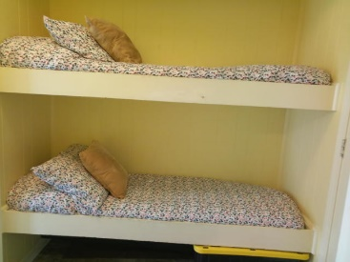
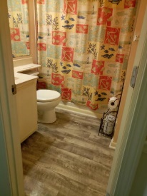

Great Beach Condo, Isle of Palms
1300 Ocean Blvd. #108
Sea Cabins on the Ocean · MLS# 19013035 · $324,900
1 BD · 1 BA · 490sf
Great vacation home and/or investment property, with direct oceanfront access,... offering excellent rental income potential, as well as a fantastic location for family getaways.
The Sun Group
P.O. Box 186
Isle of Palms, S.C. 29451
Don Morris
843-543-2272 (Cell/Text)
dimorris7@gmail.com

