Slide 1
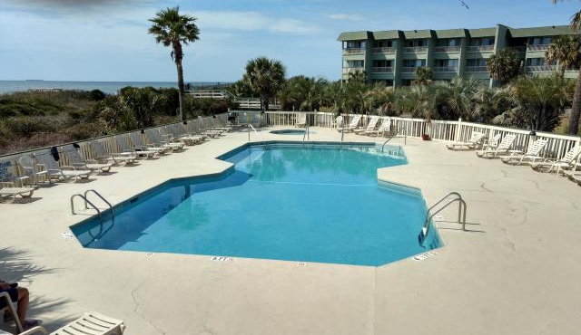
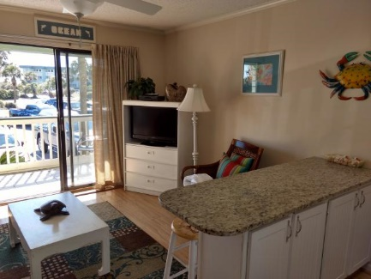
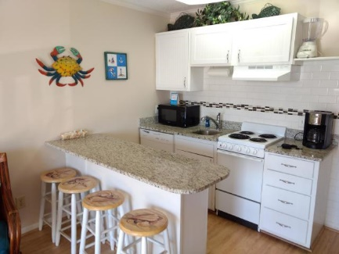
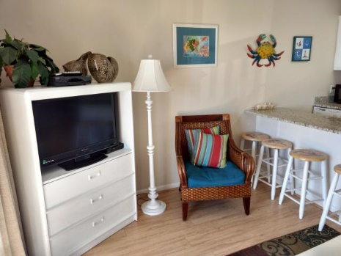
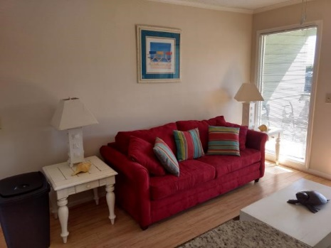
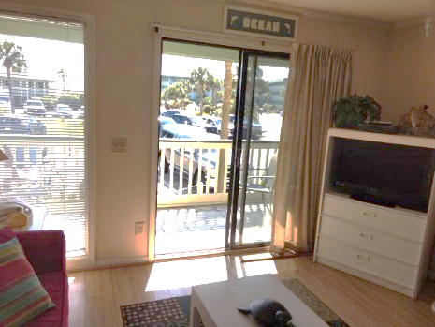
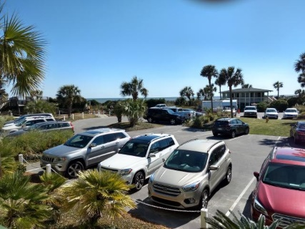
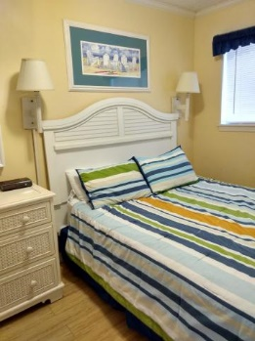
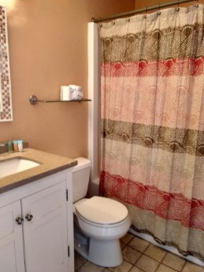


Own 13 Weeks of Beachfront Condo Living
Own 13 weeks of this beautiful one bedroom, one bath, first floor 'Sea Cabin'. Featuring relaxing views of the Ocean from the porch; along with access to the Community pool and Fishing Pier. Sea Cabins' have a terrific location, with immediate access to Isle Of Palms Restaurants and Shopping, and just a short distance to all that Charleston has to offer. This unit has been a short term rental, with good rental income (dependent on owner personal usage).
1300 Ocean Boulevard #109
Isle of Palms, SC 29451 ~ MLS# 19008606 ~ $94,750
1 Bedroom | 1 Bath | 490sf
Frank Rutigliano
843-813-4961
frutigliano@kwchs.com

