Slide 1
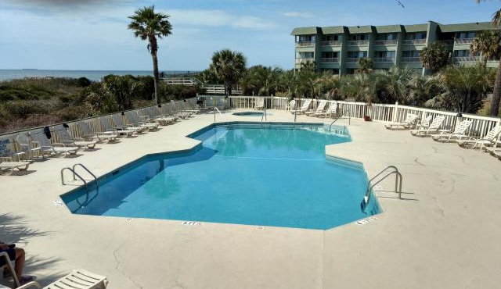
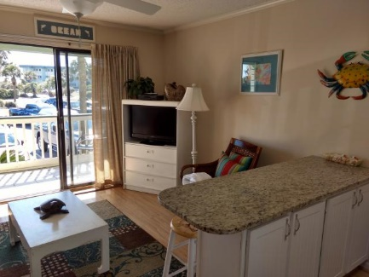
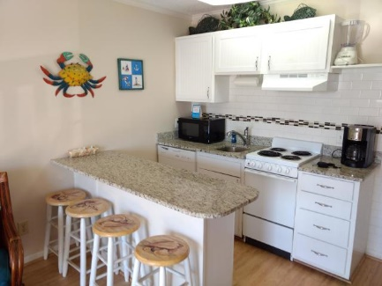
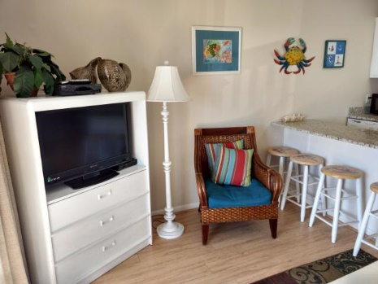
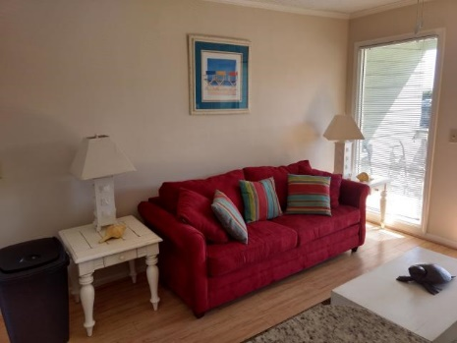
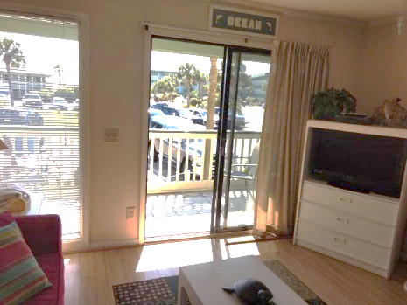
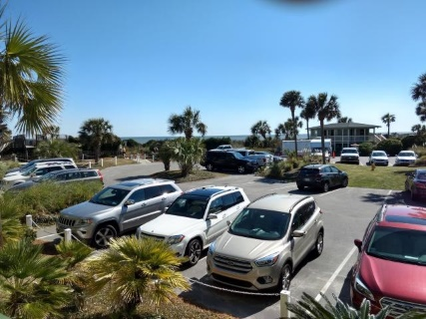
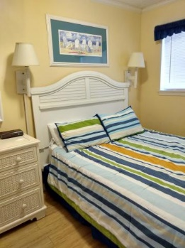
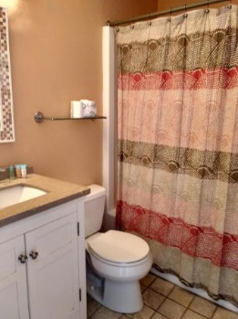


Own 13 Weeks of Beachfront Condo Living Price Reduced!!
Own 13 weeks of this beautiful one bedroom, one bath, first floor 'Sea Cabin'. Featuring relaxing views of the Ocean from the porch; along with access to the Community pool and Fishing Pier. Sea Cabins' have a terrific location, with immediate access to Isle Of Palms Restaurants and Shopping, and just a short distance to all that Charleston has to offer. This unit has been a short term rental, with good rental income (dependent on owner personal usage).
1300 Ocean Boulevard #109
Isle of Palms, SC 29451 ~ MLS# 19008606 ~ $79,000
1 Bedroom | 1 Bath | 490sf
Frank Rutigliano
843-813-4961
frutigliano@kwchs.com

