Slide 1
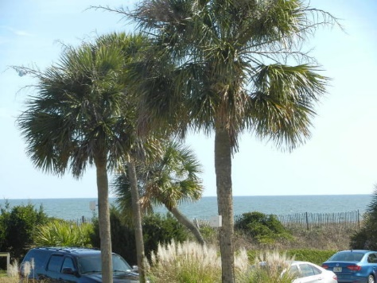
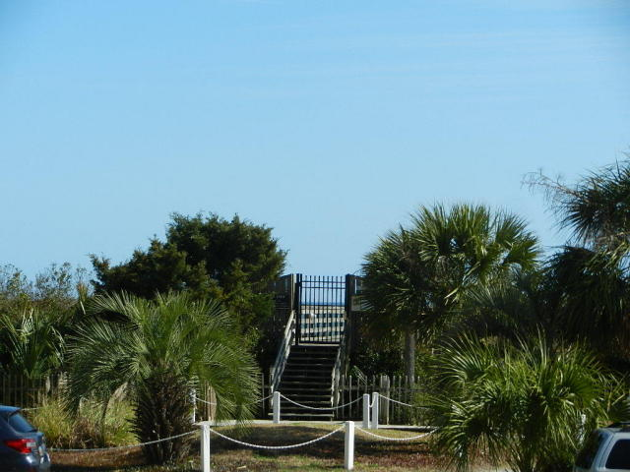
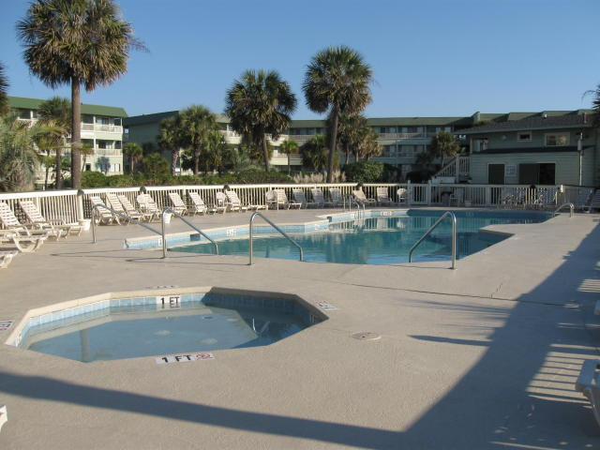
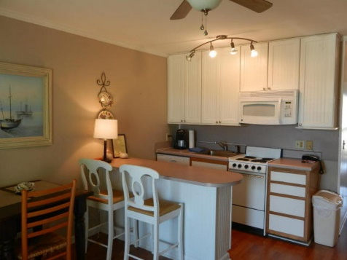
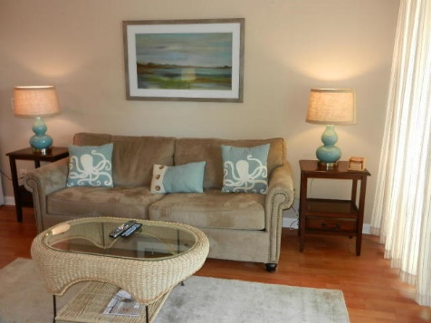
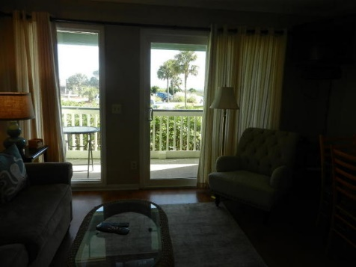
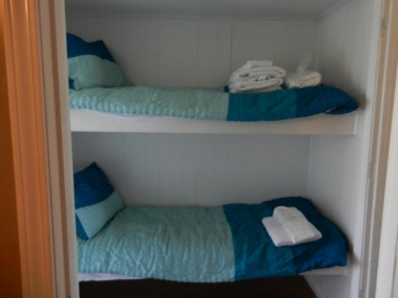
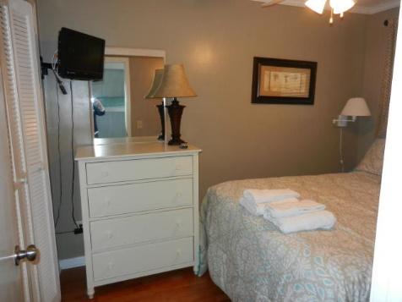


1300 Ocean Boulevard #115
Sea Cabin On The Ocean
Isle of Palms, SC 29451
MLS# 16005904
$299,000
Front Beach Condo Living
in the Heart of the Isle of Palms
w/Private Pier, Pool and Beach Access
New Price!
Located in the oceanfront complex known as the Sea Cabin's in the heart of the Isle of Palms. You will have your own private access to the beach, pool, and fishing pier. This condo is sold fully furnished and offers a great rental history. The property is located next to all of the major shopping and restaurants that Isle of Palms has to offer.
Darlene Smith
Office - (843) 886-8110
Mobile - (843) 696-7824
darlenesmith@carolinaone.com
DarleneSmithTeam.com
Carolina One Real Estate
1503 Palm Blvd Ste
Isle of Palms, SC 29451

