Slide 1
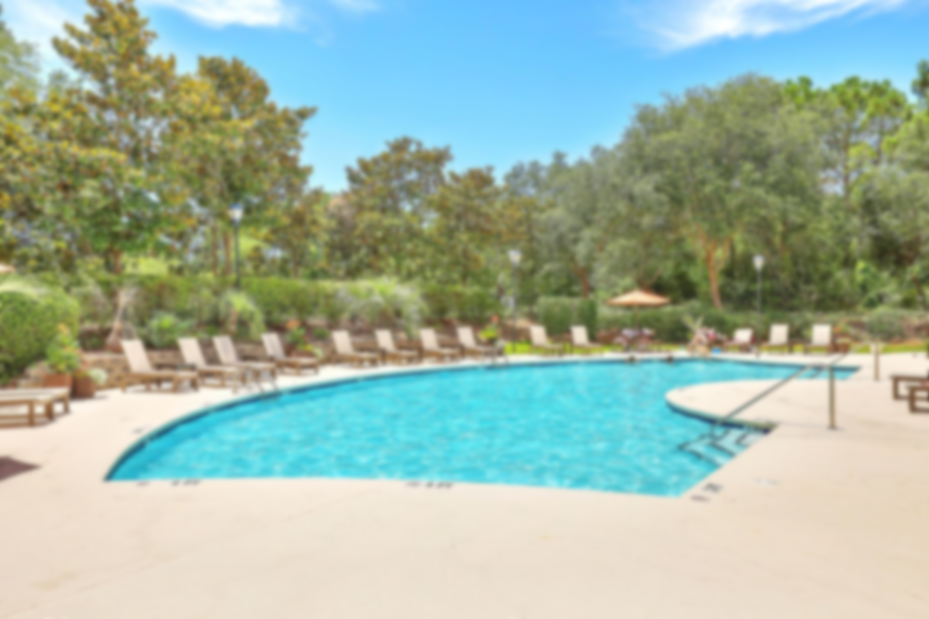
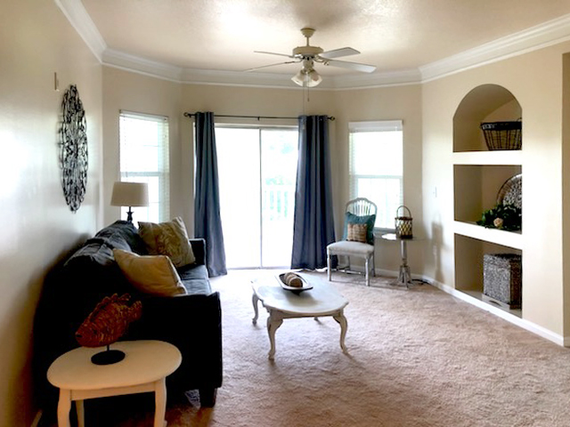
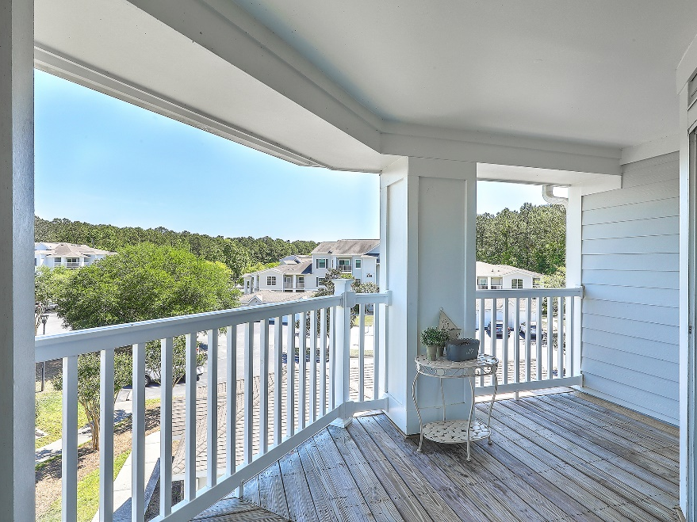
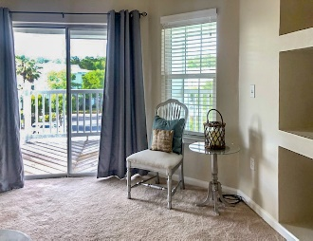
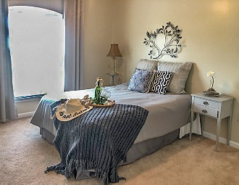
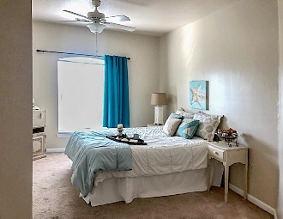
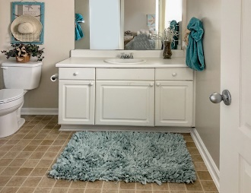
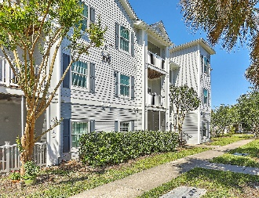
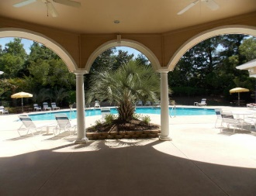
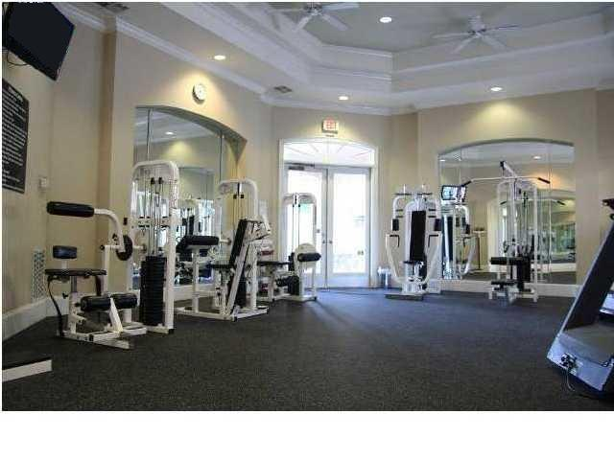
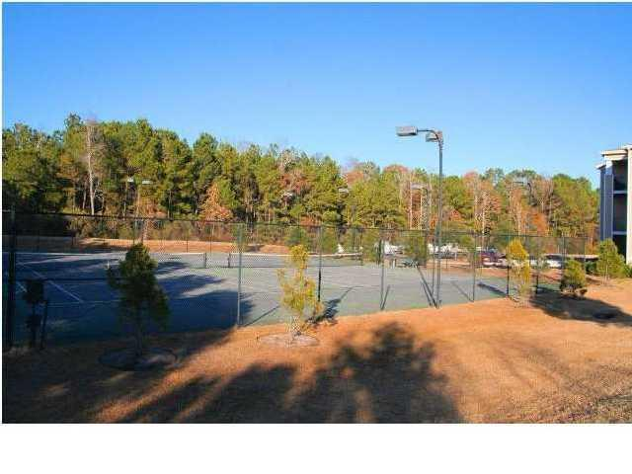
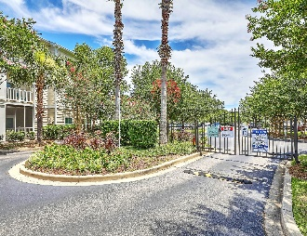


Open House Thursday 11a-2p Check Out This Beautiful New Home And Enjoy A Light Lunch
Vacant & Easy To Show
1300 Park West Boulevard 122
Park West | Mount Pleasant, SC 29466 | MLS# 20010845 | $205,000
Lovely top floor 2 bedroom, 2 bath condo with large balcony. Well maintained and ready for you to call home. Both bedrooms are on opposite sides of living area offering maximum privacy. In unit laundry includes washer and dryer. Kitchen includes refrigerator. Exterior of building has been recently painted and has new doors and windows. Balcony is extra large. Fresh interior paint & classic Crown Molding accentuates the 9 ft ceilings and creates a bright, open feel. Exterior renovations just completed. New Siding, New Windows, New Balcony Railings, New Pool Furniture, Clubhouse Renovation & New landscaping. Extra storage is in the breezeway. Madison residents enjoy Resort Style Amenities, including a state-of-the-art Fitness Center, Clubhouse area Swimming Pool, lighted Tennis Courts.
Laura McLain
(843) 509-7647
laura@lauramclainrealty.com
The Boulevard Company, LLC
806 Johnnie Dodds Blvd Ste 100
Mt Pleasant, SC 29464

