Slide 1
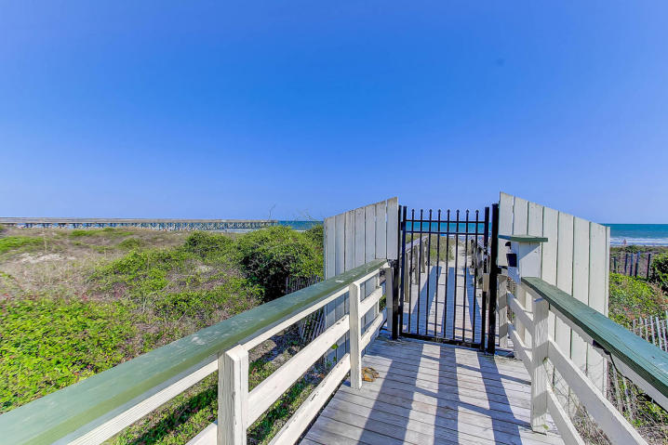
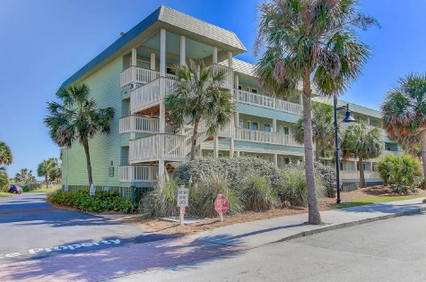
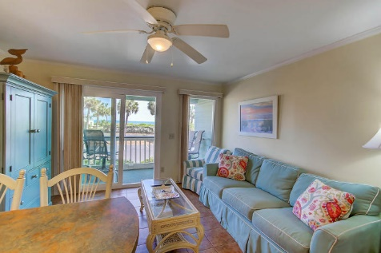
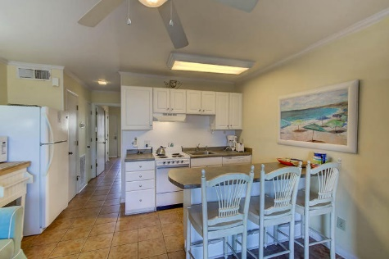
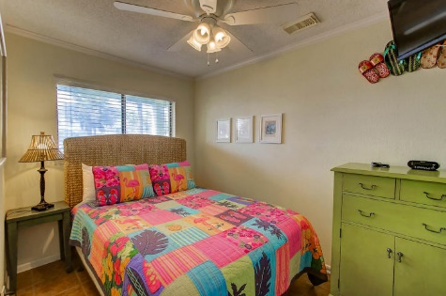
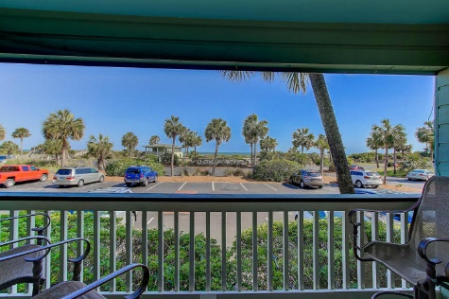
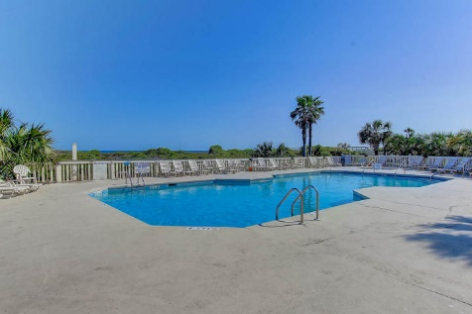


1300 Ocean Boulevard 125-B Sea Cabin On The Ocean Isle of Palms, SC 29451 MLS# 17011220 ~ $289,000
Very Well Maintained… Great Vacation Rental
New Price!
Beach front condo in the heart of the Isle of Palms. This very well maintained condo has fresh paint, tile floors throughout, smooth ceilings and great furnishings. You will enjoy the kitchen, living area and porch with great views and sounds of the ocean. Sea Cabin offers guests and owners their own private pier, gated beach access, pool and laundry. Enjoy the beach condo rental opportunity this unit offers or make this your personal retreat! Just bring your suitcase.
Darlene Smith Office - (843) 886-8110
Mobile - (843) 696-7824
darlenesmith@carolinaone.com
DarleneSmithTeam.com
Carolina One Real Estate
1503 Palm Blvd Ste
Isle of Palms, SC 29451

