Slide 1
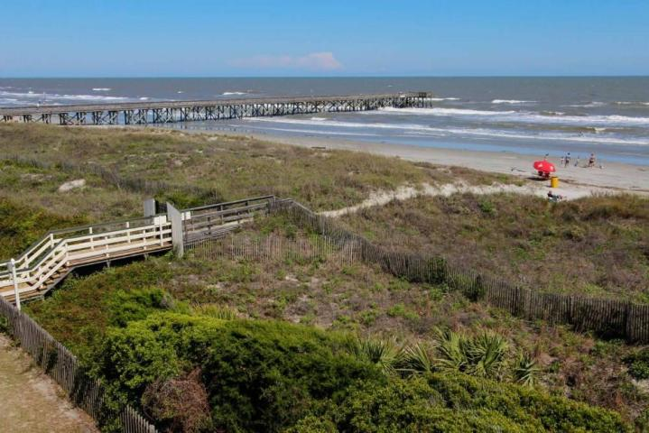
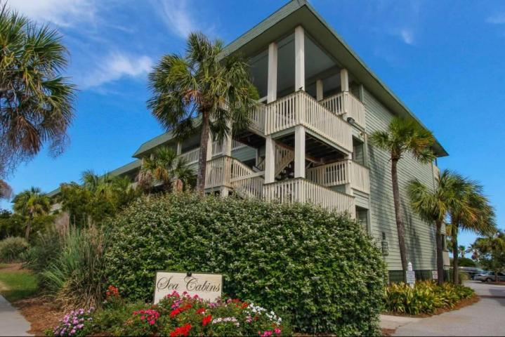
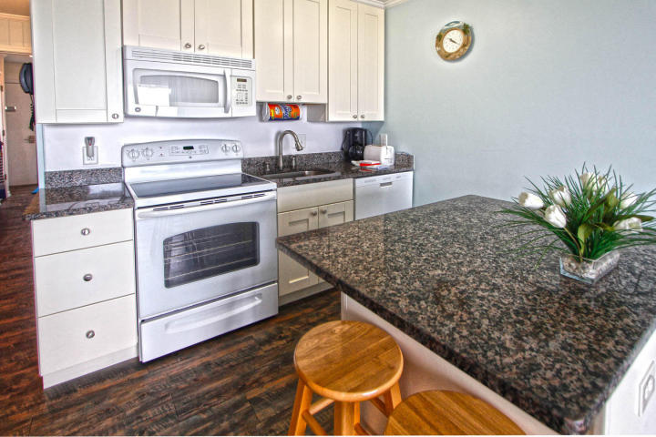
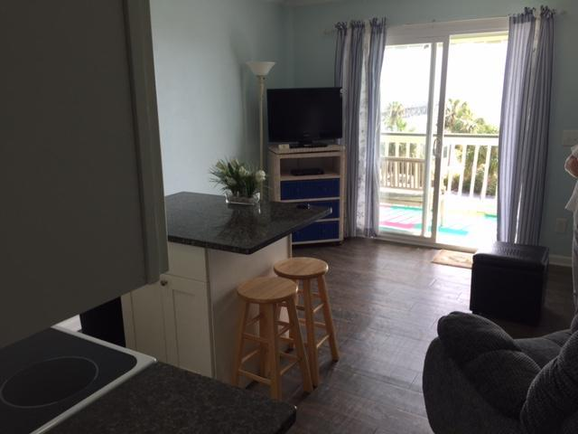
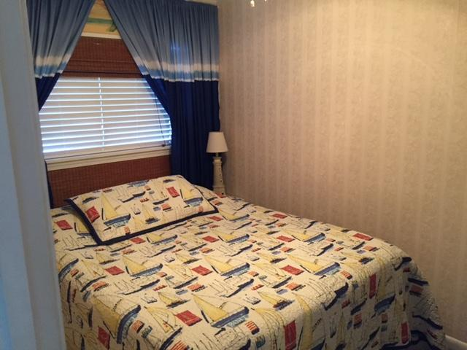
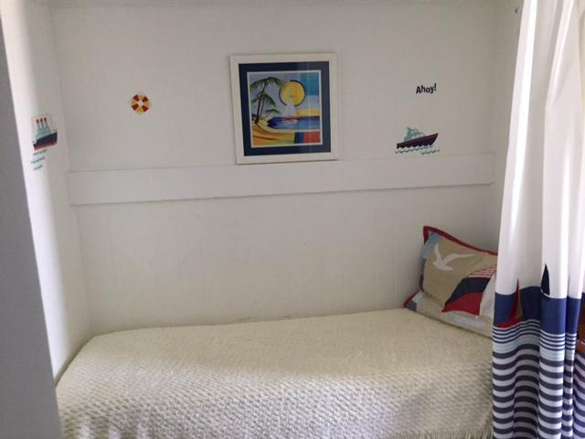
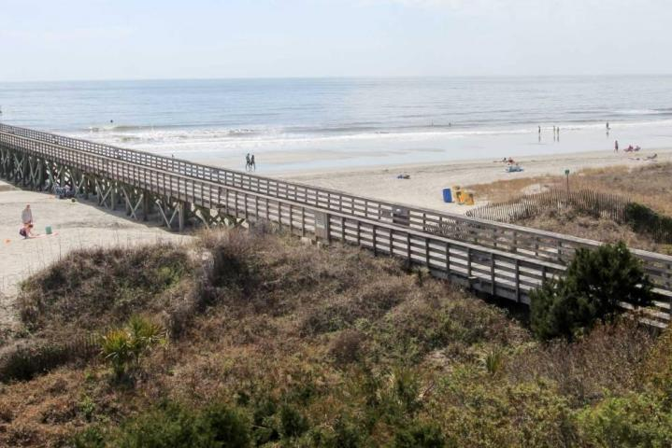


1300 Ocean Boulevard 326-B
Sea Cabin On The Ocean
Isle of Palms, SC 29451
MLS# 16028182 ~ $375,000
Easy to Show
November 12th-20th
New Price!
Welcome to the Sea Cabin's in the heart of the Isle of Palms! 326-B offers some of the best oceanfront views any time of day or night with the added bonus of your own private access to the beach, community pool and fishing pier. This property isn't all about the views but the meticulous care of the property as well and it's great rental history. You will enjoy the convenience to all major shopping and restaurants on the Isle of Palms and Mt. Pleasant.
Darlene Smith
Office - (843) 886-8110
Mobile - (843) 696-7824
darlenesmith@carolinaone.com
DarleneSmithTeam.com
Carolina One Real Estate
1503 Palm Blvd Ste
Isle of Palms, SC 29451

