Slide 1

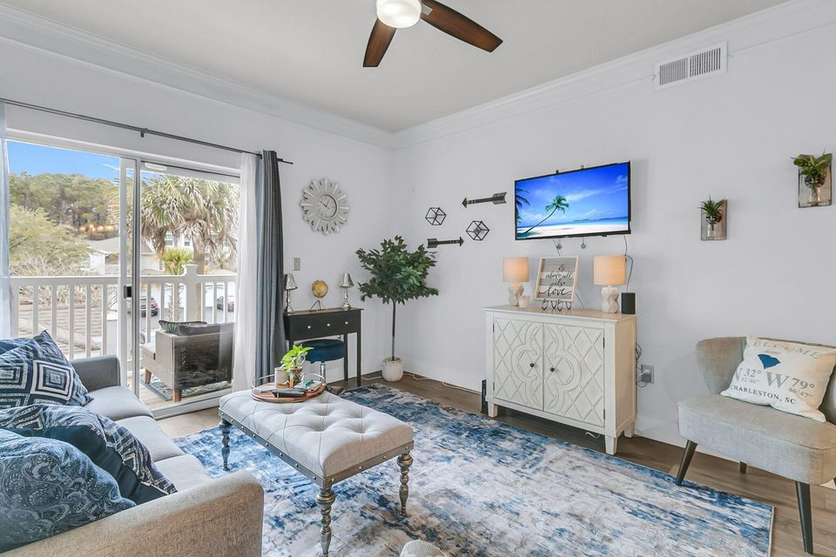
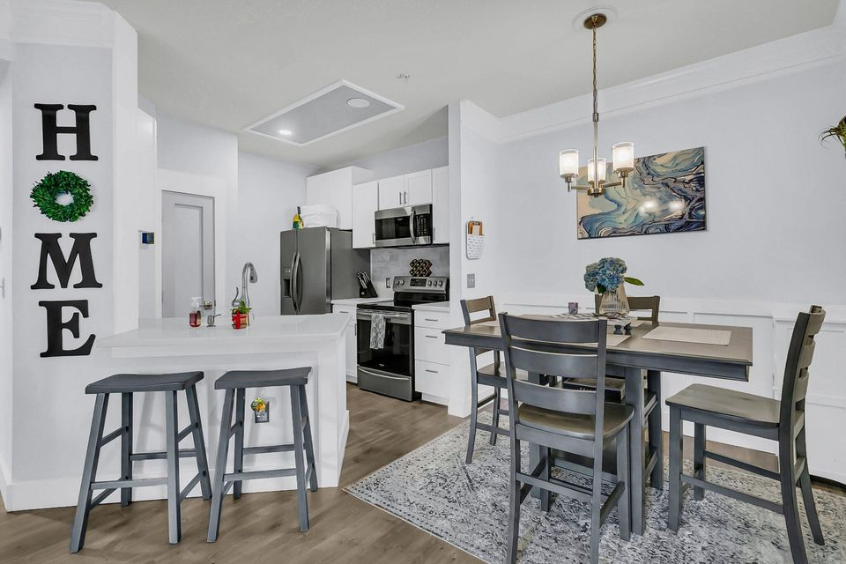
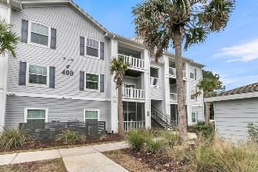
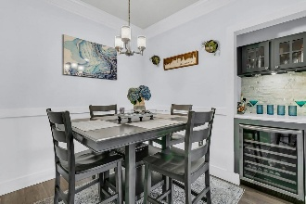
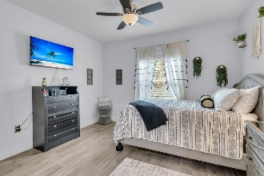
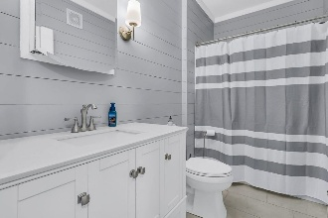
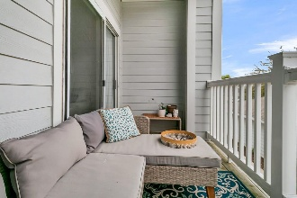

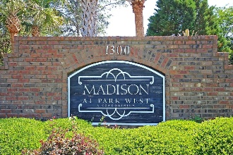
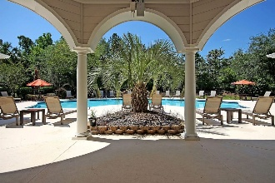
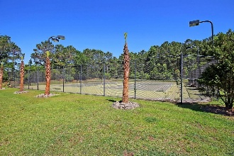
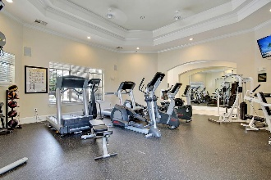
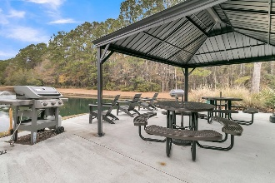
Perfect for a Vacation Retreat
Or First Home!
Debbie Cromer
ABR, RSPS, REALTOR, CRS
(843) 437-6342
debbie@debbiecromer.com
www.debbiecromer.com
1300 Park West Boulevard 417
Park West | Mount Pleasant, SC 29466 | MLS# 25001896 | $299,500
Looking for a low-maintenance second home or a charming first home in a prime location? This beautifully renovated 1-bed, 1-bath second-floor condo at The Madison at Park West offers modern upgrades, resort-style amenities, and recent community enhancements—perfect for easy living! Step inside to gorgeous wood laminate floors w/ top-tier soundproofing, ideal for a peaceful retreat. To your right, a stylish wine/mini bar features solid surface countertops, built-in cabinets w/ glass inlay doors, craftsman trim, and a stone mosaic backsplash—great for entertaining. The kitchen shines w/ smudge-proof stainless steel Frigidaire Gallery appliances, shaker-style cabinets, subway tile backsplash, solid surface countertops w/ seating, a Kohler pull-down faucet, and under-cabinet lighting.
The bedroom offers custom cabinetry in the walk-in closet, maximizing storage, while the spa-like bathroom boasts natural stone tile flooring, shiplap walls, a marble-top vanity, Kohler comfort-height toilet, rain shower head, and custom waterproof trim.
In 2022, The Madison completed extensive exterior improvements, including all-new roofs, cement plank siding, exterior painting, and an updated fitness center in the clubhouse.
Enjoy resort-style amenities, including a private pool, lighted tennis court, fitness center, clubhouse, volleyball court, grills, walking/jogging trails, picnic area, car wash station, boat storage, & trash pickup. This gated community is directly across from the Mount Pleasant Recreation Center & Dog Park, offering easy access to outdoor activities. Plus, you're just minutes from shopping, dining, & entertainment.
TAKE A VIRTUAL TOUR
Century 21 Properties Plus | 1090 Park West Blvd; Ste 103 | Mount Pleasant, SC 29466

