Slide 1
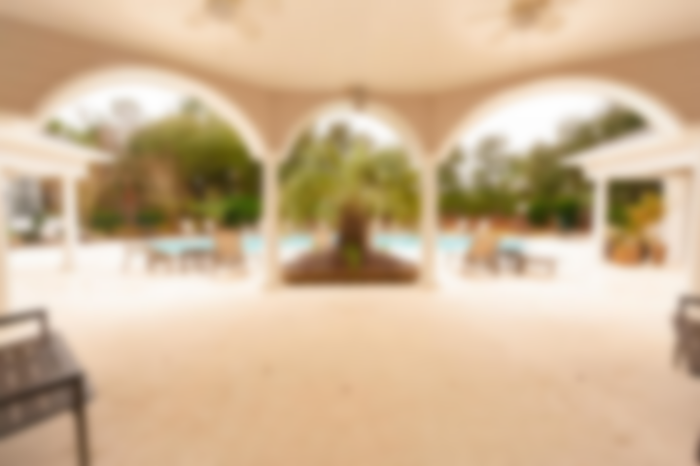
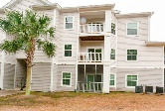
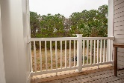

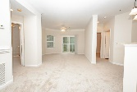
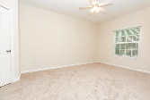
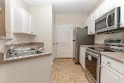
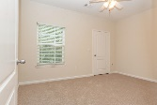
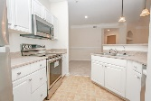
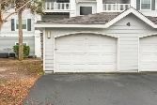
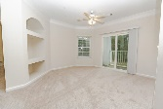
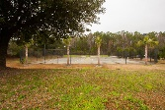
1300 Park West Boulevard #911
Park West · Mount Pleasant, SC 29466 · MLS# 19004822 · $215,000
New Low Price!!
Beautifully updated 2BR 2 bath condo located in The Madison - with GARAGE!!! This 2nd floor unit offers newly installed flooring, and new stainless steel appliances, freshly painted as well. This unit is overlooking a wooded area. The Madison's location is hard to beat, located within the expansive Park West development with walking distance to schools, parks, recreation, shopping and restaurants, as well as offering neighborhood pools and a fitness center. Come home after a long days work to quietly relaxing in a completely move-in ready condo with picturesque views of the woods and pond....The Beach, Shem Creek Downtown Charleston all a short drive away. What more could you ask for?
Neil Schneider · 843-200-8902 · neil@charleston.info

