Slide 1
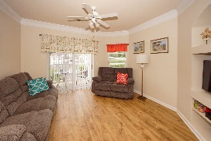
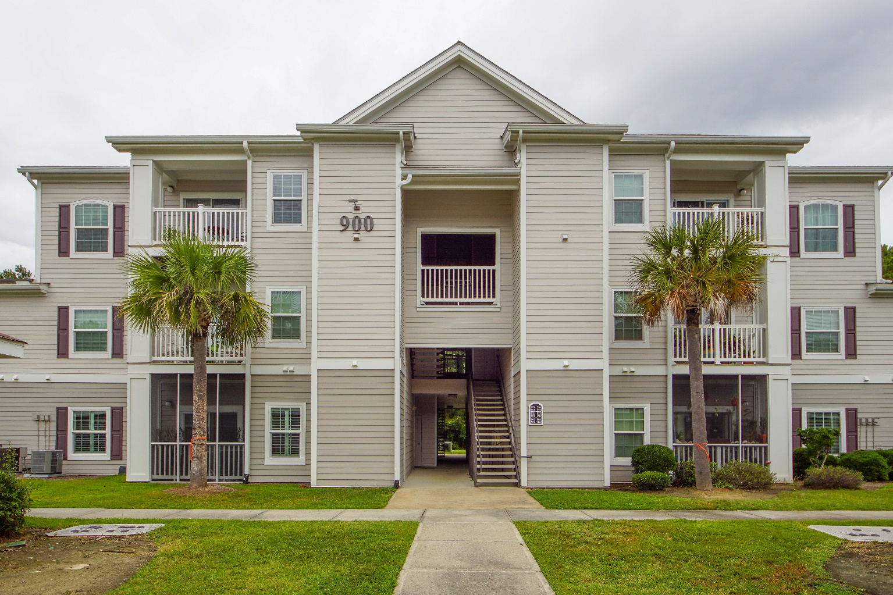
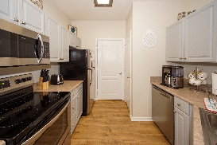
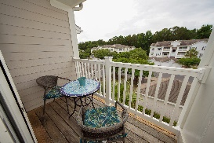
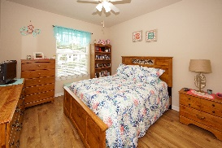
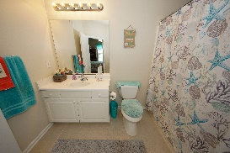
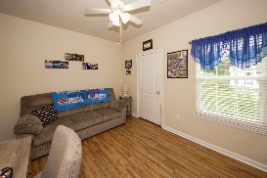
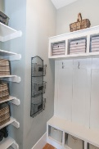
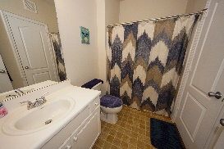
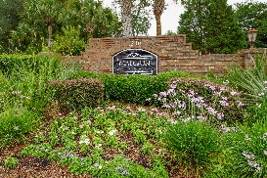
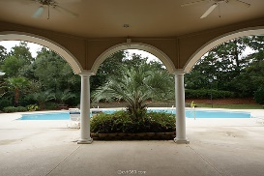
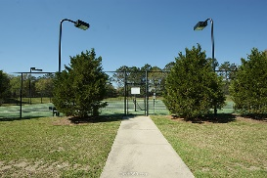


1300 Park West Boulevard 913 Park West ~ Mount Pleasant MLS# 19016722 ~ $195,000
$70,000+
Price Reduction
Immaculate Condo In Madison @ Park West
Freshly updated, immaculate and coveted third floor 2 bed/2 bath unit! No noise from above! Enjoy all new wood floors, a new hot water heater, new kitchen appliances, new lighting and more! Exterior just replaced a year ago with new hardi-board siding, new energy-efficient windows and paint. No maintenance rails also installed on your private deck. Landscaping is being replaced this month. This unit is a must see as the owner has taken care to update and refresh almost everything! The Madison has quick access to Hwy 17 North for easy commuting to work or the beaches. It is situated right at the front of Park West across from the Mt. Pleasant Recreation complex where you can enjoy the Laurel Hill County Park running/walking trails, a dog park, gymnasium, full size track, baseball, soccer, football fields and more! The shops of Park West are also only a few minutes walk where you can grab a bite eat and socialize, grab groceries, see the vet, dentist, doctor and most anything you need. The schools are also just across the street making for a quick bike ride or walk in the morning.
The Madison amenities include: Resort style pool and clubhouse, exercise facilities, lighted tennis courts, boat storage, car wash station, grilling area and a gated entrance for security.
Updates to this unit include:
New hot water heater Jan 2019
All new stainless steel kitchen appliances
New kitchen sink and faucet
New lighting in the kitchen, dining and both baths plus new cord pulls and glass shades on ceiling fans
Kitchen cabinets painted gray
Both bedrooms: carpet replaced with wood flooring
New blinds guest room
Hall Bath new faucet and refinished bathtub floor
New shower heads in both bathrooms and new curtain rods
New curtain rods throughout
New slider blinds on patio door
New closet racks added in laundry and master closet
Fresh paint on walls, most trim, and doors
All LED bulbs
Great value and still only 20-25 min to the beach or downtown Charleston where endless entertainment awaits!
Easy to show...schedule your viewing today!
Melodie Smith (843) 408-5067 M
melodie.smith@exprealty.com
www.melodiesmith.exprealty.com

