Slide 1
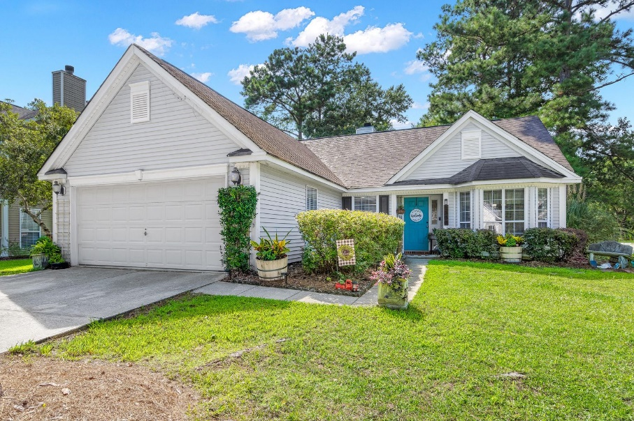
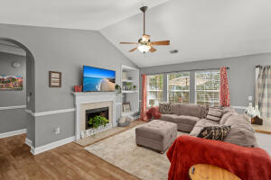
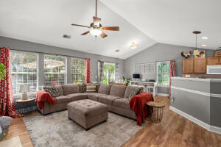
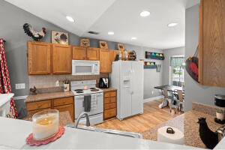
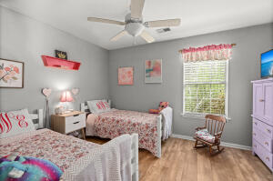
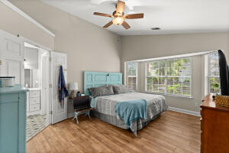
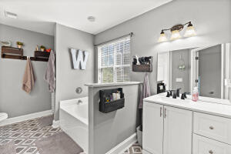
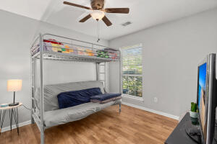
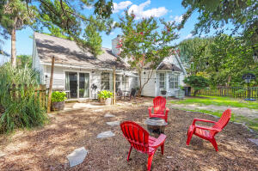
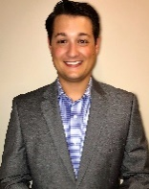


NEW LISTING! SINGLE STORY HOME IN DUNES WEST
1300 Sassafrass Circle
Dunes West
Mount Pleasant, SC 29466
MLS# 22020429
$520,000
3 Bed | 2 Bath | 1,516 sf
Welcome to Palmetto Hall in Dunes West, one of Mount Pleasant's most renowned neighborhoods. Upon entering this home, you're welcomed by the gorgeous laminate plank flooring in the foyer, which opens up into the spacious living room with high vaulted ceilings. The kitchen boasts plenty of cabinet and countertop space with ALL appliances which convey with the sale of the home. The 2 large guest bedrooms share a full bathroom. The enormous primary bedroom offers plenty of sunlight and a renovated en-suite. Upon walking into bathroom, you'll see the renovated tile, vanity and fixtures. The fenced in backyard offers plenty of space and privacy, for you to enjoy your time outdoors to yourself or private for any and all outdoor events! The sellers offering $10,000 towards a brand new roof!
Dunes West offers PLENTY of amenities from a club membership, golf club membership for the popular Dunes West Golf and River Club, pools, jogging/walking trails and so much more! This prime location offers easy access to I-526, downtown Charleston & Mount Pleasant and ALL they have to offer from restaurants, bars, shopping, grocery stores, gyms, the list goes ON! Come take a look today!
Nick Mazzilli (843) 640-5575
nick@nickmcharleston.com www.mavenrealtysc.com
Maven Realty
2180 McMillan Ave
#71672
Charleston, SC 29405

