Slide 1

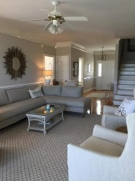
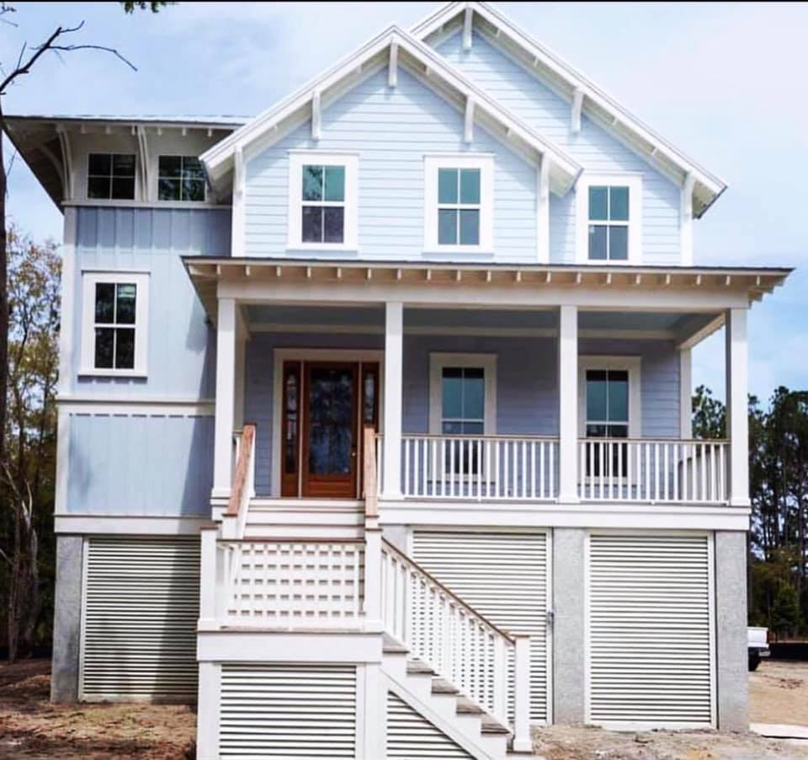
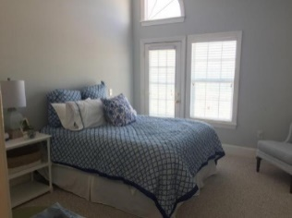
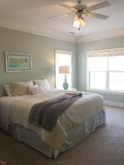
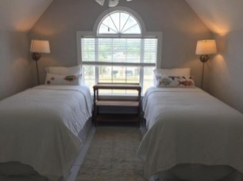
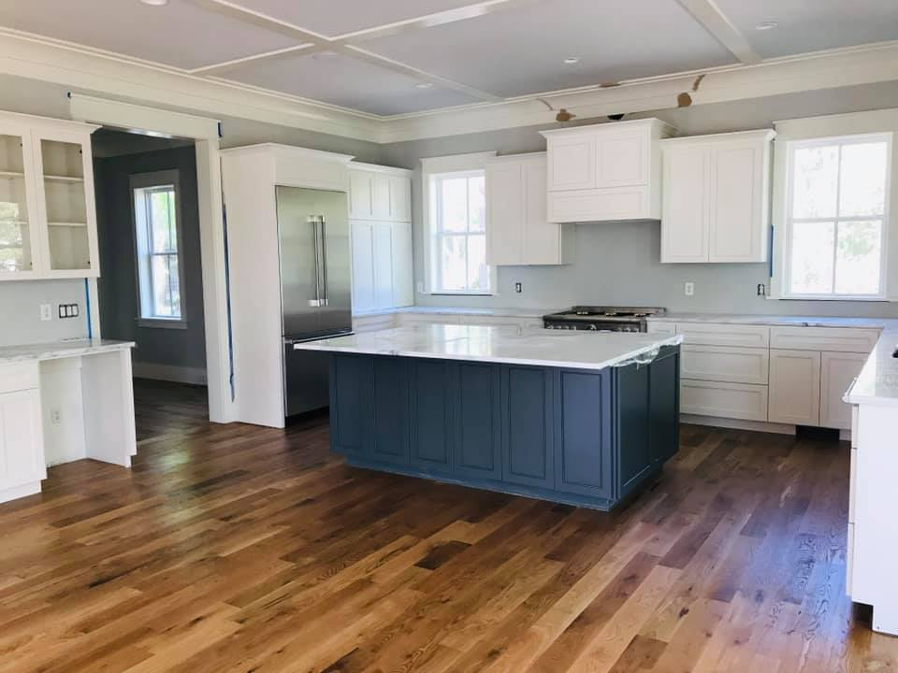
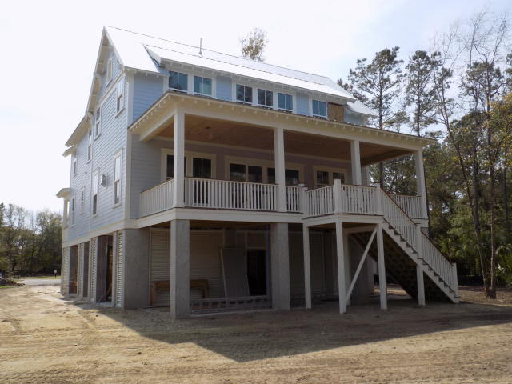
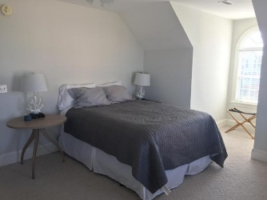
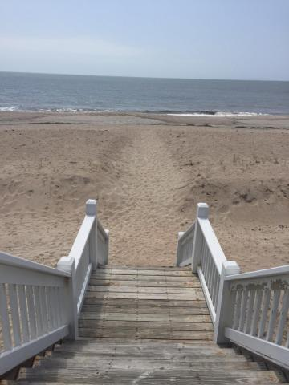

Open House Thursday 11a-2p
Check Out This Beautiful New Home
And Enjoy A Light Lunch
Quality new custom built home currently under construction by one of the areas premier custom builders. This 3400sqft home features 4 bedrooms,4.5 baths,3+ car garage, high end finishes, extensive trim, appliances, impact glass, metal roof, spray foam throughout, and hardiplank siding.
The home sits on a large lot with plenty of room for a pool on a very quiet secluded
cul-de-sac in the desirable Sound section
of Hamlin.
Please call for more information.
1301 Pleasant Walk Ct
Hamlin Plantation | Mount Pleasant, SC 29466
MLS# 18017000 | $1,195,000
Frank Thornhill
(843) 224-7997
frank@askfrankrealestate.com
The Boulevard Company, LLC
35 Broad Street
Charleston, SC 29401 www.askfrankrealestate.com

