Slide 1

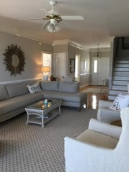
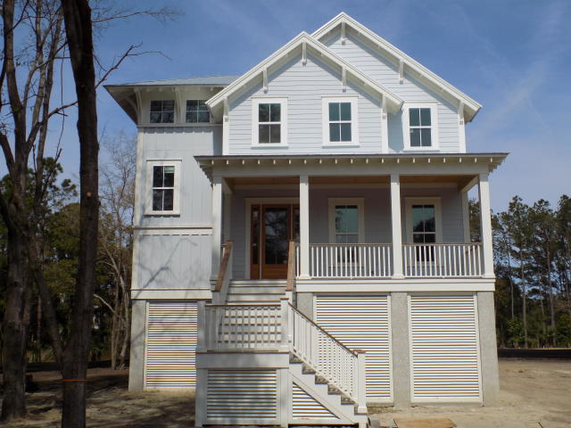
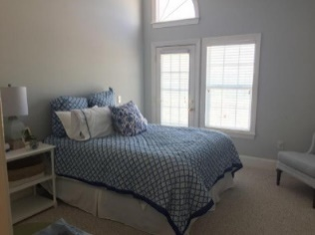
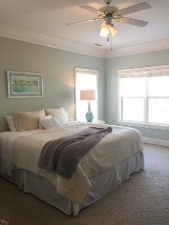
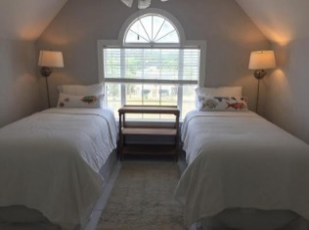
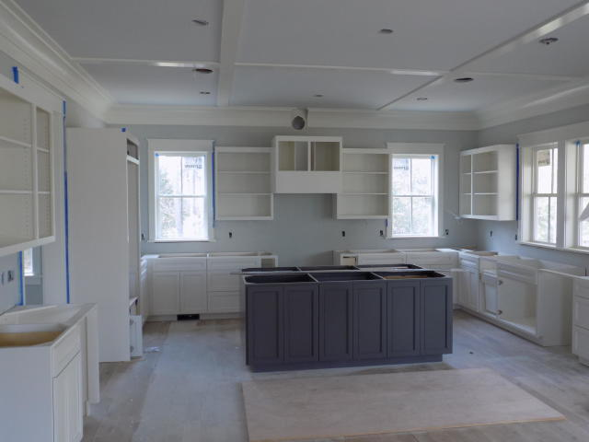
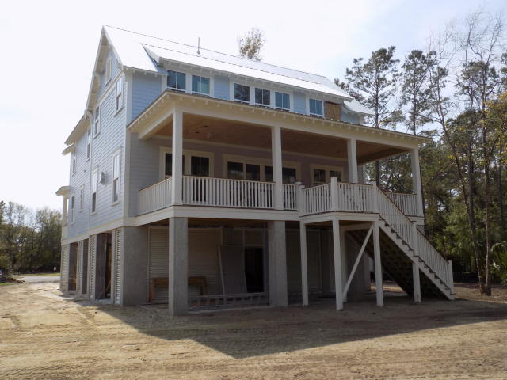
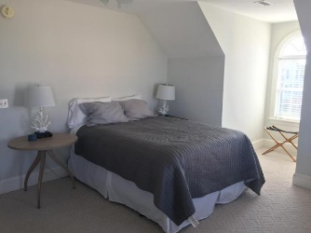
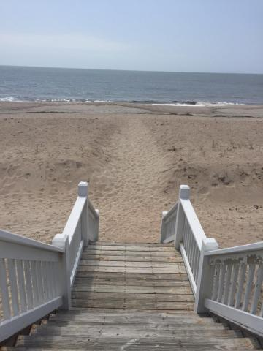

Custom Construction Ready in April
APRIL COMPLETION! Quality new custom built home currently under construction by one of the areas premier custom builders. This 3400sqft home features 4 bedrooms,4.5 baths,3+ car garage, high end finishes, extensive trim, appliances, impact glass, metal roof, spray foam throughout, and hardiplank siding. An elevator shaft is included and the elevator can be added for an additional fee or acceptable purchase price. The home sits on a large lot with plenty of room for a pool on a very quiet secluded cul-de-sac in the desirable Sound section of Hamlin. Buyer still has the opportunity to make some selections for an
April completion. Plans and specifications subject to change without notice. Please call for more information.
1301 Pleasant Walk Ct
Hamlin Plantation
Mount Pleasant, SC 29466
MLS# 18017000
$1,195,000
~
Frank Thornhill
(843) 224-7997
frank@askfrankrealestate.com
The Boulevard Company, LLC
35 Broad Street
Charleston, SC 29401 www.askfrankrealestate.com

