Slide 1
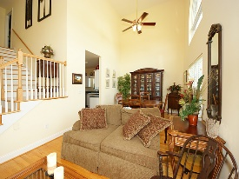
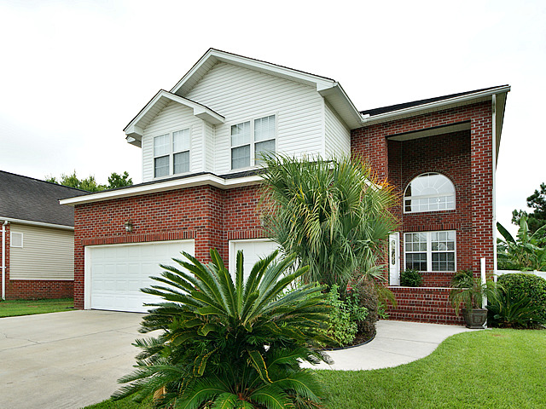
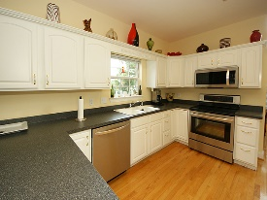
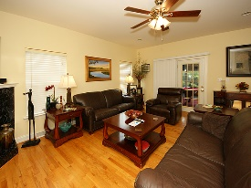
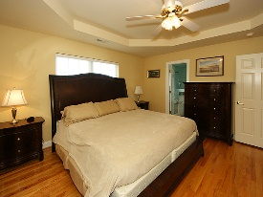
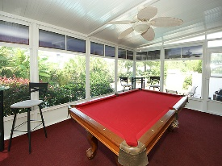
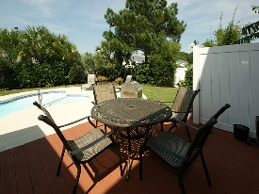
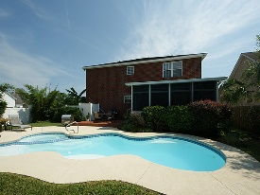


Price Reduced & Move In Ready
1301 Roma Road
Eagle Landing
Hanahan, SC 29410
Open House Canceled!
Under Contract In 3 Days!
MLS# 16023308 | $348,000
3 Bed / 2½ Bath
Spectacular brick home in desirable Hanahan! This custom built home boasts over sized windows allowing natural sun light from every angle of the house. The stair case is an amazing focal point of the house surrounded by the formal living, formal dining, spacious kitchen and a cozy family room. Screened porch leads to a fenced in back yard with an amazing in ground swimming pool. The sellers have created a paradise perfect for relaxing after work or weekends. This home is comfortable and the sellers have created an atmosphere perfect for entertaining family and friends! Providence Square does not have an HOA!
Connie White, Broker
C: 843-532-3356
conniesyouragent@gmail.com
Charleston Homes
111 Spring Hall Dr
Goose Creek, SC 29445

