Slide 1
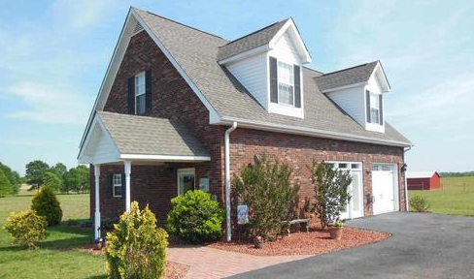
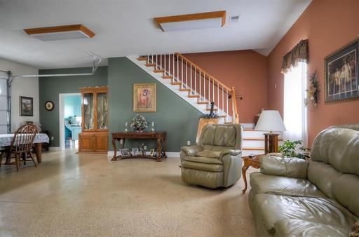
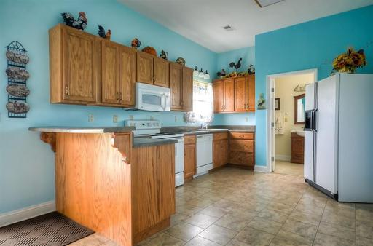
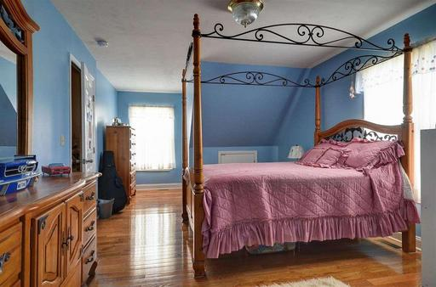
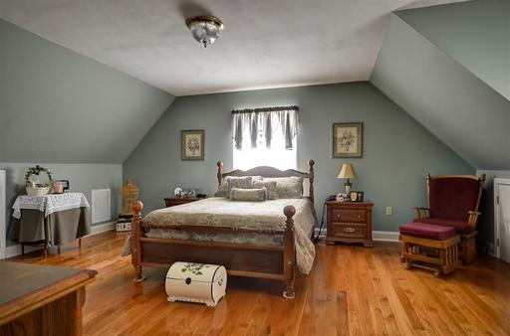
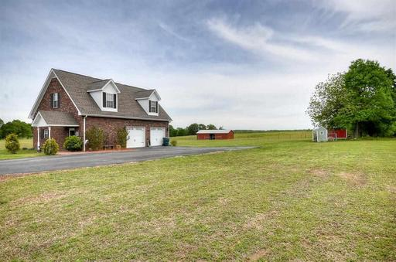


22 Acres Unrestricted and Flat
1301 State Line Road, Gaffney, SC 29341
Carriage-house home with a 2-stall barn · Tack room/utility building/workshop and a chicken coop · 2318 SF of living space features 2 spacious bedrooms and 2 full baths · Hardwoods on stairway through upstairs · Landing area between the bedrooms (approx 9 x 13) is large enough for a guest area · Large combo living and dining room area · Quality construction with thermashield insulation and solar powered attic fan · Lots of storage · This home is loaded with character. Properties like this don’t come along often · This one is a must see!!
$335,000
Peggy Wilson
Realtor, Broker, GRI, ABR
864 415-3958
peggy@realtysc.com
www.realtysc.com

