Slide 1
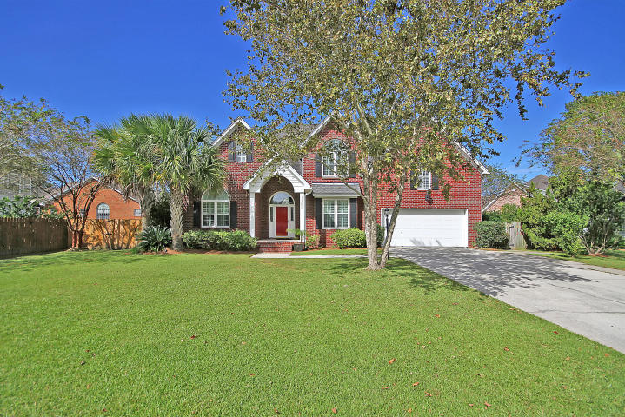
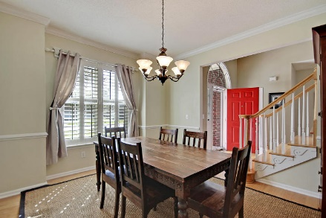
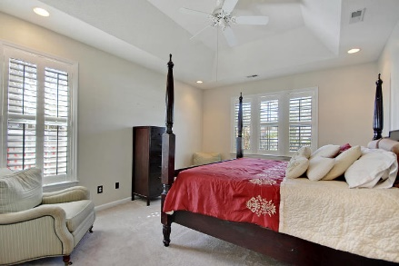
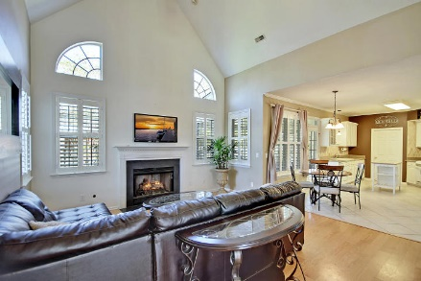
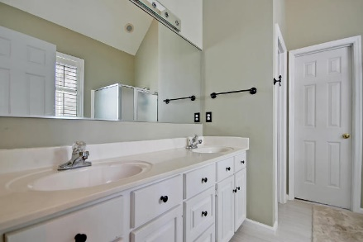
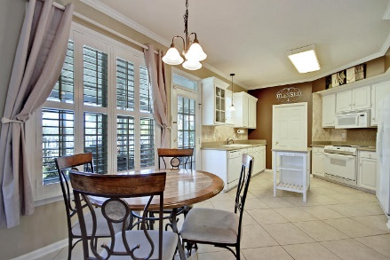
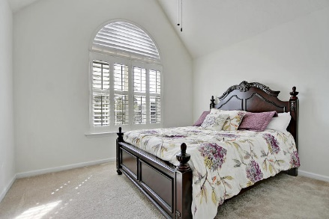
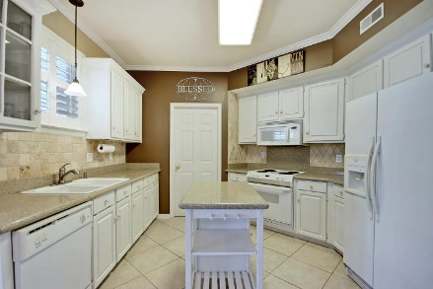
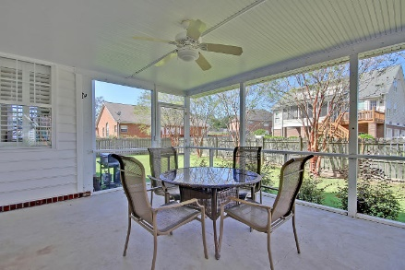
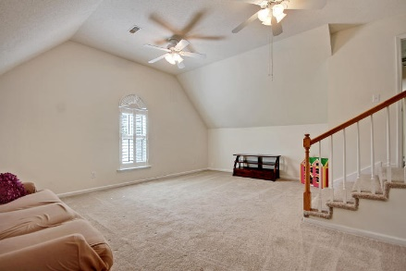
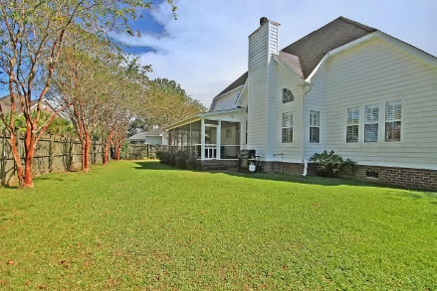

Price Reduced!
1302 Eaglet Lane
Eagle Landing ~ Hanahan, SC 29410 ~ MLS# 17028981 ~ $329,900
Situated on a cul-de sac in Eagles Landing, you can see the Goose Creek Reservoir when you are pulling up to this two story brick home with a fenced-in backyard. The two story foyer and hardwood floors greet you as you’ll gravitate towards the living room with its volume, cathedral ceiling, cozy fireplace and lots of windows to let in the natural sunlight. The eat-in kitchen boasts granite counters with a gorgeous tumbled marble backsplash and access to the spacious screened-in porch. The sun-drenched, formal dining space boasts chair rail, crown and baseboard molding. The first floor owner's retreat features a tray ceiling, an en-suite bath with dual vanity, walk-in shower, jetted tub and a walk-in shower. Eagles Landing has a pool and kayak launch in the GC Reservoir!
Additional features include:
Upstairs are remaining bedrooms, a full bath and a HUGE FROG
Plantation shutters
The fenced-in backyard is very large
Views of the lake from the front
Close to Northwoods Mall, I-26, shopping and dining
Book your showing soon!
Leslie Toller Leslie@Mattoneillteam.com 843-972-3244

