Slide 1
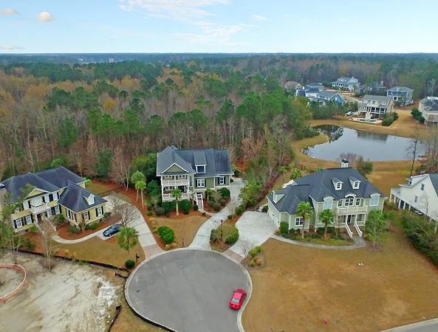
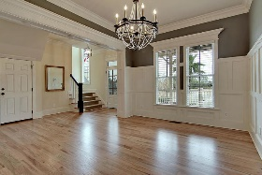
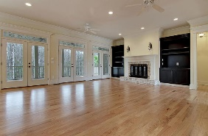
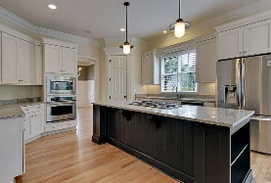
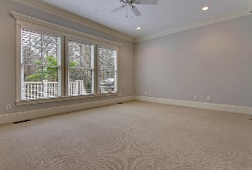
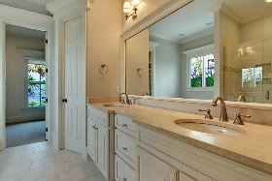
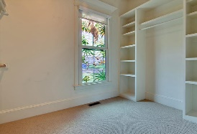
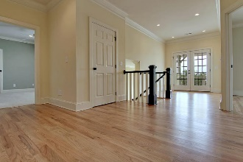
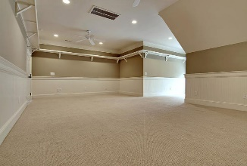
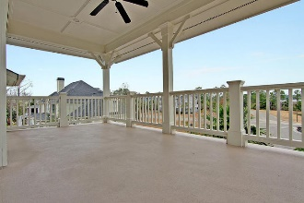
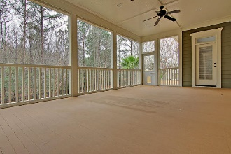
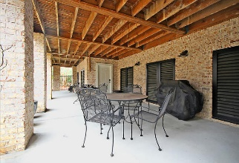
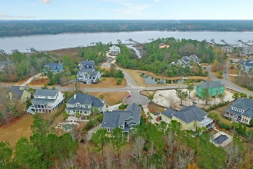


1304 King Bird Court Dunes West ~ Mt Pleasant
Impressive Lowcountry Home
Prepare to feel that "wow factor" when you drive up to this gorgeous home! This beauty is nestled into a serene Lowcountry setting at the back of a small cul-de-sac. Wetlands, marsh and a peek of the Wando River from large, covered double front porches will welcome you home each day. This home truly has it all and is located in one of Mount Pleasant's premier communities. Dunes West offers an award winning golf course and club house, pools, tennis club, boat ramp and boat storage plus plenty of walking paths. Dunes West is conveniently located close to the beaches, shopping, dining and minutes from the new Roper St. Francis hospital and a short drive to historic downtown Charleston.
Asking $880,000
MLS# 17001511
4,301 SqFt
5 Bed/3½ Baths
Don Dawson 843-514-0452 ddawson@carolinaone.com Carolina One Real Estate • 2713 Highway 17 North • Mount Pleasant, SC 29466
www.TeamDawsonSC.com

