Slide 1
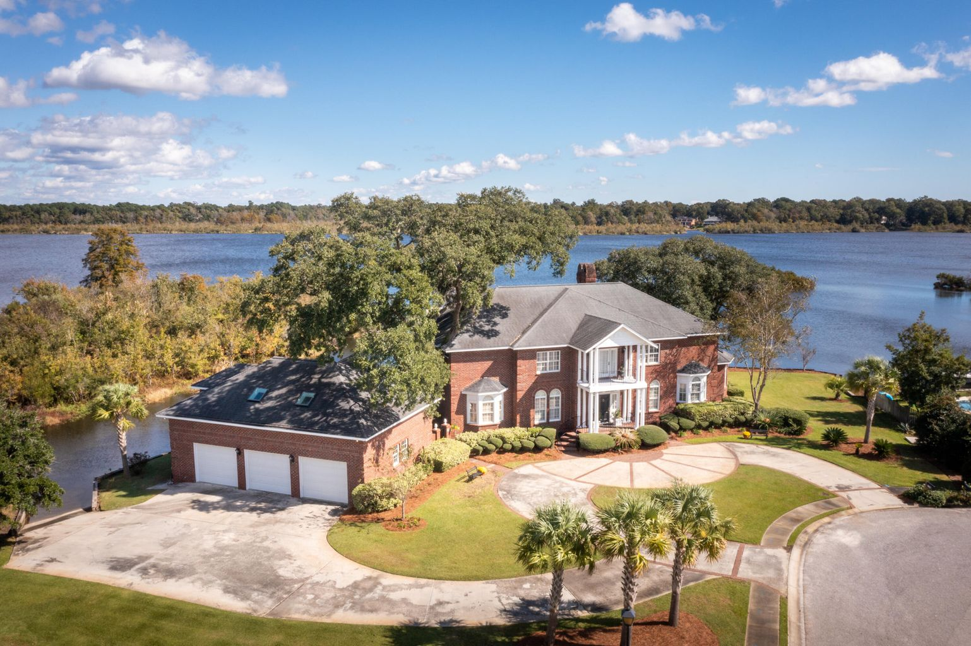
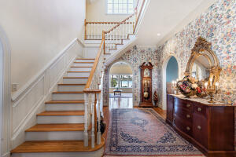
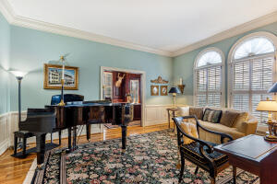
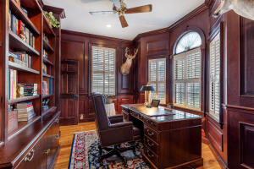
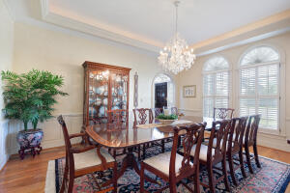
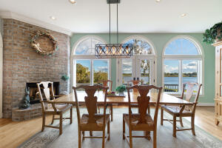


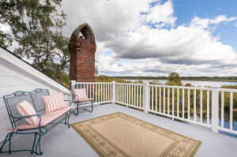


1304 Waxwing Way Eagle Landing · Hanahan, SC 29410 · MLS# 21029932 · $1,777,000
Agent Open House
Friday, November 19th from 10-12
This house is a gem! Situated on 2 1/3 lots, at the end of a quiet cul-du-sac and surrounded by water, is impressive 1304 Waxwing Way. Custom built and designed by architect Rick Osment, this 5 bedroom, 5 full bathroom home has water views of the Goose Creek reservoir from almost every room. The eat-in-kitchen area has a gas log fireplace and sweeping water views with doors that open to the large back deck. The main level master suite is a true sanctuary with gorgeous water views and gas fireplace. The ensuite master bathroom boasts dual vanities, a separate water closet, a walk-in shower, walk-in closets, and skylights bringing in natural light. The charming outdoor courtyard area is just another delightful place to relax.
Other features include: boat ramp with access to Goose Creek Reservoir, great freshwater fishing, boating and kayaking, 2 large oak trees on property, detailed special brick work on the front corners of the house, laundry chute from the 2nd floor to 1st floor, whole house central vacuum system, encapsulated crawl space, alarm system, stainless steel grill with natural gas, in ground sprinkler system supplied by a deep water well, built in ironing board, built in cabinets and separate storage room in garage, zoned for Hanahan schools, lots of shopping and restaurants nearby, and only 20 minutes from downtown Charleston. This home has been impeccably maintained.
Take a video tour: https://youtu.be/-tIsjeMFjnk
Ashley Magrath
843-452-6057
ashley.magrath@carolinaone.com
http://www.ashleymagrath.com
Carolina One Real Estate | 195 W Coleman Blvd | Mt Pleasant, SC 29464-3495

