Slide 1
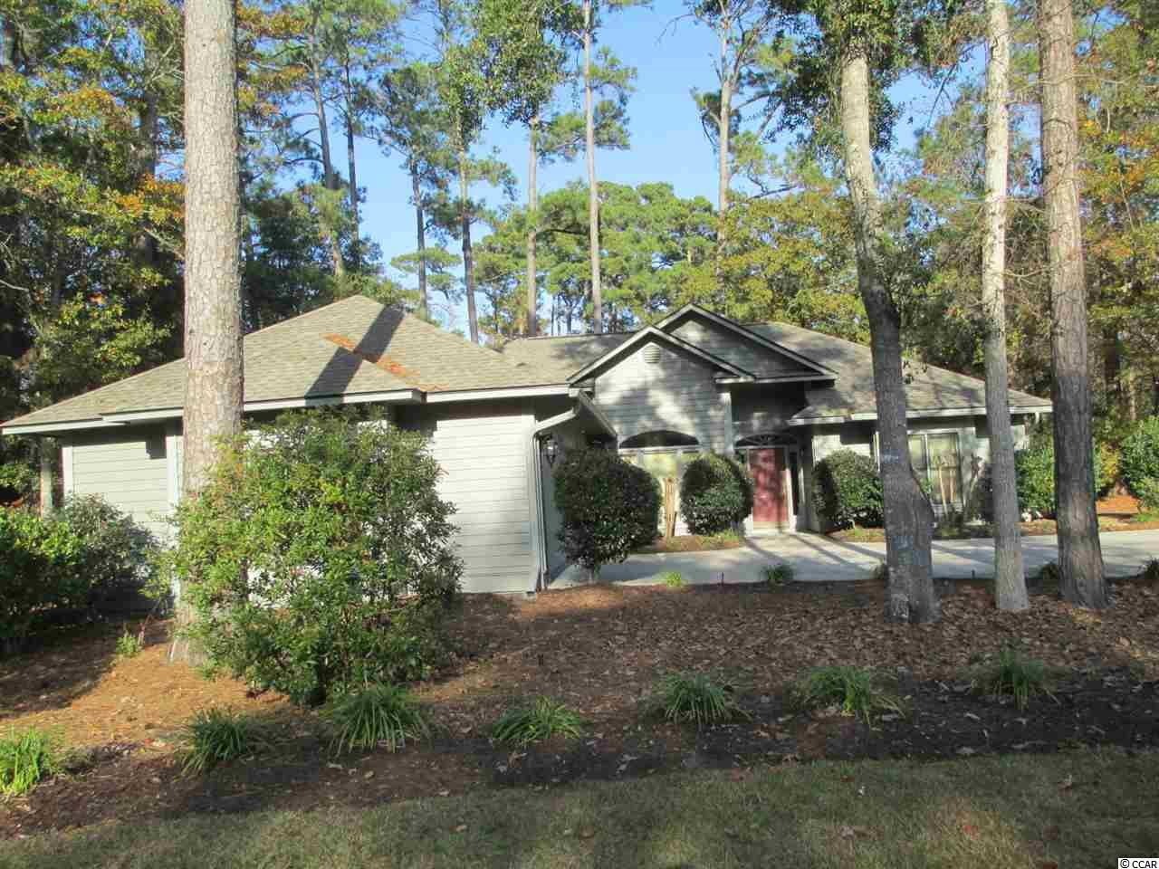
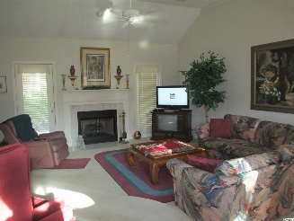
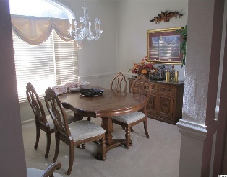
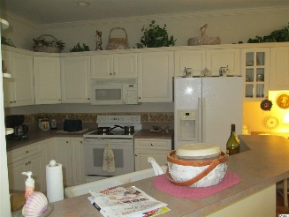
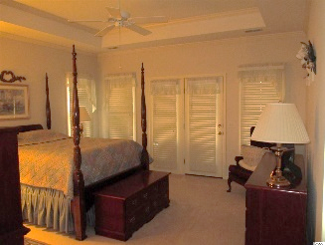
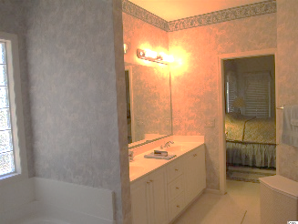
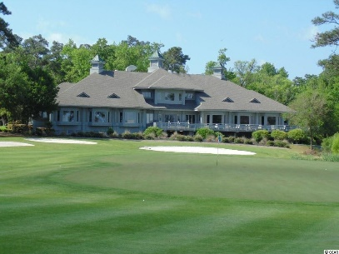
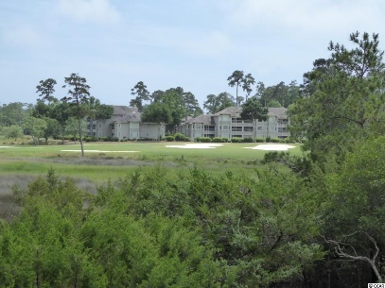
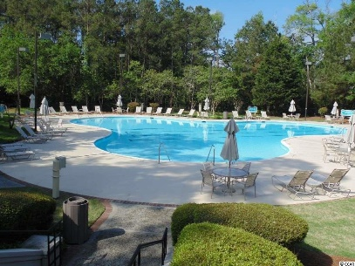
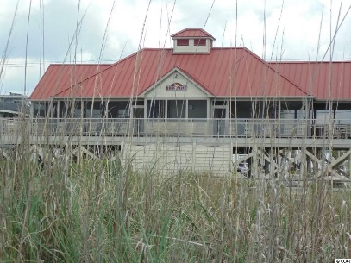

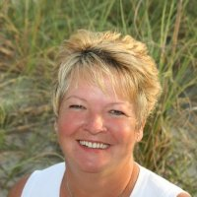
Tidewater Golf Plantation
1305 Brigantine Rd
North Myrtle Beach, SC 29582
MLS# 1902974 | $360,000
Tidewater Golf Plantation - Very nice 3 bed 2 1/2 bath split floor plan home. A must see, very well maintained. Enjoy the outdoors on open deck or screened porch. Located on tee box of #7. On a quiet wooded lot. Owners of this home enjoy all of the perks of Tidewater plantation, including, Pool, Golf, Fitness Center, restaurant, pro-shop, tennis, a summertime concert series, RV and Boat parking, and best of all- access to the Tidewater owners Oceanfront Beach Cabana located in Cherry Grove.
Donna Fortney 703-624-3517
dofortney@aol.com
Robert Jacoby 843-455-7075
NEW WAY PROPERTIES MYRTLE BEACH

