Slide 1
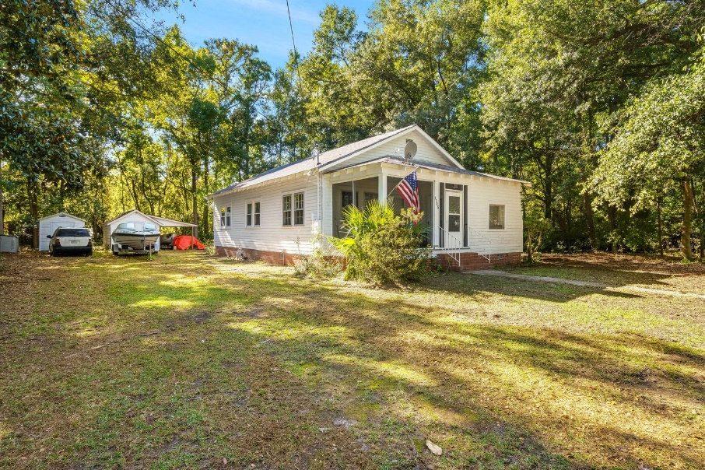
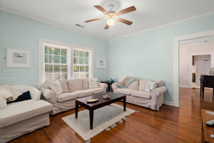
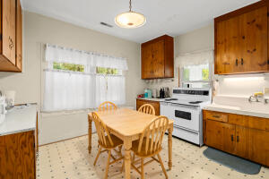
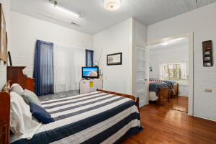
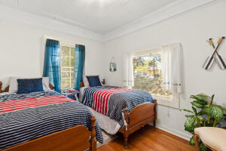
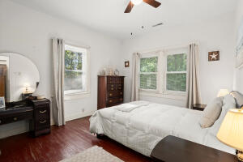
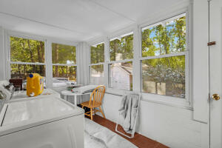
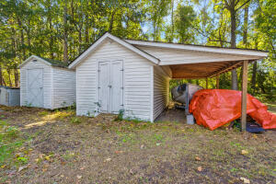
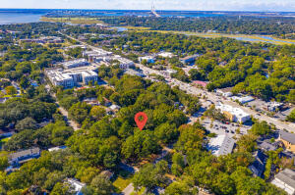



Home on One Acre Lot in Old Village Mt Pleasant!
1305 Erckmann Drive
Old Mt Pleasant
Mount Pleasant, SC 29464
MLS# 21029425
$3,300,000
3 Bed | 1½ Bath | 1,335 sf | 1.06 ac
One-of-a-kind opportunity! Adorable cottage sitting on over an ACRE of land in the renowned and HIGHLY desirable Old Mount Pleasant neighborhood. This property sits within the Coleman Boulevard Overlay District, making it one of the only mixed use zoned properties with a residence and not located on a busy road. This zoning allows for single family homes, townhomes, duplexes, multifamily, etc this list goes on! The overlay district encourages subdivision of the lot into smaller parcels. There's no minimum lot size, but the maximum residential density is 12 units per acre! This gorgeous property contains magnolias, oaks, pine trees and has tons of privacy. The cottage has 3 bedrooms and 1.5 bathrooms, boasts original hardwood flooring and has been meticulously maintained. The lot would be ideal to subdivide to create separate parcels and build additional residences or keep it all and have one of the biggest lots in all of Old Mount Pleasant! Walking distance to the farmer's market, grocery stores, coffee shops, restaurants, bars, gyms, Shem Creek and located only MINUTES to downtown Charleston; you truly have to see this property to appreciate it. Come take a look!
Take a Video Tour: https://vimeo.com/641045278
Nick Mazzilli
(843) 640-5575
nick@nickmcharleston.com
www.mavenrealtysc.com
Maven Realty
2180 McMillan Ave
#71672
Charleston, SC 29405

