Slide 1
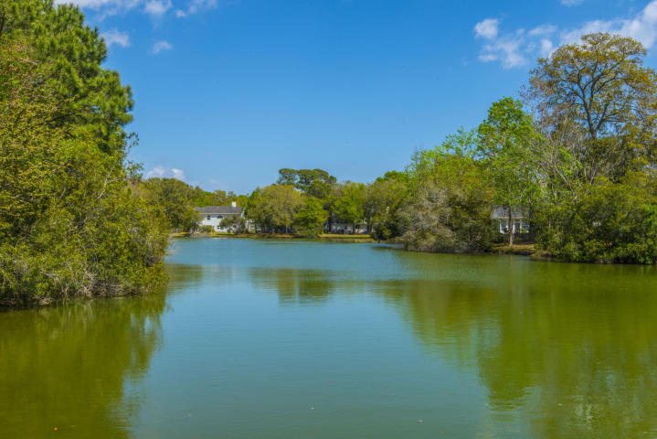
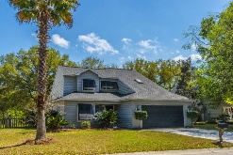
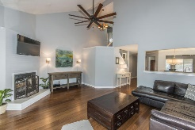
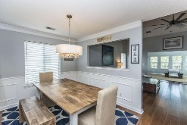
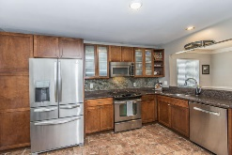
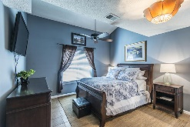
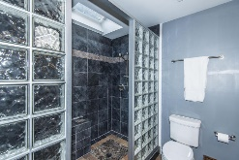
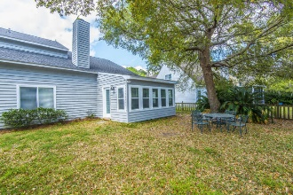
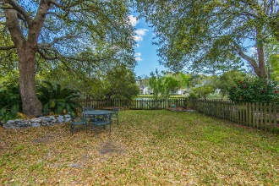
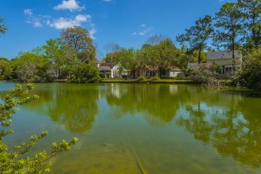
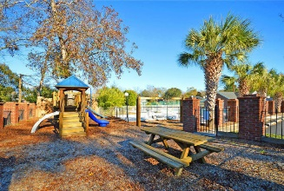
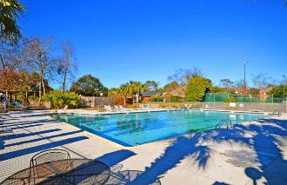
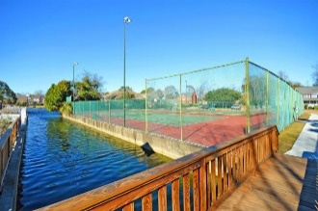


1306 Center Lake Drive
Center Lake ~ Mt Pleasant
LOCATION!! Updated in the Heart of Mt Pleasant!
Location!! Move in ready!! Shows like a model home!! Totally updated Lakefront home in the highly desirable Center Lake. Upon entering prepare to be impressed with beautiful bamboo flooring and an open floor plan. The gourmet kitchen features granite counter top, tile back splash, stainless appliances. The kitchen opens to a warm and inviting family room with fireplace with a sunroom overlooking a large private lake front yard. The wonderful master suite and bath features granite counter tops, tile shower, and walk in closet. Upstairs are two additional bedrooms and an office/study that could serve as a fourth bedroom. The home features a gas lantern and updated designer lighting and too many upgrades to believe. Amenities include pool, playground. tennis, boat/RV storage and access to the canals. Conveniently located to beaches, shopping, hospital, schools and downtown Charleston. This is a must see and won't last long.
Asking $464,000
MLS# 17009143
2,000 SqFt
3 Bed/2½ Baths
Move-in Ready!
Don Dawson
843-514-0452
ddawson@carolinaone.com
Carolina One Real Estate • 2713 Highway 17 North • Mount Pleasant, SC 29466
www.TeamDawsonSC.com

